Slide 1

Symptoms and Impact of Trauma
Sue Profilet, PhD
October 8, 2021
Child Development Specialist
Fort Bend County Behavioral Health Services
www.fortbendcountytx.gov/bh

Slide 2
Overview
Trauma-Informed Care: What is wrong with you vs. what happened to you?
What is a traumatic event? Complex trauma?
Symptoms of trauma
Impact of trauma
  Developmental
  Emotional
  Memories
  Behavioral
  Decision making

Slide 3
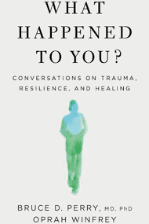
What Happened to You?
  Prenatal and childhood trauma can have a lifelong effect
  Trauma affects how a child’s brain develops
  Children are likely to display emotional and behavioral issues following traumatic experiences
  Dr. Bruce Perry and Oprah Winfrey new book - what happens to us in early childhood – both good and bad – influences the people we will become
Notes:
Childhood trauma/adversity is a major factor in physical and mental health
Your personal history – the people and places in your life – affect your brain dev.
So, each one of our brains is unique based on our life experiences.
Starting before birth, the developing brain begins to store our experiences.
Fetal brain dev. Is influenced by mother’s stress, drugs, alcohol and nicotine intake, diet, and patterns of activity.
The experiences of the first year of life are the most powerful in shaping how your brain organizes.
Young children absorb more than we realize.
People think that they can be violent in front of young children because they won’t remember it.
But children develop emotional memories that impact how trauma is stored in the brain.
This will affect their behavior for years.

Slide 4
Dr. Bruce Perry
  Senior Fellow of The Child Trauma Academy, in Houston, and Professor in the Departments of Psychiatry and Behavioral Sciences at Northwestern University
  Author of The Boy Who Was Raised as a Dog, based on his work with maltreated children
  https://www.youtube.com/watch?v=Q_3HjXNjgbQ&t=171s

Slide 5
What is a Traumatic Event?
National Child Traumatic Stress Network (nctsn.org):
A frightening, dangerous, or violent event that poses a threat to a child’s life or bodily integrity
Witnessing a traumatic event that threatens life or physical security of a loved one
Notes:
Important for young children because their sense of safety depends on the perceived safety of their attachment figures

Slide 6
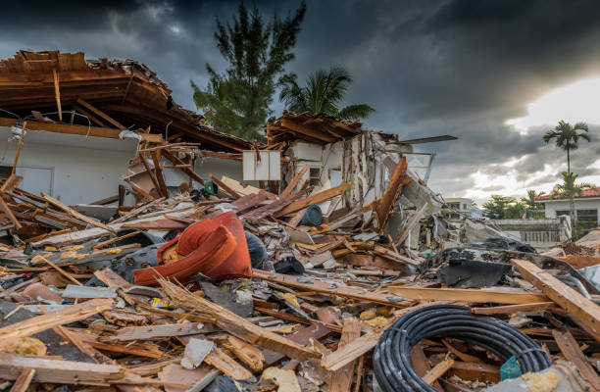
What are Some Traumatic Experiences?
Physical, sexual, or psychological abuse and neglect
Natural disasters or terrorism
Family or community violence
Sudden or violent loss of a loved one
Refugee and war experiences
Serious accidents or life-threatening illness
Military family-related stressors (deployment, parental loss or injury)
Notes:
Natural disasters – hurricanes, earthquakes, tornadoes, wildfires, tsunamis, floods, landslide
Extreme weather events – blizzards, droughts, extreme heat, and windstorms
Can cause displacement, loss of home and property, changes in schools, economic hardship, loss of community and social supports, and even injury or death of loved ones
Public health emergencies – COVID-19 – physical and emotional effects, sickness or loss of loved ones

Slide 7
What is Complex Trauma?
Both children’s exposure to multiple traumatic events—often of an invasive, interpersonal nature—and the wide-ranging, long-term effects of this exposure
Events that are severe and pervasive, such as abuse or neglect
Occur early in life and can disrupt many aspects of the child’s development and formation of a sense of self
Notes:
Sample content slide

Slide 8

Complex Childhood Trauma Affects the Brain
It changes the neural system to appear like one that is always anticipating or responding to trauma
Hyperarousal – when one’s body kicks into high alert as a result of thinking about their trauma
Notes:
Symptoms of hyperarousal:
Sleeping problems/nightmares
Difficulty concentrating
Irritability
Angry outbursts
Panic
Constant anxiety
Easily scared or startled
Self-destructive behavior such as driving too fast or drinking too much
Heavy sense of guilt or shame
Child may appear highly reactive and respond to threat even if it is not present

Slide 9
Symptoms of Childhood Trauma
Increase in health-risk behaviors
Likely to have long-term health problems or die at an earlier age
Increased use of health/mental health services and increased involvement with child welfare and juvenile justice systems
Adult survivors may have difficulty in establishing relationships and maintaining employment
Notes:
Health-risk behaviors (e.g., smoking, eating disorders, substance use, and high-risk activities)
long-term health problems (e.g., diabetes and heart disease)

Slide 10
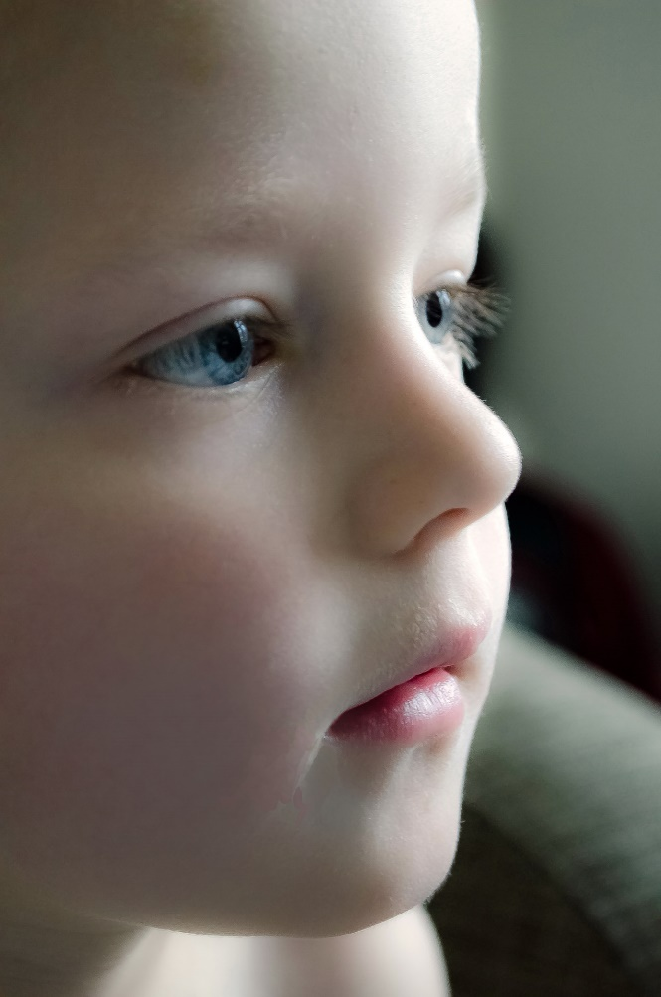
Impact of Trauma on Child
Development
Emotions
Memories
Behavior
Decision Making
Notes:
Sample content slide

Slide 11
Child Development
Age, maturity, and experience influence how we react to stress after traumatic experience
Children under age 5 are NOT too young to know what happened during traumatic event and the impression that was left is not forgotten
Traumatic experiences affect brains and behavior of even very young children, with similar reactions to those seen in older children and adults
Notes:
School-age children and adolescents can experience the full range of posttraumatic stress reactions that are seen in adults

Slide 12
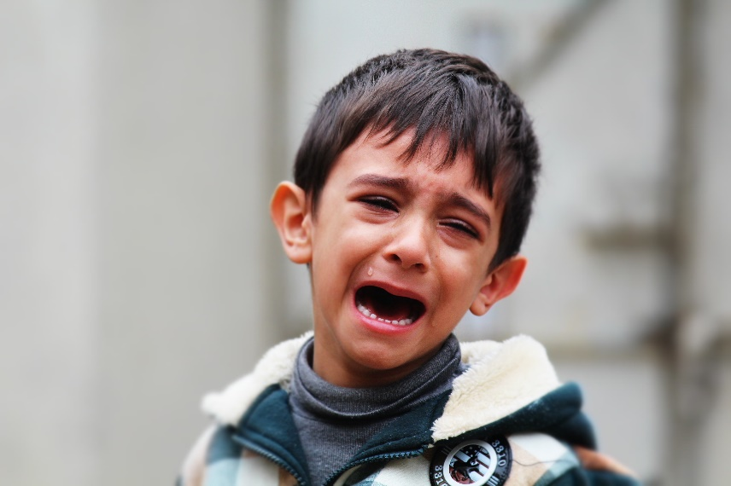
Emotions
Difficulty with self-regulation: expressing and managing emotions
Emotional regulation: control over –
  How and when – how often
  Intensity – react powerfully
  Positive/negative
  May be difficult to calm down
Notes:
Self-regulation: control of one’s emotions, cognitions, and behaviors.
May react often, react powerfully, and have difficulty calming down when upset

Slide 13
Emotion Continued
Child may react to a reminder of traumatic event/threat with:
  trembling, anger, sadness, or avoidance
  Being vigilant and guarded in their interactions with others
  Tuning out (emotional numbing)
  Being overwhelmed, fearful, or depressed
Notes:
Examples -
When a child who has been neglected needs help, he or she may become sad or avoid asking for help. They may become overwhelmed.
When a child who has been neglected has to deal with conflict, he or she may not know how.
To deal with a conflictual situation in a direct and capable way, one must have skills.
First, you must be comfortable being with someone who is angry or hurt.
Second, you must be comfortable with feeling angry or hurt yourself.
Being able to feel what you feel and stay in the situation to put your feelings into words is not something that everyone can do.
When you grew up with neglect you have no opportunity to learn these skills.
Then, when you are hurt by someone, suddenly you realize you have no toolkit to rely on to manage the situation.

Slide 14
Memories –
Early childhood trauma - associated with reduced size of the brain cortex
This area is responsible for many complex functions including memory, attention, perceptual awareness, thinking, language, and consciousness
These changes may affect ability to regulate emotions
Notes:
Sample content slide

Slide 15
Memories – School Age and Adolescents
Have wide range of intrusive images and thoughts
Think about frightening moments that happened during their traumatic experiences
Go over what could have stopped the trauma from happening and what could have made it turn out differently
Respond to reminders about the trauma
Notes:
Examples: Someone with the same hairstyle as an abuser
The monkey bars on a playground where a child got shot

Slide 16

Behavior
Child may:
be easily triggered or “set off”
react very intensely
react defensively and aggressively in response to perceived blame or attack
behave in ways that appear unpredictable, oppositional, and extreme
lack impulse control or the ability to think through consequences before acting
Notes:
Sample content slide

Slide 17

Behavior Continued -
Child may:
be overcontrolled, rigid, and unusually compliant
seem “spacey”, detached, distant, or out of touch with reality
engage in high-risk behavior
engage in illegal activities
Notes:
High-risk behaviors: self-harm, unsafe sexual practices, and excessive risk-taking such as operating a vehicle at high speeds
illegal activities: alcohol and substance use, assaulting others, stealing, running away, and/or prostitution

Slide 18
Decision Making
Something about stress of early childhood is changing the brain systems that allows one to attend to information that might signal potential risk or loss
Those who experienced childhood trauma tend to:
1. have lower brain activity during decision making and higher activity afterward - often making the choice that they were warned against
Notes:
These children are more surprised and upset after they lose a game, because they did not pay attention to cues during a game

Slide 19
Decision Making Continued -
2. become young adults unable to correctly consider risk and make healthy life decisions
This can lead to substance abuse, addictions, and other self-defeating coping mechanisms, common to untreated trauma

