Slide 1
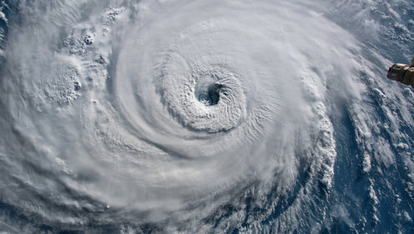

2026 Hurricane season
fort bend county
homeland security & emergency management

Slide 2





Fort Bend County: At a glance
875 square miles (562,560 acres)
17 incorporated cities and towns
County Seat: Richmond
8th Most Populous County in Texas
1st Most Diverse County in Texas
7
School Districts
5
Hospitals
281,259
Households
17,654
Total Businesses

Slide 3





Fort Bend County: Population & demographics
958,434
Total Population Estimate
~132%
Population Growth Since 2000
37.1 years
Median Age
30.0%
Foreign Born
42.8%
Speak a language other than English at home

Slide 4
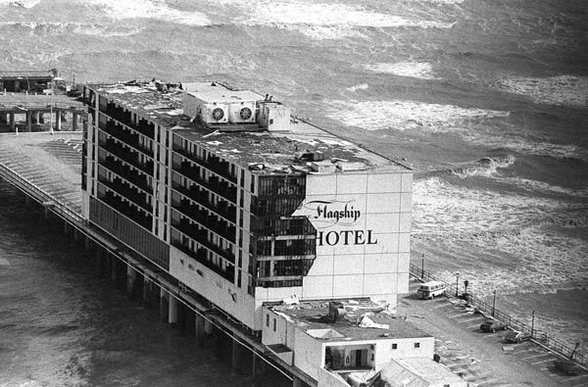
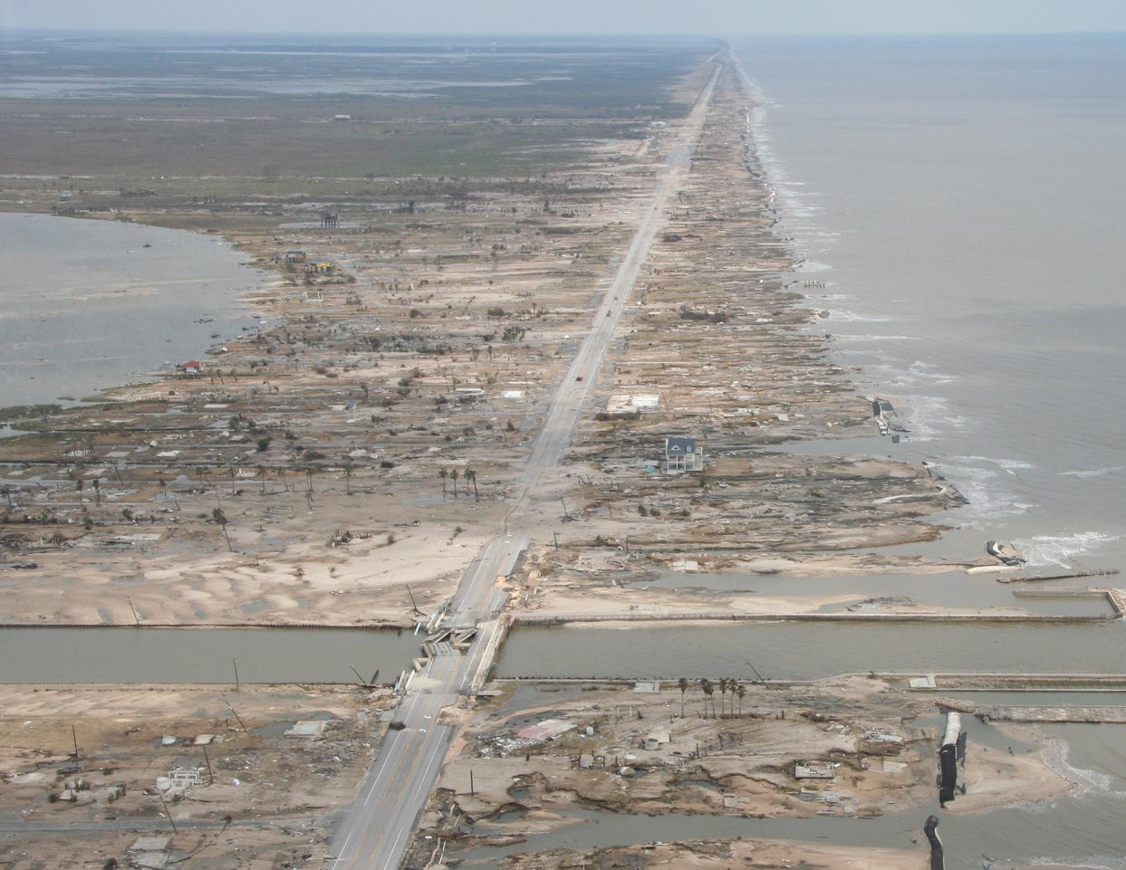
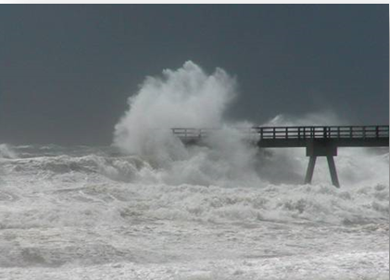
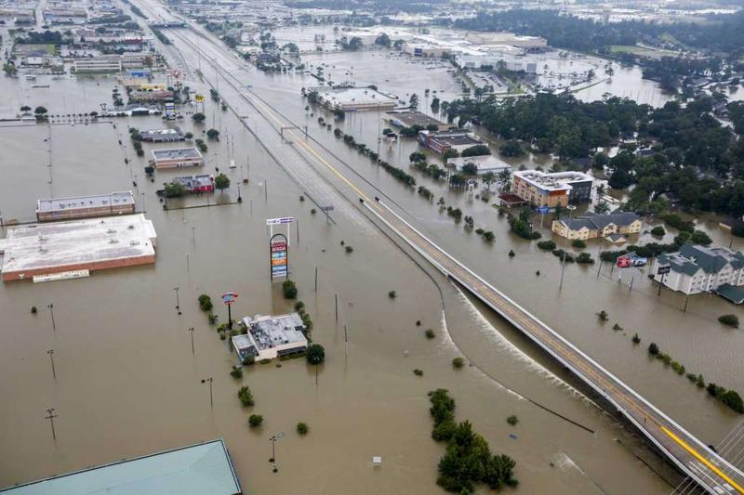
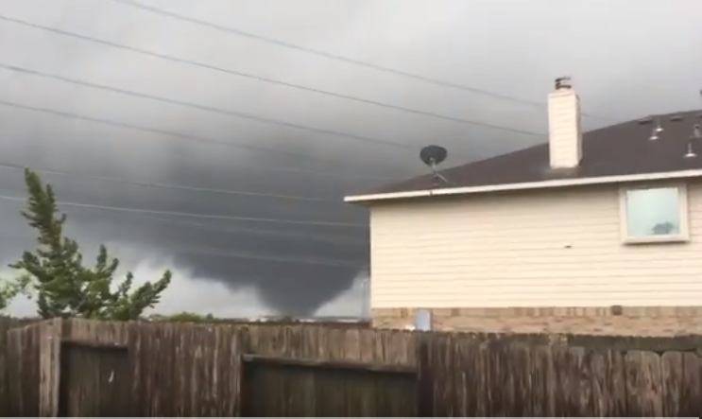
Hurricane/Tropical Cyclone Hazards
Damaging Winds
Storm Surge Flooding
Alicia, 1983
Ike, 2008
Every storm is different, brings these in different proportions.
High surf, rip currents
Flooding Rains
Tornadoes
Harvey, 2017
Nedville Area, 2023
Notes:
Every storm is different, contains some combination of these 5 hazards. NWS forecasts/warns for each of these separately so you can determine what is of greatest concern for an individual storm.

Slide 5
Hurricane Season Overview
Atlantic hurricane season runs from June 1 to November 30.
Be aware of peak activity (August – October).
Stay informed with credible sources like the National Hurricane Center.

Slide 6
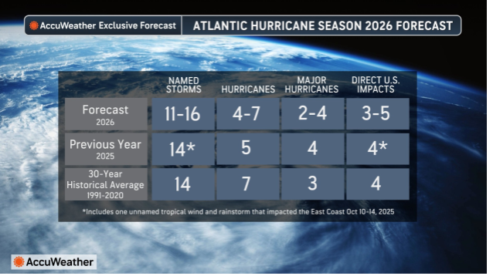
2026 hurricane season

Slide 7
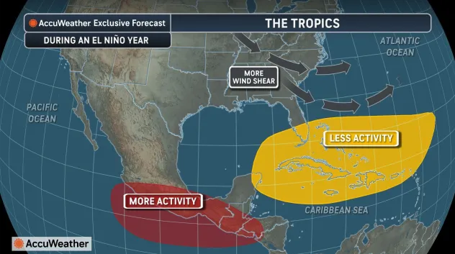
The tropics Exclusive Forecast
AVG: 14
Regardless of the outlook…it only takes one storm to make it an active season
AVG: 7
AVG: 3

Slide 8

Watches vs. Warnings
WATCH: Conditions are possible. Stay alert.
WARNING: Conditions are expected. Take action immediately.
Know the difference and respond accordingly.

Slide 9
What is Storm Surge?
Storm surge is the abnormal rise in sea level caused by a storm.
It can cause extreme flooding, especially in coastal and low-lying areas.
Never underestimate storm surge risks.

Slide 10
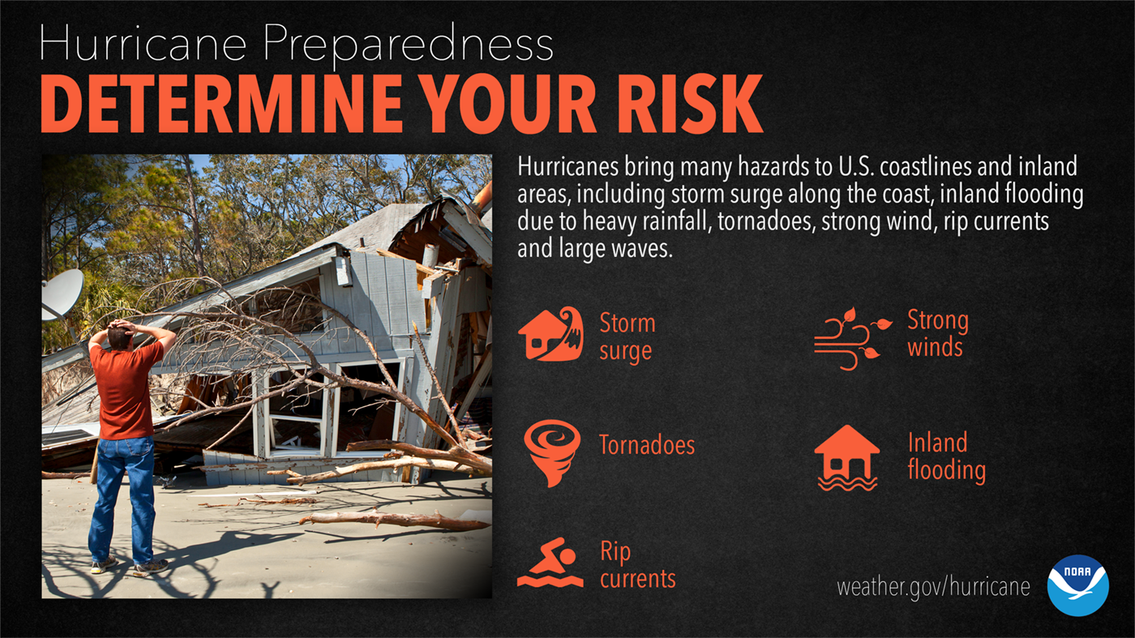
Hurricane Preparedness Determine your risk

Slide 11
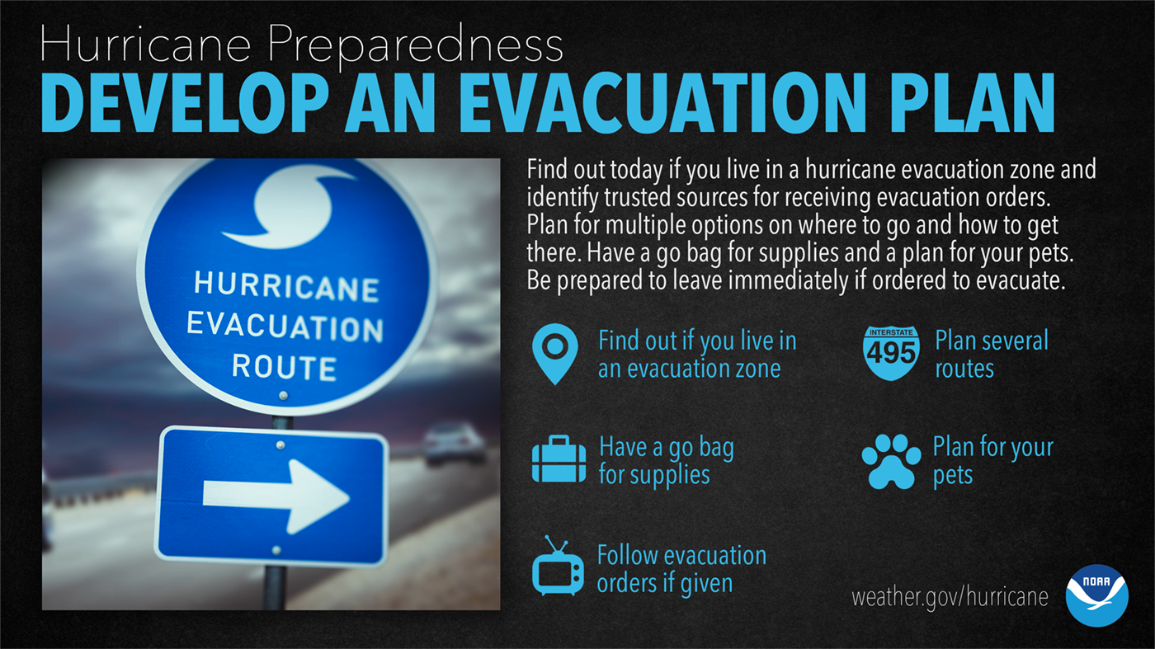
Hurricane Preparedness Develop an Evacuation Plan

Slide 12
Evacuate or not to Evacuate, That is the Question

Slide 13
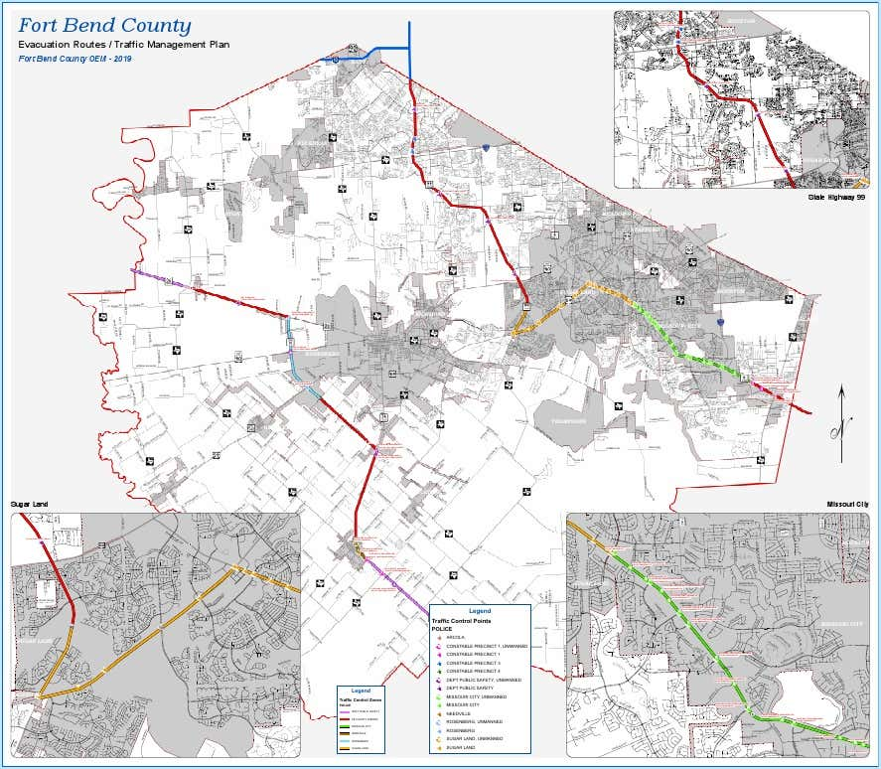
Evacuation – Fort Bend County
Fort Bend County is a 'Pass Through County'.
We support regional evacuation plans but are not a designated evacuation zone.
Know your evacuation routes and monitor local alerts.

Slide 14
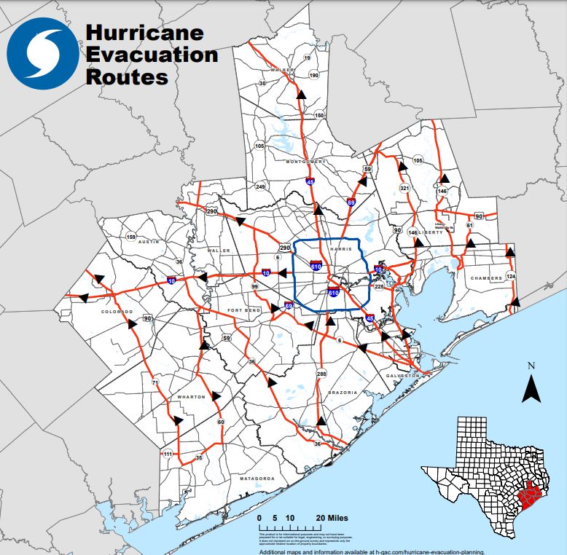
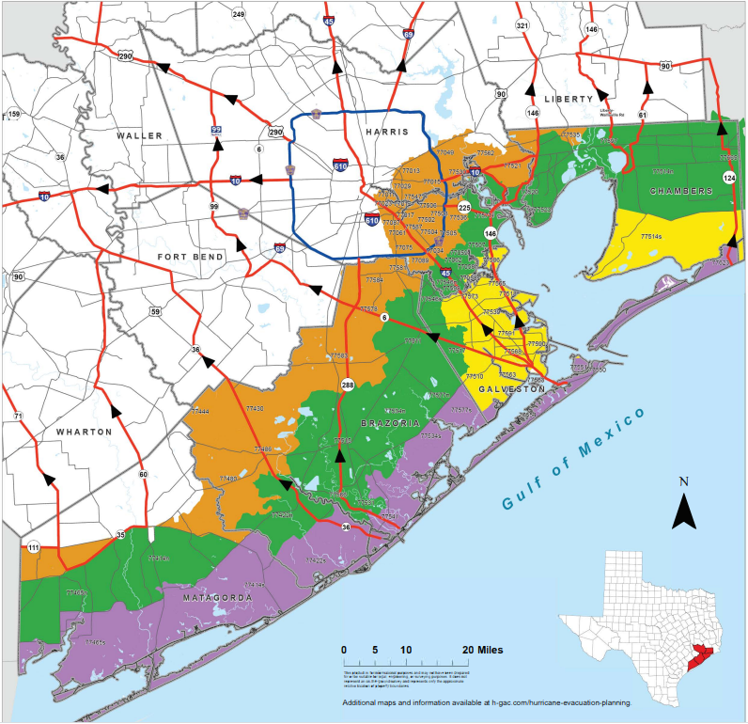
Hurricane Evacuation Routes

Slide 15
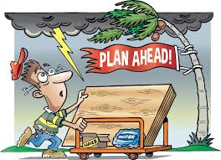
IF YOU DECIDE TO STAY

Slide 16
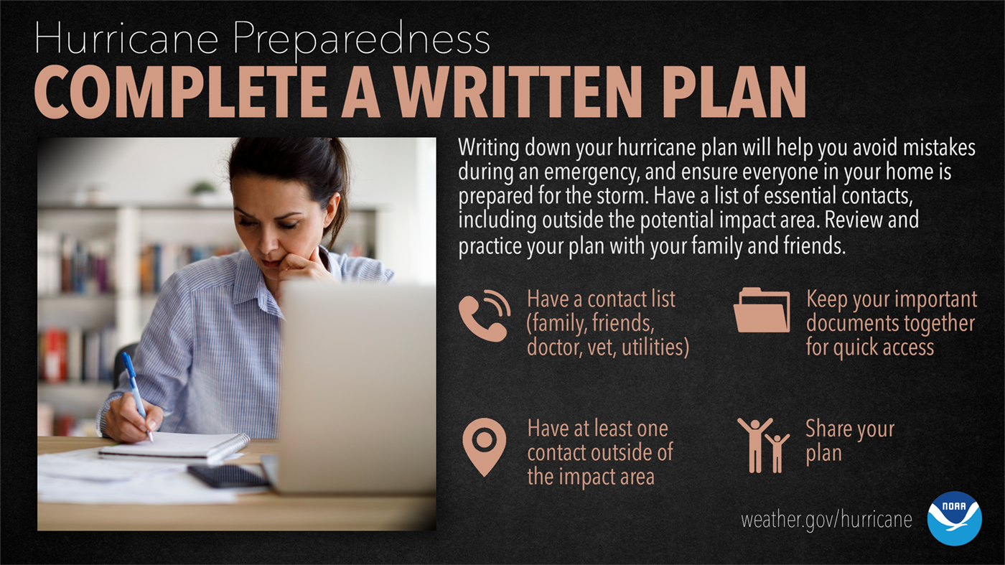
Hurricane Preparedness Complete a Written Plan

Slide 17
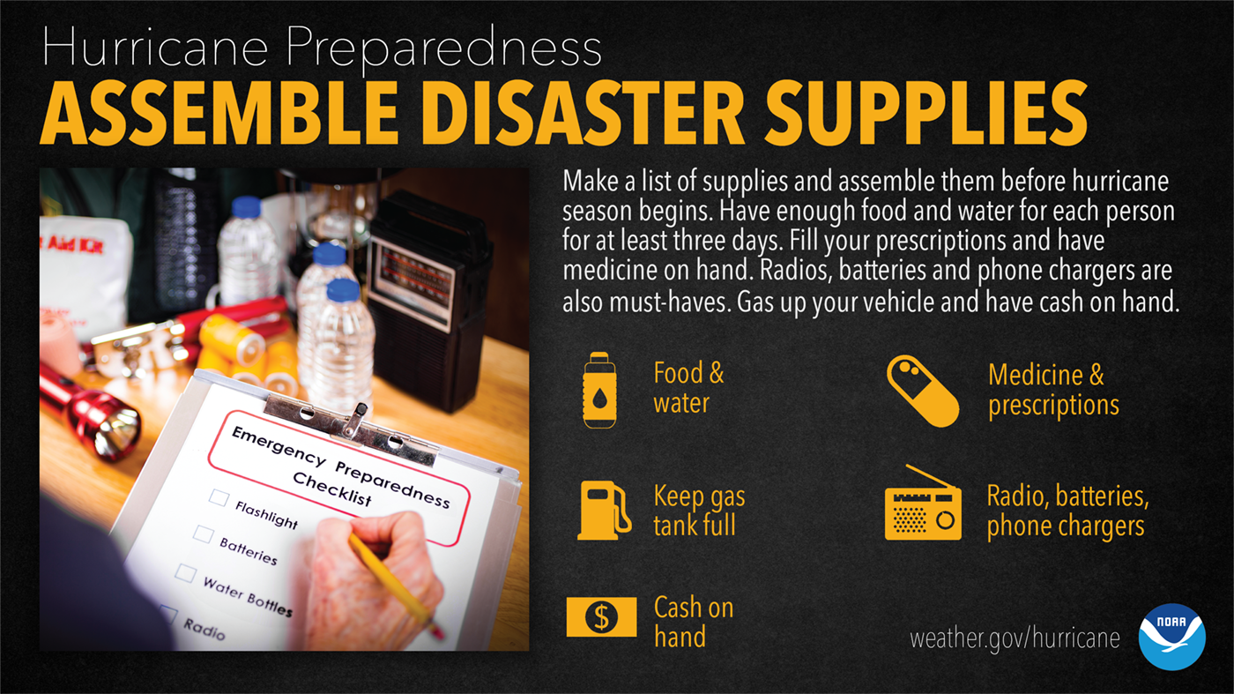
Hurricane Preparedness Assemble Disaster Supplies

Slide 18
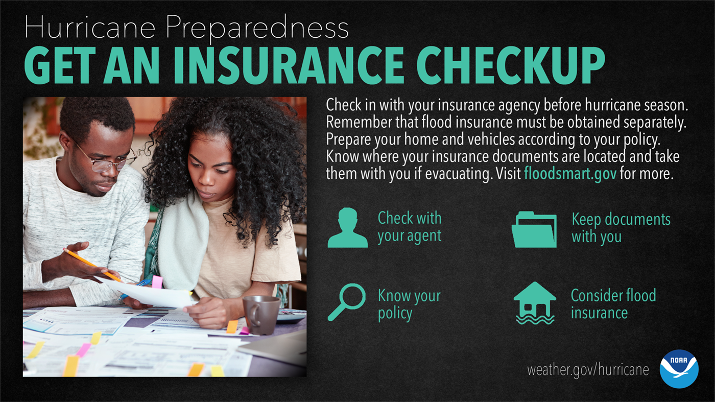
Hurricane Preparedness Get an insurance Checkup

Slide 19
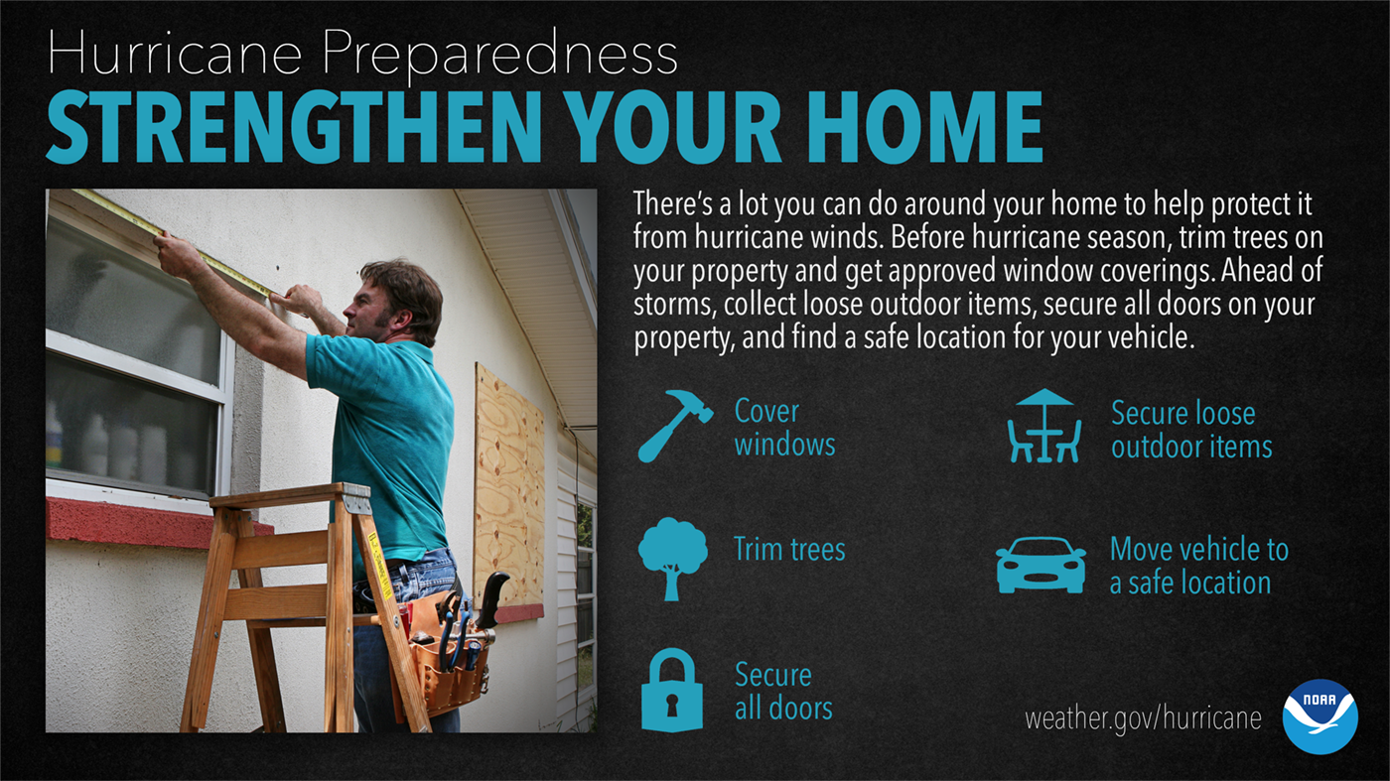
Hurricane Preparedness Strengthen your home

Slide 20
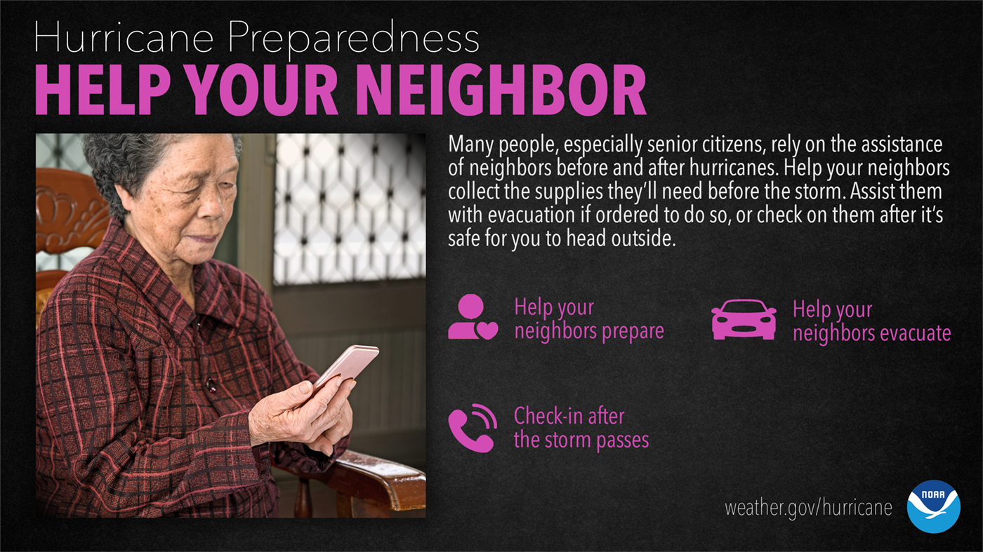
Hurricane Preparedness Help your neighbor

Slide 21
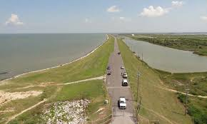
DO YOU KNOW WHAT LEVEE IMPROVEMENT DISTRICT YOU LIVE IN?

Slide 22

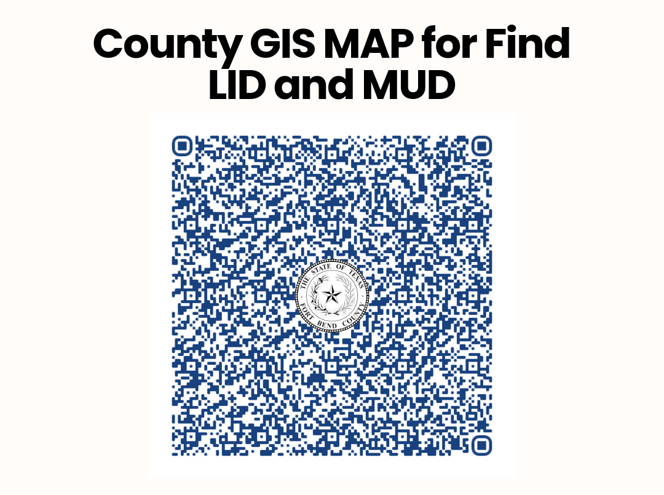
LID/MUD

Slide 23

Download Our App
Stay informed with the Fort Bend County HSEM App:
Real-time alerts
Preparedness tools
Emergency updates

Slide 24

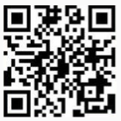
How to get Fort Bend County Alerts
Sign Up for FBC Alert: Text FBCAlert to 888777, or sign up for email, phone, and app alerts scanning the QR code.
Download the FBC Alert App: Available for Apple and Android devices.
Listen to AM 1670:
This is the dedicated AM radio station for county alerts.

Slide 25

What is the STEAR Program? State of Texas Emergency Assistance Registry
Is a free, voluntary registry that helps emergency planners and responders identify individuals who may need additional assistance during emergencies.
Why Register? Registering helps responders: ✔ Plan more effectively ✔ Prioritize assistance ✔ Support community safety
How to Register 🌐 Online: State of Texas Emergency Assistance Registry 📞 Call 2-1-1 (or video relay option) 📄 Download registration forms

Slide 26
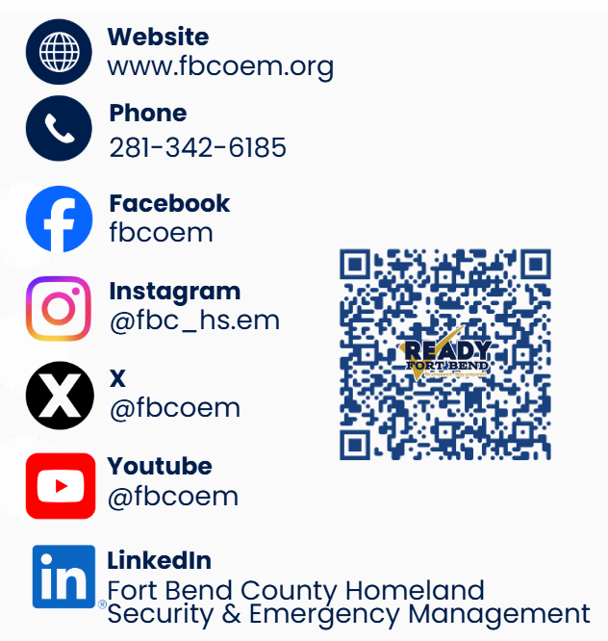
Follow US
Email: EOC@fortbendcountytx.gov

Slide 27

Greg Babst contact information
Greg Babst
Emergency Manager Coordinator
Homeland Security & Emergency Management
Greg.Babst@fbctx.gov

Slide 28

Fort Bend County HSEM EXPO

Slide 29

Ready fort bend expo flyer

Slide 30
Emergency Operations Center (EOC)

Slide 31
Martha rincon’s contact information
Martha Rincon
Community Outreach Planner
Homeland Security & Emergency Management
Martha.Rincon@fbctx.gov
(832) 612.1426 (281) 238.3401

