Slide 1
Fort Bend County Clerk Annual Report
Laura Richard
06/2022

Slide 2
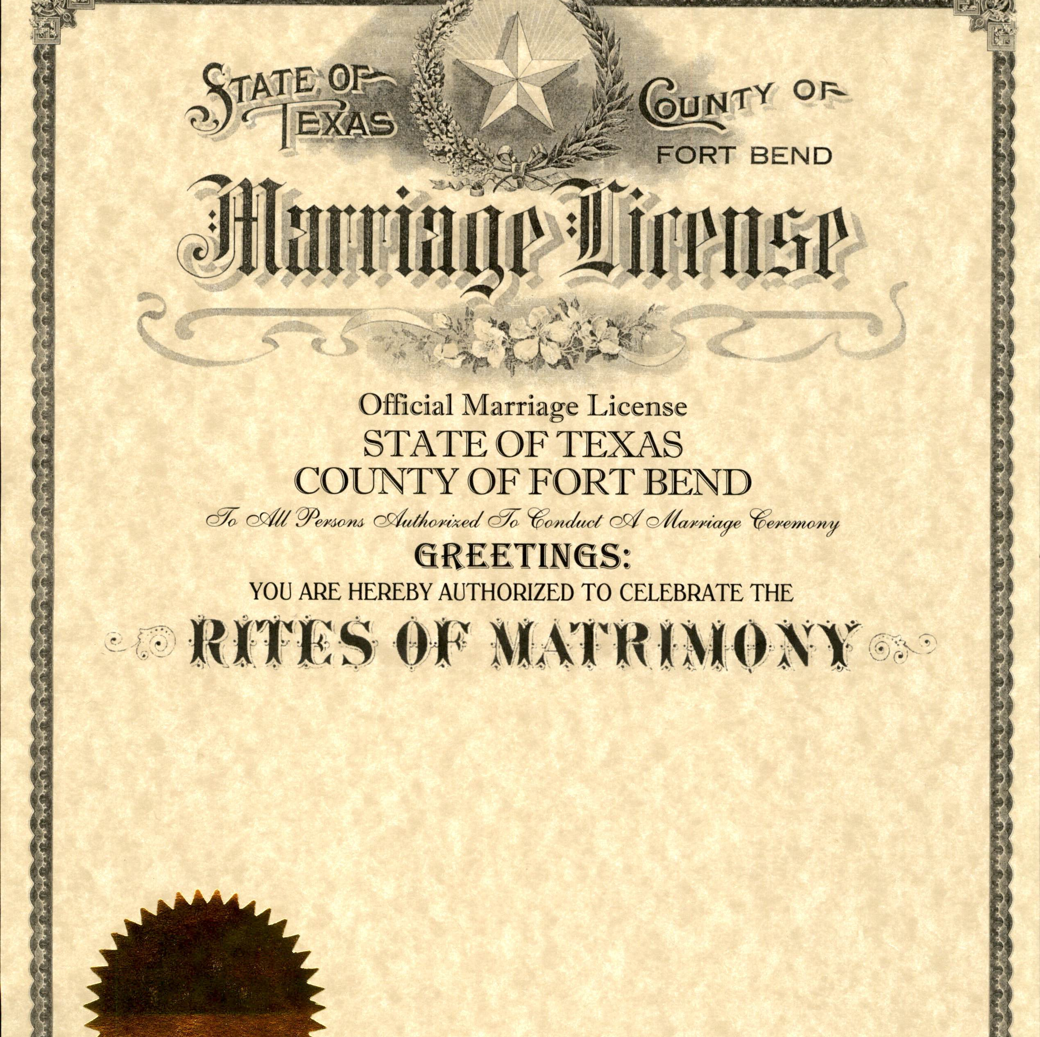
County Clerk Increased Revenue for the County
Largest revenue collection in the history of the office for FY 2021 - $11.7M
Recovered revenue from past due fines to date $330,000
Introduction of Keepsake Marriage License
Poly Sleeves for certificate safety
Launch of Historic Marriage License

Slide 3
County Clerk Increased Customer Satisfaction
Expedited service through online request for vital records
Enhanced Public Search for DBA documents
Provided in office translation solution to Fort Bend County citizens in need of language translation or hearing impaired assistance. (Available since November 2020)
Introduced Mobile Recording during FBC Fair for Marks & Brands
Added Drop Box for contactless delivery of documents
Implemented an improved Queuing System and Court software upgrade for efficiency
Debuted “How To” videos for Clerk services
Completed imaging project of historic Probate Records for electronic access

Slide 4
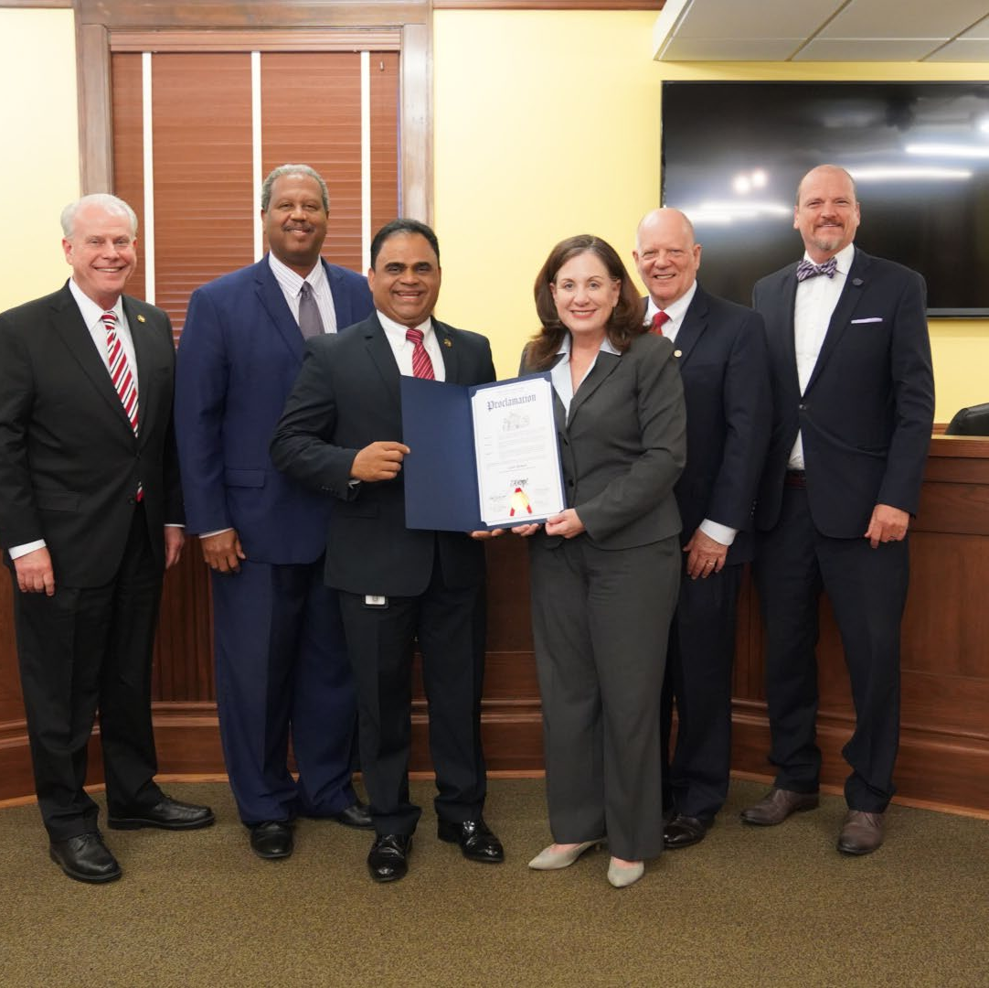
County Clerk Awards, Accolades and Education
Awarded Exemplary 5 Star Registrar from State of Texas VSU in 2021.
Awarded State’s highest 5 Star Award every year of tenure.
County Clerk, Laura Richard received the High Performance Leadership Master Certificate from NACo
County Clerk Supervisors attended continuing education focused on developing new ways to assist the public in customer service situations

