Slide 1
The Impact of Stress on the Body and Mind
First Responder Trauma:

Slide 2
What is Stress?
It is a natural reaction from our brain to our bodies
Hormones, like epinephrine and cortisol, are released to create a physiological response
We NEED stress! It helps us overcome challenges and create opportunities
BUT, if it is unmanaged, it can negatively impact our physical and mental well being

Slide 3
What’s Your Stress Level?
Activity: Holmes-Rahe Life Stress Inventory

Slide 4
Acute Stress:
Is short term stress with a quick resolution. This is the type of stress our body handles the best. If we are faced with something that requires us to “FIGHT or FLEE” (FIGHT or FLIGHT) our bodies are ready to take it on.
Example: a threatening dog- the mind and body gear up with the “fight or flight” response to handle this stress quickly then settles down.

Slide 5
Chronic Stress:
Is prolonged unrelieved stress also called cumulative stress. Prolonged unrelieved wear and tear results from too many demands
Example: “BURNOUT” when a person loses energy and interest because of unrelieved stress.

Slide 6
Acute & Chronic Stress
Daily stress can be acute or chronic
Stress is individual and we all have different tolerances. Example: driving in traffic.
Stress can also be an individual stressor or an accumulation of many things.

Slide 7
Group Discussion
List 5 internal stressors of the job
List 5 external stressors to the agency

Slide 8
Critical Incident Stress
It is incident specific. This is heavy-duty stress that causes psychological and physical discomfort for 2 days to 1 month. CIS is considered “normal” response to an abnormal extreme incident.
Events such as-
Working a gruesome accident
Involvement in a use of force incident
Involvement in a shooting
Recovering the body of a child

Slide 9
Post Traumatic Stress Disorder
PTSD creates major distress & long-lasting disruptive changes in a person's life. This is not “normal” stress and may need professional help.
PTSD is similar to CIS, but symptoms are prolonged past 1 month.
The person is unable to make the event part of their past keeping it part of their present.

Slide 10
Symptoms
Intrusion:
Flashbacks
Intrusive thoughts
Nightmares
Reliving the event
Avoidance:
Avoiding people/places
Avoiding thoughts/reminders
Avoiding talking about it
Mood/Cognition Changes:
Loss of memory
Guilt
Blaming self or others
Loss of interest in activities
Arousal:
Hypervigilance
Anger outbursts/irritability
Difficulty concentrating
Jumpy/uneasy

Slide 11
The Nervous System
Central Nervous System
-The command center
-Brain & spinal cord
Sympathetic Nervous System
-Fight or Flight
Parasympathetic Nervous System
-“Rest and Digest”
-Activates biochemical changes to the mind & body preparing response to a threat
-Controls body functions when at rest
-Returns the body systems to normal activity

Slide 12
Activating the “Stress Cocktail”
The Sympathetic Nervous System activates a stress response full of hormones, causing an increase in-
Heart rate
Blood pressure
Breathing
Sweating
Oxygen Consumption
Muscle Tension
Alertness

Slide 13
Activating the “Stress Cocktail”
This leads to changes in blood flow-
Blood is shunted away from non-critical organs in order to increase oxygen and energy to the heart, skeletal muscles, and the brain
Clotting factors change to allow blood to clot quicker in case of a wound
Changes happen to senses and perception-
Senses related to threat become more acute
Depth perception reduced
Pupils dilate
Changes in hearing, vision and time perception

Slide 14
Activating the “Stress Cocktail”
Parasympathetic Nervous System is turned off or reduced-
Digestion slows or stops as blood is needed elsewhere
Immune system is compromised
Non-critical systems are shut down
Tissue building and repairing stops

Slide 15
Activating the “Stress Cocktail”
If the SNS is constantly in high alert, and the PNS is shut off for extended periods of time, symptoms of chronic stress will occur-
High blood pressure
Irritability/hostility
Heart disease
Increased risk of cancer
Impaired sleeping
Impaired sexual/reproductive functioning
Skin disorders
**We can control smooth transitioning between the SNS and PNS by actively managing our stress**

Slide 16
Symptoms of Stress Response
Cognitive/Emotional
Physical
Social
Impaired decision making
Difficulty focusing/staying on task
Memory problems
Rapid mood changes
Irritable
Argumentative
Blaming others
Depression
Increased alcohol use
Suicide
Digestive disorders
Headaches
High blood pressure
Disrupted sleep
Excessive illness
Loss/increased appetite
Emotional distancing
Relationship problems
Withdrawn
Lost interest in hobbies
Isolation

Slide 18
Continuous Activations
Chronic stress can damage the brain by killing cells in the hippocampus
Prolonged states of hypervigilance-
Overestimation of threats
Extreme avoidance of perceived threats
Increased startle response
Interfere with sleep; causing fatigue, loss of concentration, inability to focus
Feelings of paranoia
Leading to changes in behaviors

Slide 19
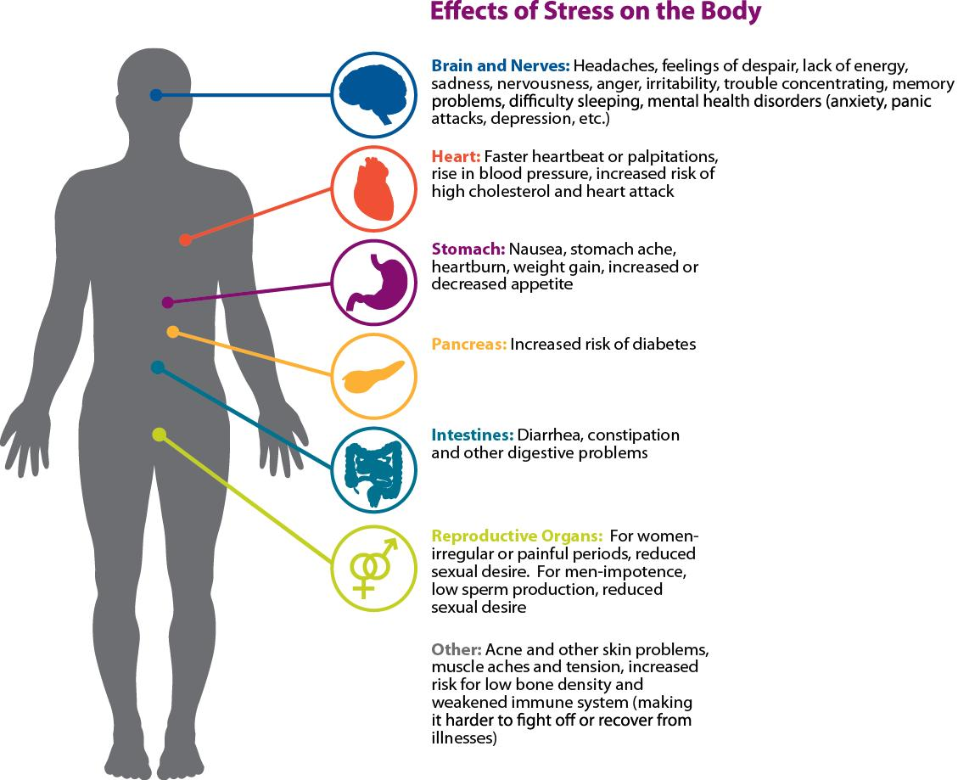
It’s Not Just in Your Head

Slide 20
Studies: First Responders First 2020
90% of first responders report they have been exposed to trauma on the job
Estimated 1/3 of emergency responders will eventually be diagnosed with a mental health disorder
1/3 of firefighters reported alcohol abuse
18% of male officers and 16% of female officers reported they had negative consequences due to alcohol consumption

Slide 21
Studies: Ruderman White Paper- Mental Health and Suicide of First Responders, 2018
Female firefighters- 40% reported binge drinking that month, 16.5% of them screened positive for problem drinking behaviors
Depression in firefighters- out of 112, 11% found with depression (general population 6.7%).
Out of 1,000 firefighters across the U.S., 46.8% reported imagining or thinking about suicide at least one time in their career
Alcohol was present in over 85% of police officer suicides

Slide 22
Studies: Ruderman White Paper Update 2022
“10 Fatal Factors” of First Responder Suicide
Interpersonal relationship issues
Access to firearms
Alcohol/substance abuse
Medical issues
Nearing retirement
Cumulative stress and trauma
Being under investigation
Mental health concerns
Sleep disturbances
Other major life events

Slide 23
Retirees
Law Enforcement
Fire/EMS
2018-2022: Average of 30 retired officers die by suicide per year (Blue Help, 2022)
Most LE officers die within 5-6 years of their retirement (DOJ, 2021)
Life expectancy is 12-15 years less than the average person (DOJ, 2021)
2018-2022: Average of 1.5 retired FF/EMT die by suicide per year
Fire Fighter life expectancy is 10 years less than the average person due to toxic chemicals and protective equipment (PBS, 2022)

Slide 24
What Are/Aren’t You Doing?
Activity: Self-Care Bingo

Slide 25
Share Resources!
Texas SB 1359- requiring paid Mental Health Leave
Texas SB 64- requiring state peer support network TLEPN
Law Enforcement Mental Health and Wellness Act
https://cops.usdoj.gov/lemhwaresources
American Warrior Association
https://awa-usa.org/
LEMIT Post Critical Incident Seminar
http://www.lemitonline.org/

Slide 26
Share Resources!
The Blue Bow Foundation
https://www.bluebow.org/#/
UTHealth Trauma & Resilience Center
https://med.uth.edu/psychiatry/research/centers/trauma-and-resilience-center/
ASIST Suicide Prevention Training
TacMobility- Resilience Training
https://tacmobility.org/

Slide 27
Thank You
Deputy Theodore Deaver
832-361-0833
Theodore.deaver@fortbendcountytx.gov
Kayla Elwood Agudo
832-265-4651
Kayla.elwood2@fortbendcountytx.gov

