Slide 1
Caring for Children
Who Have Experienced Trauma
Early Childhood
(Ages 0 – 5)

Slide 2
Introductions
Social Workers
Clinicians
CASAs
Attorneys
Parents (birth, adoptive, foster, kinship)
Others?
Notes:
Ask who is in the room and what they hope to gain from the training.

Slide 3
What Research Tells Us
Getting things right the first time is easier and more effective than trying to fix them later
Early childhood matters because experiences early in life can have a lasting impact on later learning, behavior, and health
Highly specialized interventions are needed as early as possible for children experiencing toxic stress
Early life experiences actually get under the skin and into the body, with lifelong effects on adult physical and mental health
www.developingchild.harvard.edu

Slide 4
Exacerbating Risk Factors for Families
Parental substance abuse
Parental depression
Poverty
Abuse and neglect
Lack of support systems
Witnessing domestic violence
Child’s own experience of trauma, especially multiple traumas

Slide 5
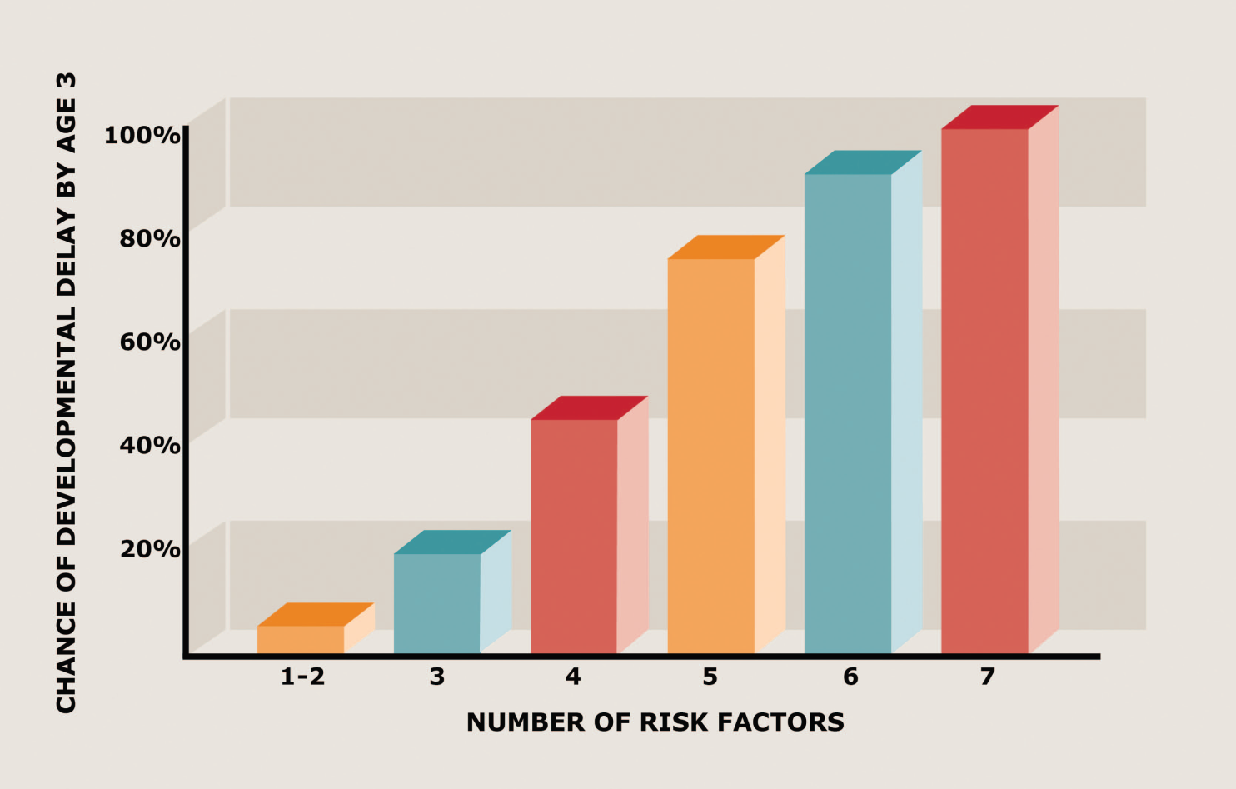
90-100% Chance of Developmental Delays when Children Experience 6-7 Risk Factors
Barth et al. (2008)
Notes:
Significant adversity impairs development in the first three years of life—and the more adversity a child faces, the greater the odds of a developmental delay. Indeed, risk factors such as poverty, caregiver mental illness, child maltreatment, single parent, and low maternal education have a cumulative impact: in this study, maltreated children exposed to as many as 6 additional risks face a 90-100% likelihood of having one or more delays in their cognitive, language, or emotional development.

Slide 6
Protective/Resilience Factors
One stable parent or caretaker
Higher IQ (Silva, 2000)
Good peer relationships (Criss, 2002)
Secure attachment and good care ages 0-2 (Stroute, 1999)
Friendly, outgoing temperament in the child
Other supportive adults – i.e., daycare providers

Slide 7
Video: The Science of Neglect
https://www.youtube.com/watch?feature=player_embedded&v=bF3j5UVCSCA
Notes:
Extensive biological and developmental research shows significant neglect—the ongoing disruption or significant absence of caregiver responsiveness—can cause more harm to a young child’s development than overt physical abuse, including subsequent cognitive delays, impairments in executive functioning, and disruptions of the body’s stress response. This edition of the InBrief series explains why significant deprivation is so harmful in the earliest years of life and why effective interventions are likely to pay significant dividends in better long-term outcomes in learning, health, and parenting of the next generation.
This 6-minute video provides an overview of The Science of Neglect: The Persistent Absence of Responsive Care Disrupts the Developing Brain, a Working Paper from the National Scientific Council on the Developing Child.

Slide 8
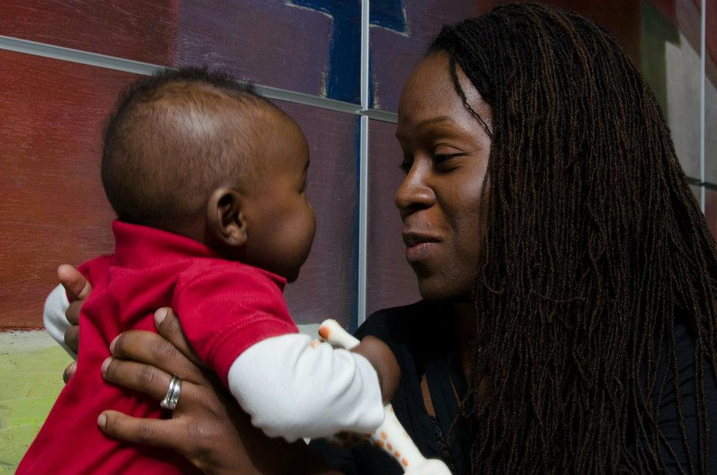
Urie Brofenbrenner Says:
“In order to develop normally, a child requires progressively more complex joint activity with one or more adults who have an irrational emotional relationship with the child. Somebody’s got to be crazy about that kid. That’s number one. First, last, and always.”
Urie Bronfenbrenner
(National Scientific Council
on the Developing Child,
Summer 2004)

Slide 9
Complex Trauma:
The Impact on Attachment

Slide 10

Attachment Defined
Attachment refers to the quality of a child’s connection to or relationship with parents
Attachment behavior is:
  Seeking safety
  Receiving comfort
  Getting help to get needs met
Notes:
Questions to think about:
How does your child/foster child seek comfort from you?
Do they physically reach out for you?
When you give it, do they accept it?
Children with attachment issues
Fail to ask
Parent did not get the cue, so they end up not getting their needs met

Slide 11

Relationship Blueprints
Internal Working Model
Based on experience with parent
Not conscious choices
Formed in 1st year
Lasting, resistant to change
Feelings about:
  Self-worth
  Other’s trustworthiness
  Safety in the world
Notes:
Ask the child’s caregiver:
What happened to your child during their first year?
Drug exposure
Domestic violence
Chaotic Environment
Numerous caregivers

Slide 12

Florida mother drives van with children into ocean – ages 8, 10 & 3

Slide 13
Ebony Wilkerson
Mental Illness
Domestic Violence
Pregnant
Notes:
Gave birth in jail; newborn child in kinship care
Eight year old alerted other children and got help from bystanders
3 year old strapped in car seat

Slide 14
Key points to remember
Parents and children function according to the relational problem built in their first relationships
If parents were frightening or neglectful, attachment difficulties may be created
A child cannot be disciplined out of this problem
A child needs to experience nurturing parents
Nurturing experiences revise their blueprint
Notes:
Attachment exercise – ask for 8 volunteers
We parent the way we were parented. This is our default road map.
We can change the road map by keeping the good and resolving our childhood hurts. This happens through thoughtful, sensitive parenting and developing a secure attachment.

Slide 15
Attachment Styles
Almost two-thirds of adults are secure/autonomous (60-65%)
About 20% are avoidant/dismissive
About 10% are preoccupied
About 5-10% are unresolved
Children are more likely to have the same style as parents
Foster children are more likely to be “secure” if foster parents are also secure/autonomous
              - Dozier et al., 2000
Notes:
Review your own attachment history.
Talk about it with your partner
Seek outside help if necessary
Review your parenting roadmap:
What was good?
What could be changed or discarded?
What causes me to default to the old roadmap?

Slide 16
Why is this so important?
As parents, if we understand our attachment styles and we know what parenting roadmaps we automatically use, we are better able to parent with:
  Sensitivity
  Good emotional regulation
  Good behavioral regulation
  Using kindness and mindfulness
  In other words, we know our buttons and we keep them out of reach!

Slide 17
Trauma and Attachment
Trauma occurring within the caregiving relationship
Parent is frightening or frightened
Physical, sexual, emotional abuse within the family environment
Neglect
  Lack of food
  Lack of parent interaction
Repeated separations
  Losses of parent figures
  Many caregivers
  Numerous placements
  - www.attach.org
Notes:
A “frightened” parent can be as scary as a “frightening” parent.

Slide 18
Mechanisms of Intergenerational Transmission of Trauma
Silence –
The child senses their parent’s vulnerability and has to avoid anything that will trigger parent

Slide 19
The “Conspiracy of Silence”
“What cannot be talked about can also not be put to rest; and if it is not, the wounds continue to fester from generation to generation.”
B. Bettelhelm, 1984

Slide 20
Mechanisms of Intergenerational Transmission of Trauma
Over-disclosure
The child is traumatized by hearing too much and having no ability to handle it

Slide 21
Mechanisms of Intergenerational Transmission of Trauma
Identification
The child is repeatedly exposed to symptoms > identifies with parent’s role as victim and mimics parent’s behavior

Slide 22
Mechanisms of Intergenerational Transmission of Trauma
Re-enactment
The survivor (i.e., parent) re-enacts the trauma and in the process traumatizes the child or produces similar feelings.
Usually unconscious
Can endanger child

Slide 23
Impact on Infants
Maternal PTSD symptoms significantly impact infants’ behavior and the ability to develop secure attachments.
- Schuengal, 1999

Slide 24
General Findings on Children Living with a Parent with PTSD
Feelings of shame
Feeling angry, but helpless to do anything about it and guilt about feeling angry
Feeling invisible
Emotional needs neglected
Self-blame and low self-esteem
Jumpy and nervous
Exhaustion from being parent’s caretaker

Slide 25
Family Violence
Intergenerational transfer of PTSD and unresolved trauma
Untreated family violence victims suffer from chronic or delayed PTSD
The trauma history becomes the central organizing factor in these families across generations

Slide 26
So How Do PTSD Symptoms Affect Parenting?
Intrusive Symptoms
  Parent feels out of control, is unpredictable – affects trust
  Parent reacts with anger to flashbacks – fear, self-blame, shame
  Child may resent that life revolves around parent’s crises (Porterfield, 1996)
  Parent is pre-occupied, adult trauma takes precedence over child’s needs (Scheeringa and Zeanah, 2001)
  Parent may react as if the child is part of flashback

Slide 27
Nightmares and Insomnia
Makes for cranky parents, snap at child
Startling a sleeping parent can result in abuse
Nightmares may be scary to watch for a young child

Slide 28
Avoidance Symptoms
Parent avoids triggers or crowds so family avoids activities (Porterfield, 1996)
Parent is unable to go to school events or play with child
Parent cannot handle noise, snaps at child for normal toddler behavior
Child cannot have play dates because parent can’t handle it or is unpredictable

Slide 29
Avoidance of Triggers
“In an attempt to avoid thinking about the trauma, people with PTSD often blame the trigger instead of the trauma for their feelings . . ., many times, they blame their family.”
- Porterfield, 1996

Slide 30
Negative Alterations in Cognition and Mood
Emotional numbing and detachment – child feels unloved and unworthy
Lack of emotional response
Risk of physical or emotional neglect
Making children afraid of the world
Constant anger

Slide 31
Hyperarousal Symptoms
Parent is on edge – family feels anxious
Some parents become overprotective
Parent may isolate and/or isolate the family (Porterfield, 1996)
Response to child’s roughhousing, quick movements as if it means danger
Anger outbursts – risk of abuse

Slide 32
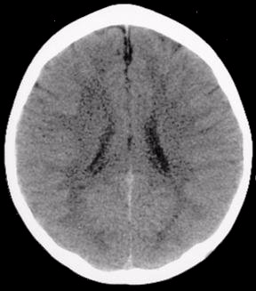
Brain Development in Abused Children

Slide 33
Solutions
Repairing the Damaged Relationship through Relationships

Slide 34
Cognitive Behavioral Techniques
Beyond Consequences and Coercion
  Match expectations to developmental not chronological age of child
  Focus on teaching
  More focus on socially reinforcing desired behaviors
  Teach child new response skills that lead to new, desirable behaviors
  Use the “teachable moment” approach
  Punishment shame rage

Slide 35
Foundations of Therapeutic Parenting/Caregiving
Caregiver’s learn to “read” small clues to the child’s upset
  Find the meaning of behavior based on the child’s past experiences
Teaching emotional regulation
  Negative feelings can be tolerated (by child)
  Help (from parent) is always available
Notes:
Cues for understanding child’s state of mind:
Tone of voice, hanging head (shame)
Avoidance of eye contact (shame, fear)
Fight, flight, freeze, submit (fear)

Slide 36
Implicit and Preverbal Memory
Child may be triggered and react as if the terrifying event was happening again, but will not be able to explain his reaction
If parents/caregivers can accept the reality of the child’s fear, even without knowing the source of it, they will be more effective at comforting their child
Child needs to hear that the parent understands, and will do everything she can to keep him safe
- www.attach.org
Notes:
Implicit memory – occurs unconsciously, not aware of why. Cells hold memories; deep soul wounds – birth to age 3.

Slide 37
Trauma Triggers
Unresolved trauma is re-experienced mentally and physically
  Sights
  Sounds
  Smells
  Facial expressions
  Tone of voice
  Physical surroundings
These hi-jack the brain – unconscious, pre-determined neural pathways
Behavior modification will NOT work – hi-jacked brain does not reason, it reacts

Slide 38
Touch re-regulates
Touch is integral to human development
Children need to learn to tolerate and welcome safe, nurturing touch
May take a long time and lots of experimenting
Must understand where the child is on the regulation/dysregulation continuum when deciding appropriateness of physical touch

Slide 39
Helping
Developmental Play
Floor time
Let the child lead the play with you acting as the scaffolding – hold the child together
Sensory rich environment – paints, colors, clay, water and sand
Notes:
Bouncing on exercise balls
Painting with sugar & salt
Rice scattered on floor
Even pressure (i.e. weighted blankets)
Hula hoops
Rubbing reflexology points
Play dohs
Dance therapy

Slide 40
Centering the Child
Gentle hand to forehead
Gentle hand to back of neck
Breathing –
  Breathe in “smell the flowers”
  Breathe out “blow out the candles”
Notes:
Do both at the same time, discussed in TBRI video (Dr. Karyn Purvis)

Slide 41
Establish Safety and Security
Respond to and provide opportunities for children to receive positive human physical contact to reaffirm needs for sensory comfort and care
Help children get enough sleep and nutrition
Provide them with physical symbols of nurturing, love or remembrance (i.e., LifeBooks)

Slide 42
Theraplay Nurturing Activities
Manicure
  Wash your child’s hands or feet in a basin of warm, soapy water. Gently dry them off and massage them with lotion, then paint their nails. Keep talking to your child as you paint, and finish off by reading books together while nails dry.
Caring for hurts
  Check your child’s hands, arms, legs, etc . . ., for scratches or bruises. Give them magic kisses. Rub magic cream, lotion or powder on or around hurts. If your child won’t let you, try just gently touching hurts with cotton ball.
Face painting
  Paint flowers and hearts on cheeks. Mustaches and beards are fun for boys. Make your child feel special.
Twinkle Song
  Adapt the words of this song to be about your child. With two adults, you can spread a blanket on the floor, lie your child down on it, then lift up the corners for a magic carpet ride. If your child needs “babying,” swaddle them in the blanket and give them a drink from a bottle or lidded cup.

Slide 43
What Young Children Need
Explain traumas and related symptoms in age-appropriate language
Don’t share all the gory details
Don’t avoid sharing altogether
Notes:
Everyone involved in the child’s life needs to say these things: parent, foster parent, day care providers, therapists, CASAs, etc . . .

Slide 44
Messages Children Need to Hear
“It’s not your fault”
“You did not cause this”
“You can’t fix it”
“Someone else will take care of your parent (who?), but it is not your job.”
“Your parent still loves you but they have a problem right now that gets in the way of showing it”
“Lots of other adults care about you (and who)”
Notes:
“It’s OK to play and have fun and be a kid, even if your parent is struggling.”

Slide 45
What’s a teacher to do?
Share child’s history and triggers
Assess thoroughly
Designate one safe person
Communicate OFTEN, openly
If safe person/teacher is absent, may keep child at home
Changes in routine
  Parties and field trips may be difficult
Have achievable expectations, natural consequences
Notes:
Safe person may be the janitor

Slide 46
Classroom strategies
Connect with the child at the beginning and end of the day
Child needs to know he is like the other children
Notice child’s behavior and help him understand it
Remain calm and kind so school is less scary
  Child is sensitive to negative emotions
Give choices
  If child choose to not cooperate, let him know the results of that
  May not change the behavior for the next time
Notes:
Let children sit on exercise balls
Velcro tabs under table (in traditional classrooms)
Stress balls to squeeze on

Slide 47
Classroom Strategies for Disruptive Times
Create a safety plan with the team
Escort child from the room to a quiet, calming place
  not the childcare director’s office or principal’s office
Child should NEVER be left alone
If child hurts someone he needs an opportunity to mend the relationship

Slide 48
Resources
Center on the Developing Child - The mission of the Center on the Developing Child is train others on the role of cognitive development in young children and how science-based innovation can achieve breakthrough outcomes for children facing adversity.
  http://developingchild.harvard.edu/about/
Hope for Healing: A Parent’s Guide to Trauma and Attachment. Association for Treatment and Training in the Attachment of Children (ATTACh, April 2011)
The Hope Filled Parent CD, Michael Trout (www.infant-parent.com)
Hughes, D.A. (2006). Building the bonds of attachment (2nd ed.). New York, NY: Jason Aronson, Inc.
National Child Traumatic Stress Network (www.nctsn.org)

Slide 49
Thank You!
Naijean Bernard-Onwere, PhD nonwere@cenpatico.com
STAR Health – Texas Foster Care Program

