Slide 2
Introduction of Gabriel & Chaplain Tim Engel

Slide 3
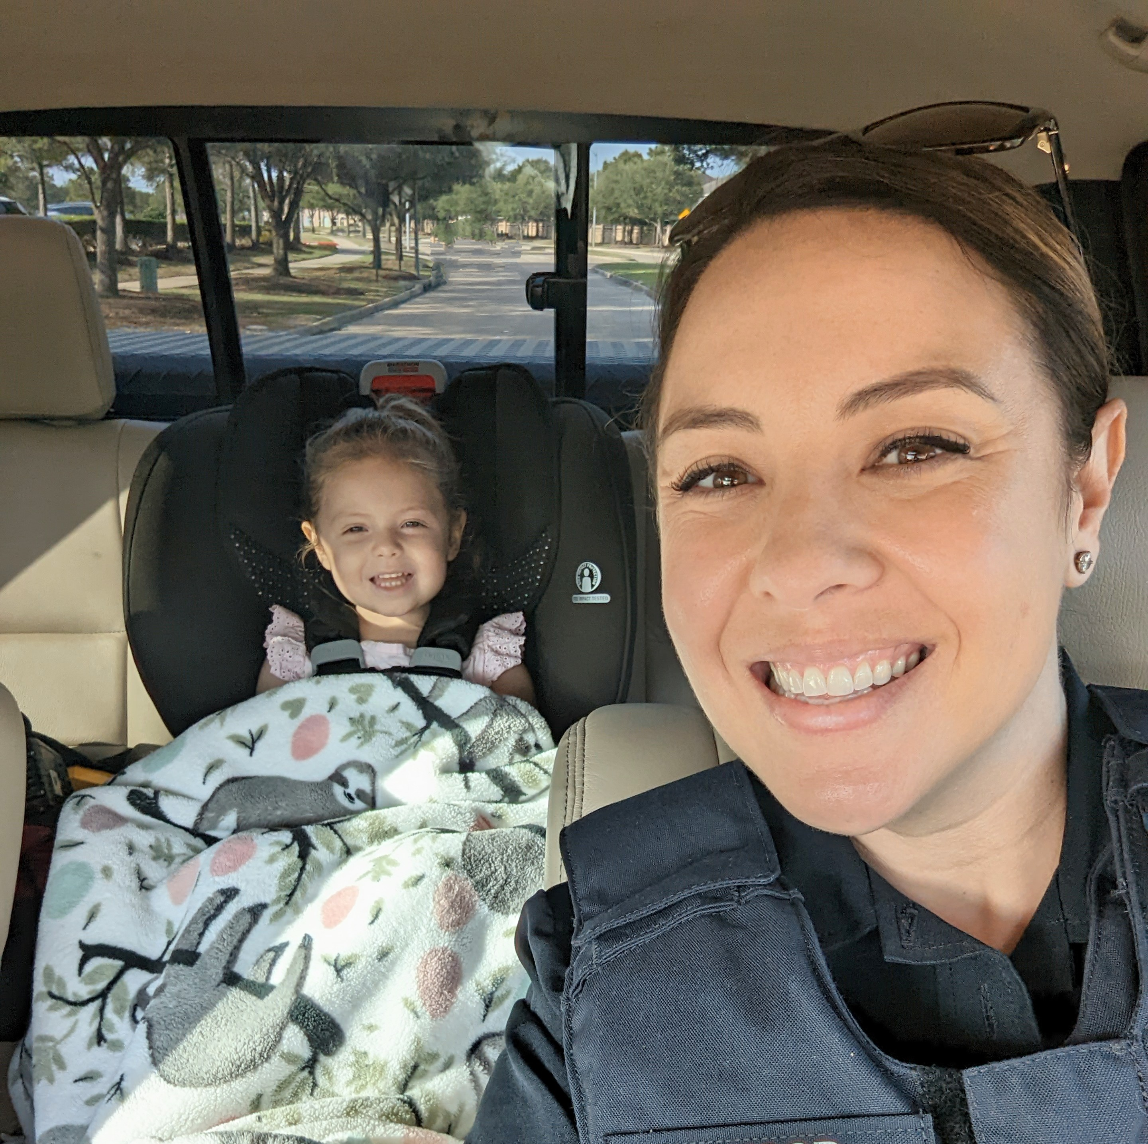
My story
Kayla Elwood
Fort Bend County Sheriff’s Office Deputy
Soon to be LPC

Slide 4
Introduction
Compassion fatigue is an occupational hazard of “any professionals who use their emotions, their heart”, it is the psychological cost of healing others. “It’s like a dark cloud that hangs over your head, goes wherever you go and invades your thoughts”. - Charles R. Figley, PhD, Traumatology Institute at Tulane University

Slide 5
Compassion Fatigue
Vicarious Trauma
Burnout
Secondary Traumatic Stress
Experiencing secondary exposure to clients’ trauma
Negative responses and emotions from helping others through empathetic work
Impact on personal beliefs and world view
Cognitive disruptions carry beyond the scope of work
Slow build up of exhaustion and lack of motivation in work
Feeling that your work has little or no impact
Typically stems from occupational stress and feeling overworked
Can usually be improved by change of work assignment or profession
Another term for compassion fatigue
Mirrors symptoms of PTS/PTSD with less intensity
Empathic strain and general exhaustion from caring for trauma survivors or people in distress

Slide 6
Who Is At Risk?

Slide 7
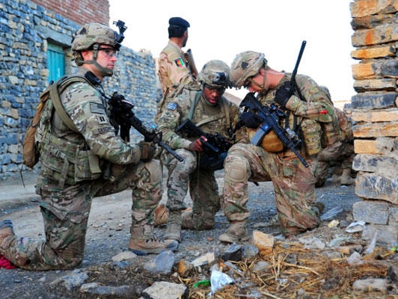
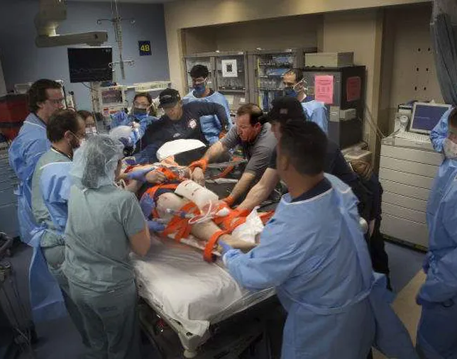

Slide 8
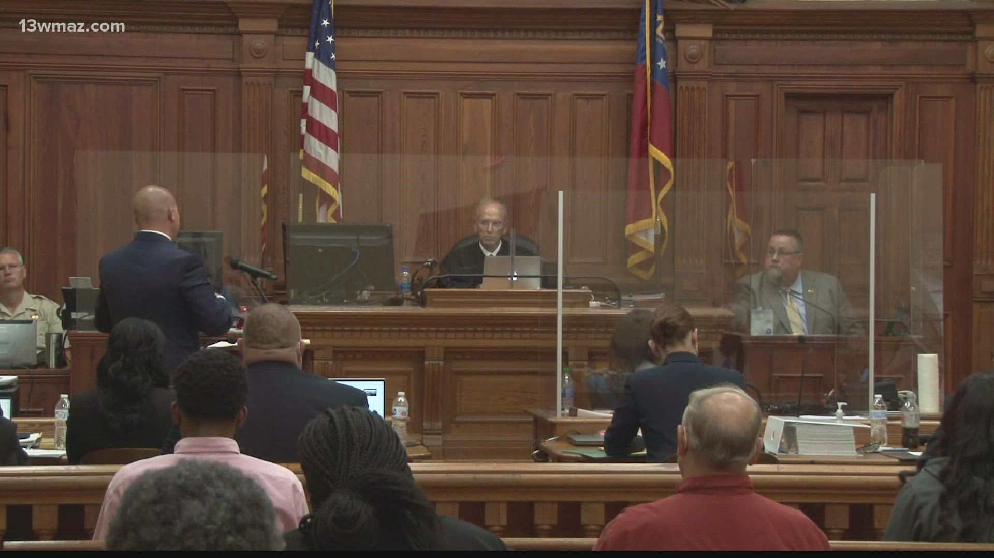
CPS
Teachers
Juvenile Division
Judges
Attorneys
Bailiffs
Mental Health Professionals
Counselors
Psychologists/Psychiatrists
Child Advocate Center
Special Crimes Investigators
Court Personnel
Jurors
DA Investigators
Social Workers
Crisis Line Operators

Slide 9
What Does it Look Like?

Slide 10
At Work
Irritability
Poor job satisfaction or performance
Feeling undervalued
Detached from colleagues
Negative feelings towards the caregiver relationship
Impatient with clients or colleagues

Slide 11
At Home
Physical symptoms- headaches, physical & emotional exhaustion, weight loss or gain
Poor sleep
Diminished concentration
Detached or withdrawn
Negative impact on interpersonal relationships

Slide 12
Our Identity
Feeling helpless, hopeless, or powerless
Feeling a loss of purpose or meaning
Losing sight of “the good” in the world
Lack of motivation for hobbies

Slide 13
What Can We Do About It?

Slide 14
Take Control
Be aware of the symptoms
Recognize you are NOT immune
Make self-care a routine*
Honor commitments to yourself
Recognize your own stressors and make time to manage them

Slide 15
Breathe. Smile. Repeat.
Spending time in nature has been linked to cognitive benefits and improvements in mood
Bond with your fur babies for an increase in oxytocin….yup, it’s true!
Exercise releases endorphins, boosts natural energy levels, and improves symptoms of anxiety or depression

Slide 16
Play. Create. Write.
Engaging in ways to be creative encourages the brain to change functions and release dopamine
Creativity allows your brain to stop running wild with intrusive thoughts by focusing on a task

Slide 17
Socialize
Make the time for your family and friends
Set a new goal for yourself
Look for a change up at work- move positions or take a new training
Plan a trip
Plan for retirement
Consider talking to a mental health professional yourself
Consider the need for medication if it’s beyond your coping abilities

Slide 18
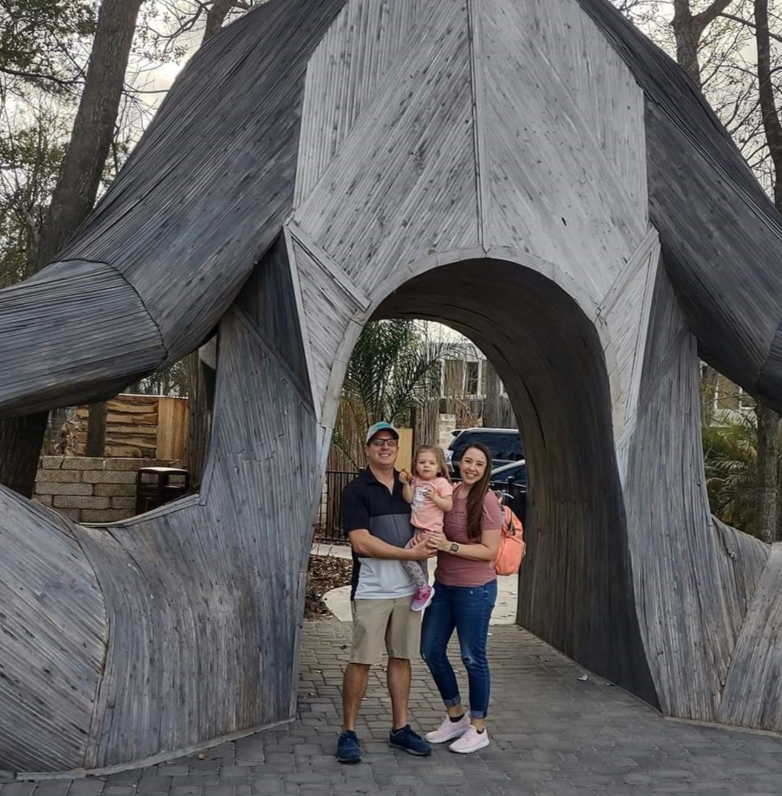
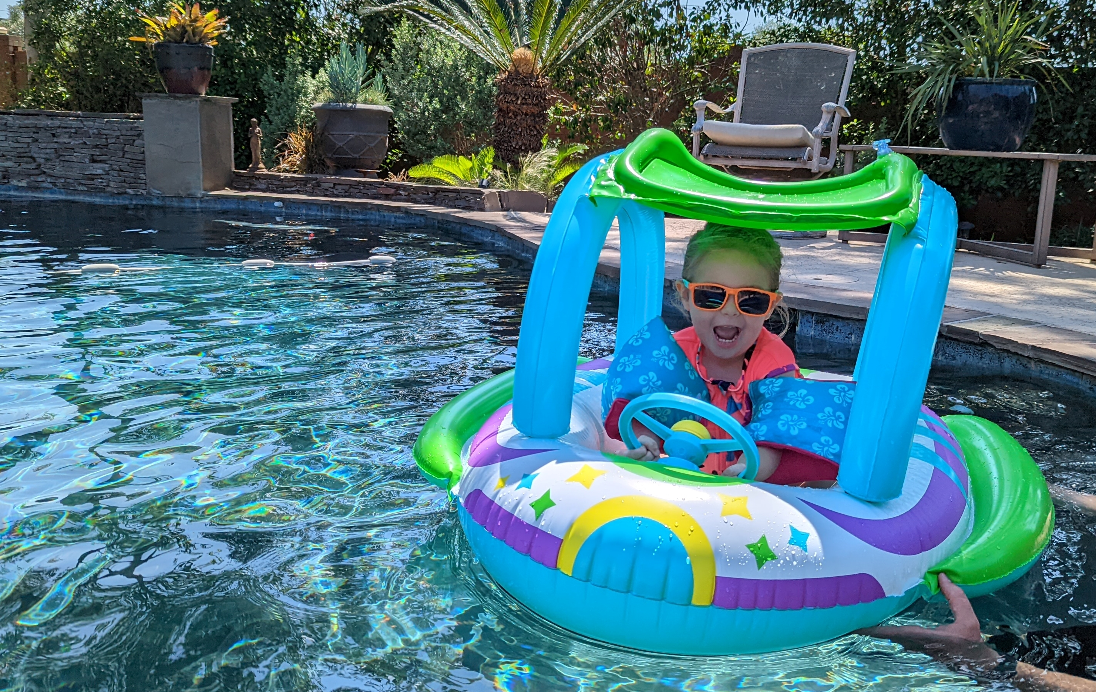
Find your purpose

Slide 20
Thank you
346-306-4159
Kayla.Elwood@fortbendcountytx.gov

