Slide 1
Overview of Children’s Mental Health and the Importance of Starting Early
Asim A. Shah ,
Executive Vice Chair and Professor of Psychiatry,
Baylor College of Medicine,
Chief of Psychiatry for Ben Taub Hospital/ Harris Health Systems.

Slide 2
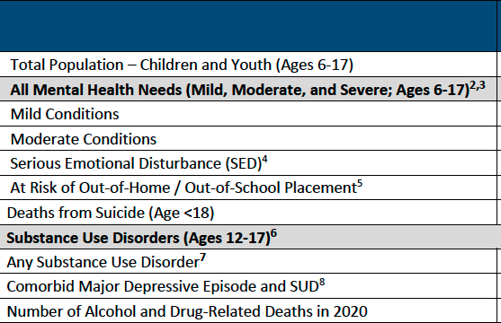
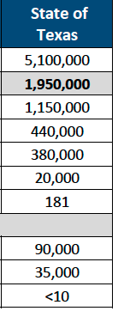
Twelve-Month Prevalence of Mental Health Disorders Among Children and Youth in Texas (2019)

Slide 3
Suicide
Suicide is the second leading cause of death for youth and young adults, and in the 12 years prior to the pandemic, the rate of death from suicide for youth increased over 55 percent.
The spike in need began early in the pandemic, the proportion of mental health-related emergency department (ED) visits increasing 31 percent among adolescents aged 12-17.

Slide 4
The rate of pediatric emergency room visits for suicide is now double pre-pandemic levels. Parents are also being affected by the burden of caregiving during the pandemic, and, as compared to non-parents, are more likely to suffer from depression and about 50 percent more likely to experience serious suicidal ideation, making them less able to care for their children in need.
Child abuse and covid..?

Slide 5
According to MHA’s March Data
Parent
76% of parent screens taken in March show a child at risk for emotional, attentional, or behavioral difficulties
Percentage represents a decrease from February data
Youth
79% of youth screened in March are at risk for emotional, attentional, or behavioral difficulties
Percentage shows a slight decrease from February data
What are the main things contributing to your mental health problems right now?
Loneliness/Isolation
Past Trauma
Relationship problems Note: Coronavirus ranked 7th out of eight contributing factors.

Slide 6
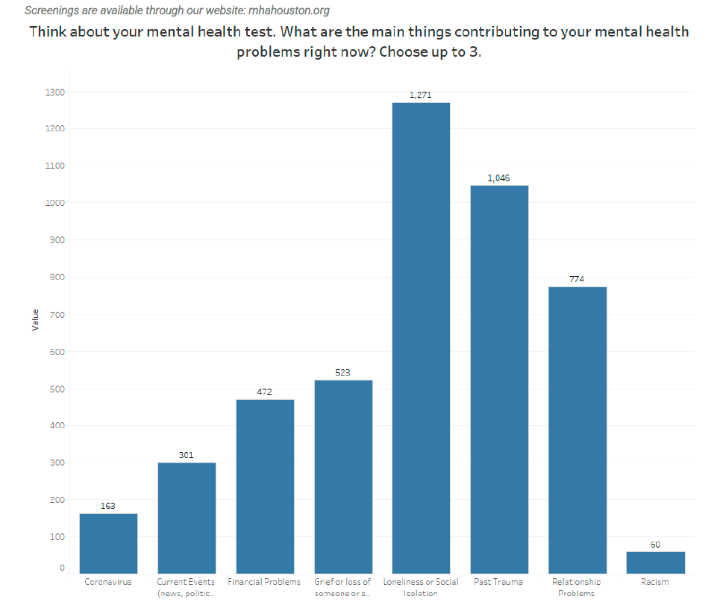
Greater Houston Data (Harris and Fort Bend County) March 2022 Results
Think about your mental health test. What are the main things contributing to your mental health
problems right now? Choose up to 3.
Coronavirus Current Events Financial Problems Grief or loss of Loneliness or Social Past Trauma Relationship Racism
(news, politics… someone or s.. Isolation Problems

Slide 7
Covid Orphans
World- wide 5.2 Million children are Covid Orphans
In USA we have over 214,000 children
Time to rethink our priorities….

