Slide 1
Resiliency in Children & Tips for Parents
Presenters: Dr. Profilet
May 24, 2022
12pm-1pm
Welcome!

Slide 2
Resiliency in Children
What it is
Why it’s important
5 Tips for Parents

Slide 3
What if Everything was Easy?
What if there was no adversity??
If there were no difficult situations…
“Most of the important things in the world have been accomplished by people who have kept on trying when there seemed to be no hope at all.” – Dale Carnegie

Slide 4
The Impact of Adversity
Use adversity to increase our resilience
“Strength doesn’t come from what you can do. Strength comes from overcoming the things you thought you couldn’t.” – Unknown

Slide 5
Children Developing Resilience
We all face adversity
What are some obstacles that children face??
Some children develop resilience while others do not
Notes:
What are some obstacles that children face??
bullying, getting sick, moving to a new neighborhood, lose friends, deal with divorce, death of a loved one, growing up in poverty, having a parent with a physical or mental illness, being exposed to violence…
All children encounter stress in varying degrees as they grow.
Parents can’t protect children for everything.

Slide 6
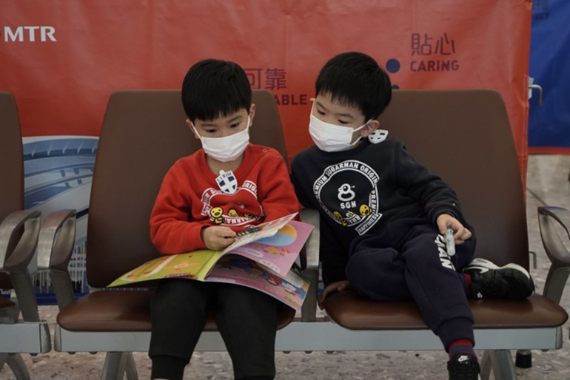
What is Resilience
Resilience – ability to steer through serious life challenges and find ways to rise above adversity
Adapt
Remain strong
Bounce back
Notes:
Resilience helps children navigate through stressful situations.
We want children to persevere when there are problems and to bounce back from adversity.
When children have the skills and confidence to confront and work through their problems, they learn they have what it takes to confront difficult issues.
The more they bounce back on their own, the more they internalize the message that they are strong and capable.

Slide 7
Video - In Brief: What is Resilience (2:23)
Notes:
So – resilience is built over time.
It’s in the interaction between the person and the environment – this means that when you face something difficult, such as losing your job or losing a loved one, you have to figure out how to deal with it.
Sometimes things are unexpected.

Slide 8
Children Need to Experience Manageable Stress
With the help of supportive adults
Positive stress can promote growth
Notes:
Learning to cope with manageable threats is critical for the development of resilience.
Not all stress is harmful.
There are lots of opportunities in every child’s life to experience manageable stress – and with the help of supportive adults, this positive stress can promote growth.
Over time, we become better able to cope with life’s obstacles and hardships, both physically and mentally.

Slide 9
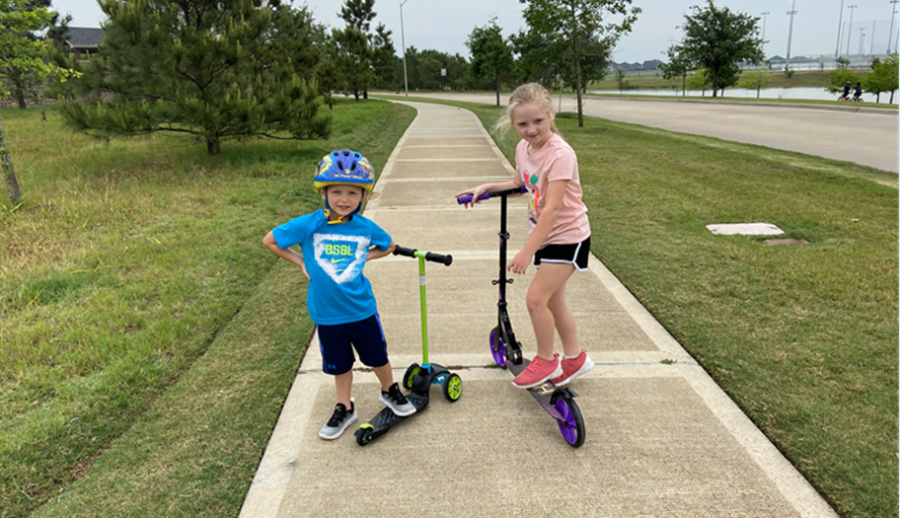
Children who are Resilient
When children are resilient,
they are:
Braver
More curious
More adaptable
Notes:
If you never face hard times, you will not learn to be brave.
You learn from adversity – how to problem solve and learn and children become more adaptable (quickly learning new skills and behaviors in response to changing circumstances).

Slide 10
In Brief: How Resilience is Built (2:17)

Slide 11
Protective Factors
Resilience – combination of protective factors
Protective factors – skills, resources, supports or coping strategies that help people deal with stressful events
Within children, families, schools and communities
Notes:
Neither individual (genetic or biological) characteristics or environments alone are likely to ensure positive outcomes for children who experience long term toxic stress.
It is never too late to build resilience.
Protective factors within the child:
Social skills – how to act in social situations
Communication skills – helps to talk to others and resolve conflicts
Positive attitude – optimistic
Confidence – comes from experiences of success

Slide 12
Single Most Common Factor to Develop Resilience
At least one stable and committed relationship with an adult
Notes:
It can be a parent, caregiver, or other adult.
These relationships provide the responsiveness, scaffolding, and protection that buffer children from developmental disruption.
They also build capacities in the child – the ability to plan, monitor, and regulate behavior – that help the child to respond in adaptive ways and thrive.

Slide 13
In Brief: The Science of Resilience (2:30)

Slide 14
Protective Factors within the Family
Harmony and stability
Supportive parenting
Family values
Affection
Consistent discipline
Notes:
Harmony – helping children get along with others and accepting differences of opinions.
Stability – consistency of family activity and routines – provides a sense of predictability in children’s lives.
Supportive parenting – have your child’s best interests at heart. Being present, helpful, and involved.
It includes encouraging them to do their best in school and hobbies.
Parents should listen without judgment.
Teach children stress management.
Family values – cultural values that pertain to the family’s beliefs, function, roles, and attitudes.
Affection – and warmth from parents to children results in life long positive outcomes.
Consistency – children crave predictability and structure.

Slide 15
Parenting to Build Resilience

Slide 16
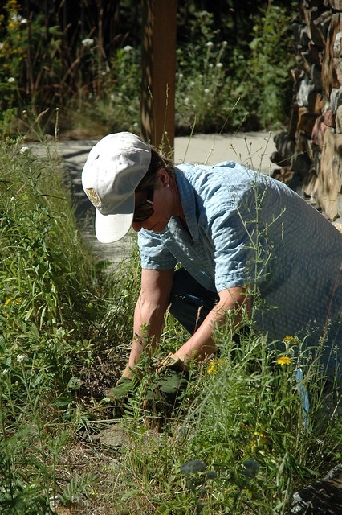
5 Strategies to Build Resilience
1. Have children do hard things
Problem solving when something is broken
Encourage learning from mistakes
Be honest – some things are hard but we still do them
Encourage risk-taking through play
Notes:
Children learn resilience from doing boring tasks or even being bored – they can become creative.

Slide 17
How Does Play Contribute to Resilience?
Emotional regulation (managing feelings)
Pleasure and enjoyment (feel good)
Responses to stress and uncertainty (making sense of things)
Notes:
Mr. Rogers “play give children a chance to practice what they are learning.”

Slide 18
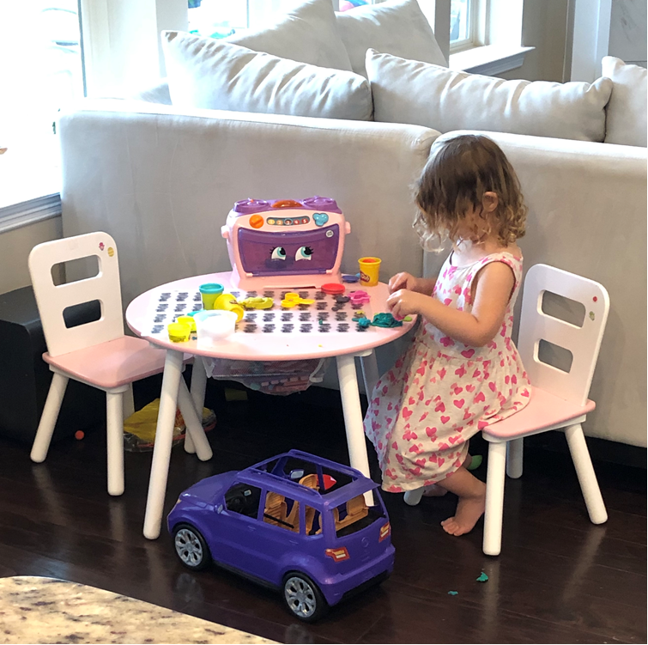
How Does Play Contribute to Resilience continued -
Being creative (using imagination)
Learning (develop life skills)
Attachment to people and place (with friends and family)
Problem solving (I can do this myself)
Notes:
Through play: children learn to problem solve – example – how to build with Legos or with blocks – how to build a tower without it falling.
Play helps children form relationships with peers and parents.

Slide 19
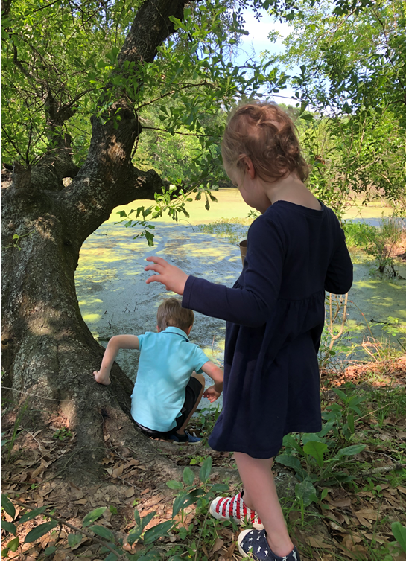
Taking Risks in Play
Taking risks in play gives children the chance to:
Test their own limits
Discover new skills

Slide 20
Model Resilience
2. Parents need to model resilience in their own lives
Handle situations
Connect to family and friends
Make good choices
Contribute to the community
Cope with stress effectively
Adapt to changing situations
Notes:
Children watch and notice what their parents do.
They often grow up to have similar behaviors, beliefs, and attitudes as their parents.
“Do as I say, not as I do” doesn’t work.

Slide 21
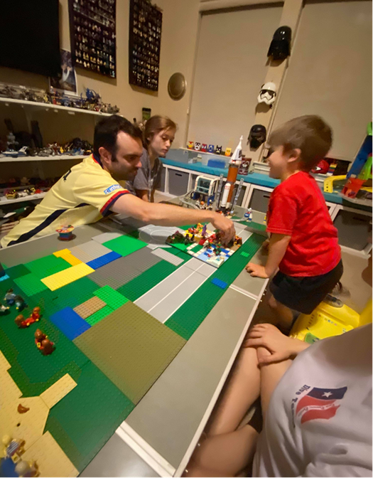
Family Time
3. Family time:
Turn off the news
Family game night
Movie night
Notes:
Take a walk
Take a bike ride
Go to a museum

Slide 22
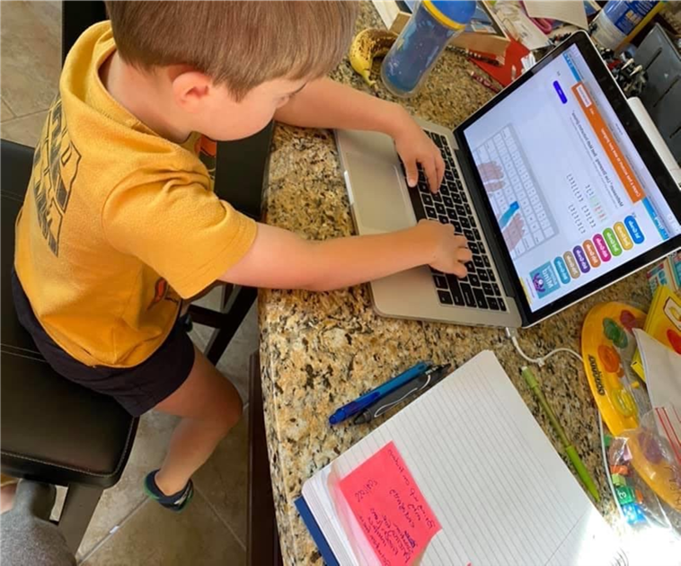
Routines
4. Routines
Make even your unpredictable days predictable
Predictability is essential for children and teens, especially in times of crisis

Slide 23
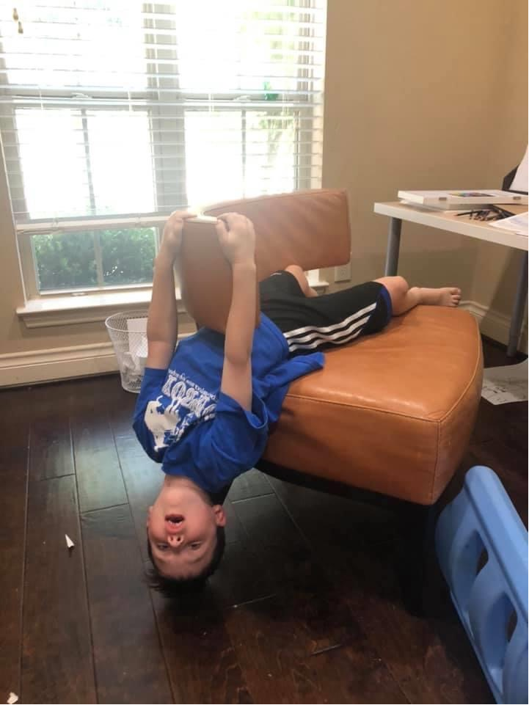
Teach Self-Regulation (calm yourself by yourself)
5. Teach self-regulation strategies
Practice calming strategies – 3 ways:
How does my body feel right now?
* Hungry? Tense? Tired?

Slide 24
2 More Questions for Self-Regulation
B. What strategy can I use to relax, calm down, or focus?
Deep breathing
Get a snack
C. How do I feel after using the strategy?
Calmer or More alert?

Slide 25
How to Help Children Learn Resilience Through Failure

Slide 26
The people who accomplish the most and achieve the greatest fulfillment in life are those who embrace fear, stress, and even pain

