Slide 1
The 3 T’s of Trauma: Trajectory, Treatment, and Trust
Staci Grant, PsyD
UT Health science center at Houston

Slide 2
Overview
Definition of Trauma
Trajectories of Traumatic Stress
Trauma-Focused Treatments

Slide 3
What is Trauma?

Slide 4
Posttraumatic Stress Disorder (PTSD)
Exposure to a traumatic event
Re-experiencing (1 or more)
Distressing dreams, memories, thoughts, physiological reactivity, intense psychological distress
Avoidance (3 of more)
Places, people, activities
Trauma-related thoughts and feelings
Increased arousal (2 or more)
Difficulty sleeping, irritability, trouble concentrating, hypervigilance, exaggerated startle
Symptom duration for more than 1 month
Causes clinically significant distress or impairment
(APA, 2013)

Slide 5
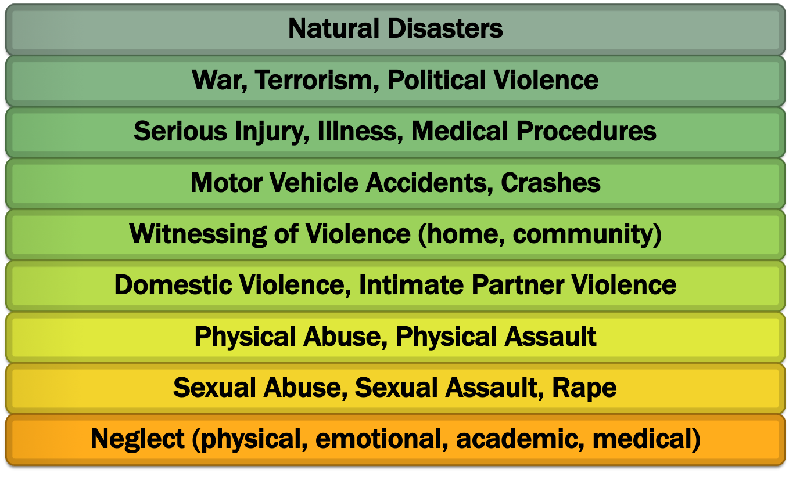
Potentially Traumatic Events

Slide 6
Trajectories of Traumatic Stress

Slide 7
Trajectories of Traumatic Stress
(Lai, Beaulieu, Ogokeh, Tiwari, Self-Brown, 2016)
Notes:
Resistance trajectory (Layne et al., 2007), individuals never develop symptoms of disorder.
Resilience trajectory, is characterized by initial symptoms followed by recovery. Improvement to levels that indicate absence of psychological symptoms. “Ability to maintain relatively stable, healthy levels of psychological … functioning” (Bonanno, 2005, p. 20) in the face of highly disruptive, threatening events.
Chronic distress trajectory, individuals who are initially symptomatic remain so over time.
delayed distress trajectory (Bonanno et al., 2007; Layne et al., 2007), is characterized by initial resistance that is lost and gives way to distress.

Slide 8
Impact of Trauma on Mental Health
Prolonged, sustained distress and impairment
Acute trauma reactions
Resilience

Slide 9
Impact of Trauma on Mental Health
Affect
Behavior
Biology
Cognitive
Social
School

Slide 10
Impact of Trauma on Mental Health
Comorbidity: Over 80% of persons with PTSD suffer from other psychiatric disorders.
Major Depressive Disorder
Alcohol/Substance Use Disorders
Panic Disorder
Suicidality
Functional Impairment: Many also experience marital, occupational, financial, and health problems.

Slide 11
Impact of Trauma on Youth
Abuse and victimization in childhood correlated with:
Trauma and Stressor-Related disorders
PTSD, Acute Stress Disorder
Anxiety disorders
Social Phobia, Generalized Anxiety Disorder
Depressive disorders
Substance use/abuse/dependence
Delinquency and criminal behavior
Violent behavior
Peer aggression, dating violence, spouse/partner violence
Notes:
Other problems (future victimization, self-esteem, guilt, shame, self-blame, relationship difficulties, academic performance, occupational achievement, neurobiological development)
Comorbid problems

Slide 12
Impact of Trauma on Youth
Notes:
Finkelhor, Turner, Ormrod, & Hamby, 2009
Finkelhor, D. Turner, H.A., Shattuck, A., & Hamby, S.L. (2013). Violence, crime, and abuse exposure in a national sample of children and youth: An Update. JAMA Pediatrics, 167(7), 614-621.

Slide 13
Trauma Symptoms by Age
Early Childhood
Become more fearful in new situations
School-Age
Intrusive thoughts linked to original threat
Adolescence
Embarrassed by responses to trauma reminders
Strong startle reactions, aggressive outburst, regression in milestones due to trauma reminders
Poor development of emotional regulation skills
Shift between withdrawn and aggressive behavior
Poor emotion regulation
Poorer social adjustment and fewer friends
Increased risky behavior (e.g., substance use, sexual)
Poor school performance and occupational achievement

Slide 14
Trauma Symptoms by Age
Early Childhood
Impacts brain development that governs emotion
School-Age
Lessened ability to manage fears, anxieties, and aggression
Adolescence
Difficulty appraising danger/safety
Can effect IQ and use of thinking to regulate emotions
Difficulty with sustaining attention for learning
Problems with impulse control
Poor understanding of consequences of behavior
Difficulty with abstract thinking for learning and problem solving
Notes:
**Trauma vs ADHD – look closely at behavior, consider creating a timeline
Children who present with PTSD-related symptoms often have persistent thoughts and feelings related to fear, safety, and loss.
Children with ADHD often have thoughts and feelings related to motivation, such as feeling overwhelmed by tasks and thus not wanting even to get started

Slide 15
PTSD and Young Children
Young children can, and do, develop PTSD following trauma exposure
“Classic triad” is apparent
Harder to “see” in preverbal children
Greater focus on behavioral observations (more nightmares, traumatic play)
DC 0-3: Includes items more developmentally sensitive to the age group (e.g., new separation anxiety, new fears unrelated to trauma, loss of previously acquired skills)
Notes:
Scheeringa, Peebles, Cook, & Zeanah, 2001; Scheeringa & Zeanah, 1995; Scheeringa, Zeanah, Drell, & Larrieu, 1995

Slide 16
Trauma-Focused Treatments

Slide 17
Trauma INFORMED vs Trauma SPECIFIC
Trauma Informed services incorporate knowledge about trauma in all aspects of service delivery
Police investigations
Legal proceedings
Child welfare
Physical exams
Mental health assessment

Slide 18
Trauma INFORMED vs Trauma SPECIFIC
Trauma Specific treatments are designed specifically to address trauma-related symptoms, such as:
Prolonged Exposure (PE)
Cognitive Processing Therapy (CPT)
Trauma Focused Cognitive Behavioral Therapy (TF-CBT)

Slide 19
Trauma-Focused Treatments
Some of the core components of trauma-focused interventions include:
Psychoeducation (trauma and its impact)
Directly addressing and processing traumatic experience as well as grief and loss (when appropriate)
Increasing individual’s sense of physical and psychological safety
Identifying triggers for trauma reactions
Developing emotional regulation skills (skills to control and express strong feelings)
Developing trauma-informed parenting skills
Focus is on symptoms improvement AND improving functioning, resiliency and developmental trajectory.

Slide 20
Trauma-Focused Treatments
Abuse-Focused Cognitive Behavioral Therapy (AF-CBT)
Child-Parent Psychotherapy (CPP)
Cognitive Behavioral Intervention for Trauma in Schools (CBITS)
Cognitive Processing Therapy (CPT)
Eye Movement Desensitization and Reprocessing (EMDR)
Multisystemic Therapy (MST)

Slide 21
Trauma-Focused Treatments
Parent Child Interaction Therapy (PCIT)
Project SafeCare
Seeking Safety
The Incredible Years (TIY) Series
Trauma-Focused Cognitive-Behavioral Therapy (TF-CBT)
Triple P – Positive Parenting Program
Notes:
Who can provide these treatments? a provider who has received adequate training, supervision, and consultation in the TF-CBT model as well as TF-CBT certification
Licensed therapist or psychologist

Slide 22
Trauma-Focused Treatments
Parent-Child Interaction Therapy (PCIT)
Evidence-based approach originally intended to treat disruptive behavior problems in children age 2.5 to 7 years
Targets caregiver-child relationship
Teaches parents skills to improve their relationship with their children (Child Directed Interaction)
Teaches positive parenting and appropriate and safe discipline skills (Parent Directed Interaction)
Short-term, but NOT time-limited
12 to 14 sessions on average
Notes:
Use PCIT when behavioral concerns are primary, and/or when parenting concerns are primary

Slide 23
Trauma-Focused Treatments
Trauma-Focused Cognitive-Behavioral Therapy (TF-CBT)
Evidence-based and evidence supported
Conjoint child and parent psychotherapy model
Effective with children age 3 to 18 years
Experiencing significant emotional and behavioral difficulties related to traumatic life events
Component-based treatment protocol
Time limited, structured approach
Usually completed within 12-20 sessions

Slide 24
Trauma-Focused Treatments
Very important to…
Identify trauma reminders
AKA Triggers
Person, place, thing, situation, internal state, song, smell, etc.
Internal or external
Recognizing connections between triggers and trauma responses is CRITICAL to effective treatment
Provide trust and support!

Slide 25
Referrals and Resources
Notes:
Attachment and Trauma Center of Houston
CAFB
Forensic Interviews
Forensic interviews are neutral, non-biased and aimed at eliciting facts from children in a developmentally appropriate manner.
Medical Exams
Coordinate medical exams. When necessary, child advocacy centers will ensure that children receive appropriate medical attention.
Multidisciplinary Team Case Reviews
Coordinate a multidisciplinary team for response to child abuse allegations
Therapy
Offer mental health services for victims and their families.
Court Preparation
Offer victim support and advocacy to clients throughout the investigation and legal proceedings. Conduct case tracking to monitor case progress.
Court Preparation
Offer victim support and advocacy to clients throughout the investigation and legal proceedings. Conduct case tracking to monitor case progress.

Slide 26
Where do I find information about EBTs for Trauma?
www.nctsn.org
http://www.nctsn.org/resources/topics/treatments-that-work/promising-practices
https://www.childwelfare.gov/pubs/guide2011/guide.pdf
http://www.cebc4cw.org/ (California evidence-based clearinghouse)

Slide 27
Questions?
Thank you!

Slide 28
References
American Psychiatric Association. (2013). Diagnostic and statistical manual of mental disorders (5th ed.). https://doi-org.ezproxy.frederick.edu/10.1176/appi.books.9780890425596
Finkelhor D, Turner H, Ormrod R, Hamby SL. Violence, abuse, and crime exposure in a national sample of children and youth. Pediatrics. 2009 Nov;124(5):1411-23. doi: 10.1542/peds.2009-0467. Epub 2009 Oct 5. PMID: 19805459.
Finkelhor, D. Turner, H.A., Shattuck, A., & Hamby, S.L. (2013). Violence, crime, and abuse exposure in a national sample of children and youth: An Update. JAMA Pediatrics, 167(7), 614-621.
Lai, B. S., Osborne, M. C., Lee, N., Self-Brown, S., Esnard, A. M., & Kelley, M. L. (2018). Trauma-informed schools: Child disaster exposure, community violence and somatic symptoms. Journal of affective disorders, 238, 586–592. https://doi.org/10.1016/j.jad.2018.05.062

Slide 29
References (Cont.)
Scheeringa, M. S., Peebles, C. D., Cook, C. A., & Zeanah, C. H. (2001). Toward establishing procedural, criterion, and discriminant validity for PTSD in early childhood. Journal of the American Academy of Child & Adolescent Psychiatry, 40(1), 52-60.
Scheeringa, M. S., & Zeanah, C. H. (1995). Symptom expression and trauma variables in children under 48 months of age. Infant mental health journal, 16(4), 259-270.
Scheeringa, M. S., Zeanah, C. H., Drell, M. J., & Larrieu, J. A. (1995). Two approaches to the diagnosis of posttraumatic stress disorder in infancy and early childhood. Journal of the American Academy of Child & Adolescent Psychiatry, 34(2), 191-200.

