Slide 1
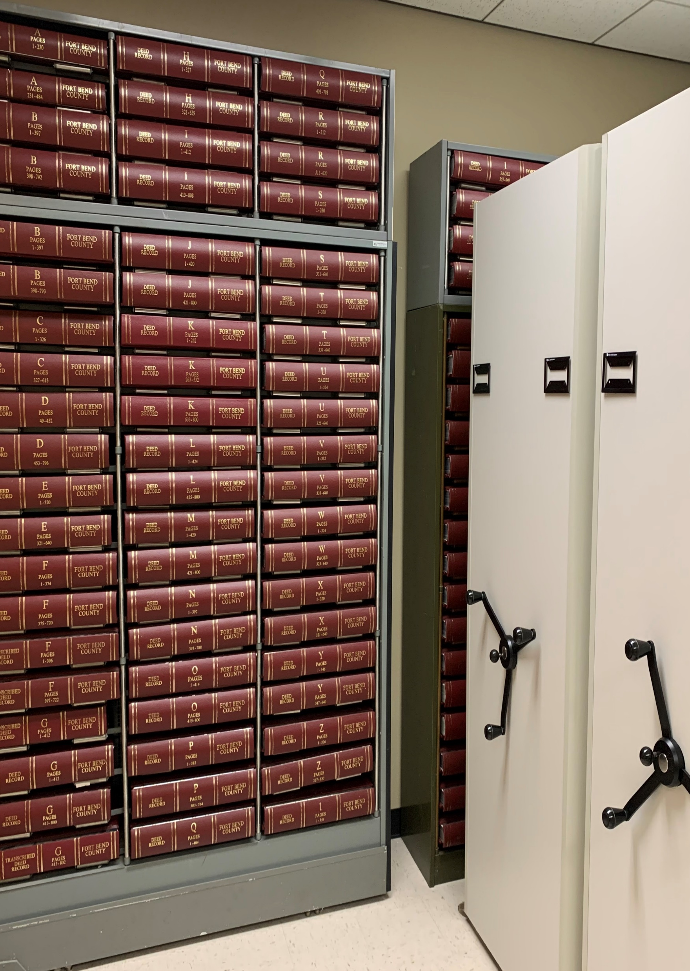
Fort Bend County Clerk Annual Report
Laura Richard
7/2023

Slide 2
County Clerk Increased Revenue for the County
County Clerk’s Office Revenue collection for FY 2022 - $9.5M.
Recovered revenue from past due fines to date over $350,000+.
Under budget every year of tenure.

Slide 3
County Clerk Increased Customer Satisfaction
Expedited services offered for Vital Records with dedicated staff to fulfill orders.
Property Fraud Alert, a free service that monitors documents recorded in public record by individual’s names with over 13,000 members and growing.
Keeping the public informed through social media of County Clerk services and important public information.

Slide 4
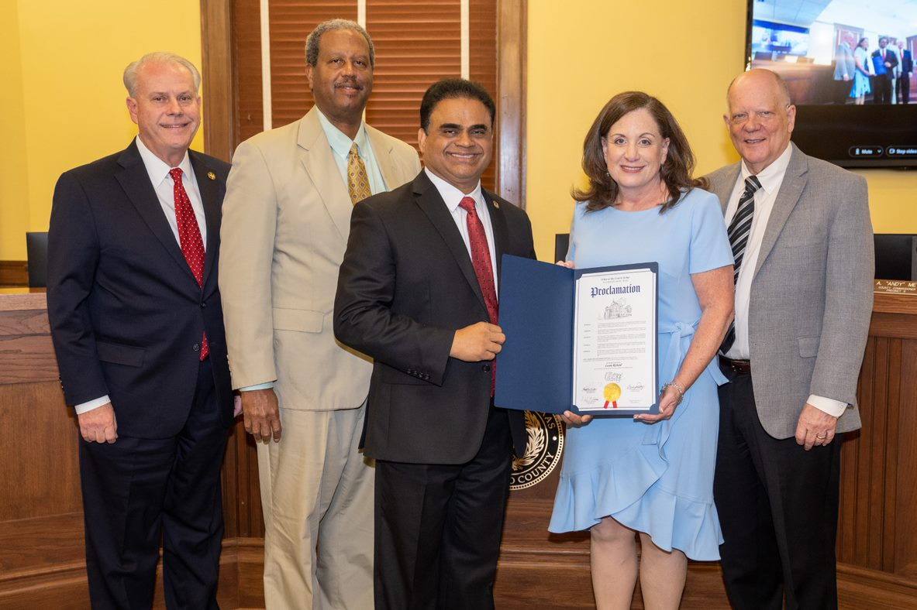
County Clerk Awards & Accolades
Awarded Public Official of the Year for 2023 from the University of Houston Master of Public Administration (MPA) program.
Awarded Exemplary 5 Star Registrar from State of Texas VSU in 2022.
Awarded State’s highest 5 Star Award every year of tenure.
Recognized as an Honoree from the National Association for Diversity Empowerment (NADE) during their Women’s History Month.
Received the Certificate of Special Congressional Recognition from Congressman Troy Nehls in honor of the Public Official of the Year Award.

Slide 5
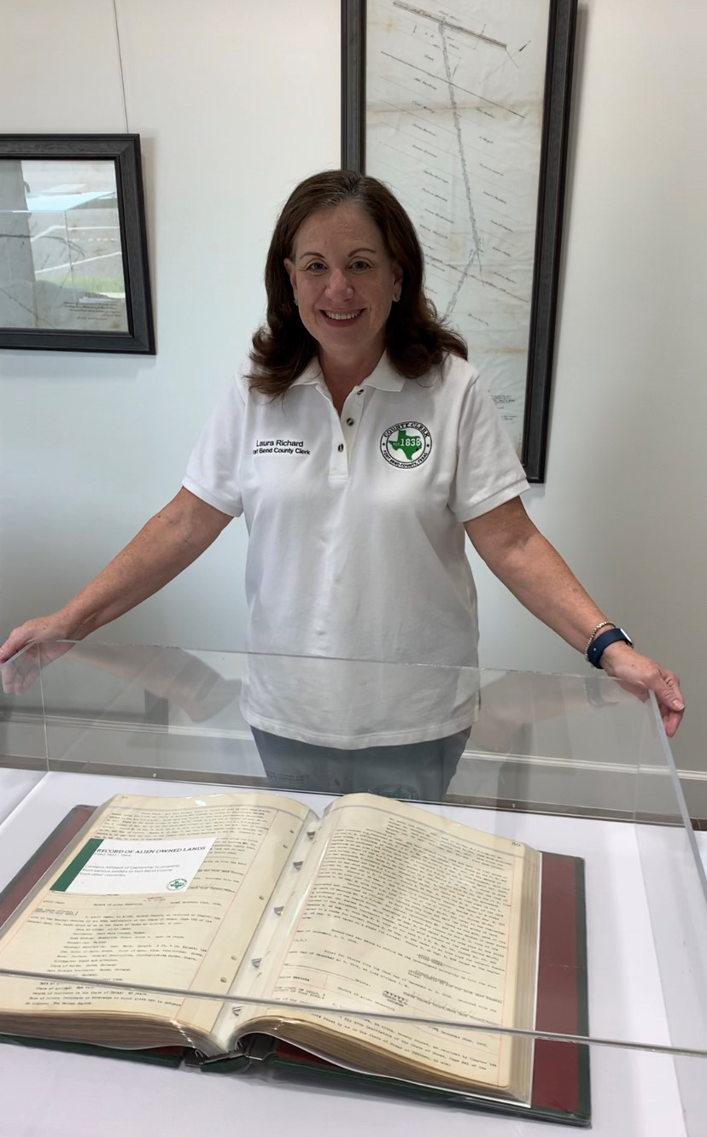
Preserving Fort Bend County History
Completed imaging project of historic Probate Records.
Exhibited a collection of documents from local historical figures in County Clerk records including bonds, deeds, and marriage licenses at the Fort Bend Museum.

Slide 6
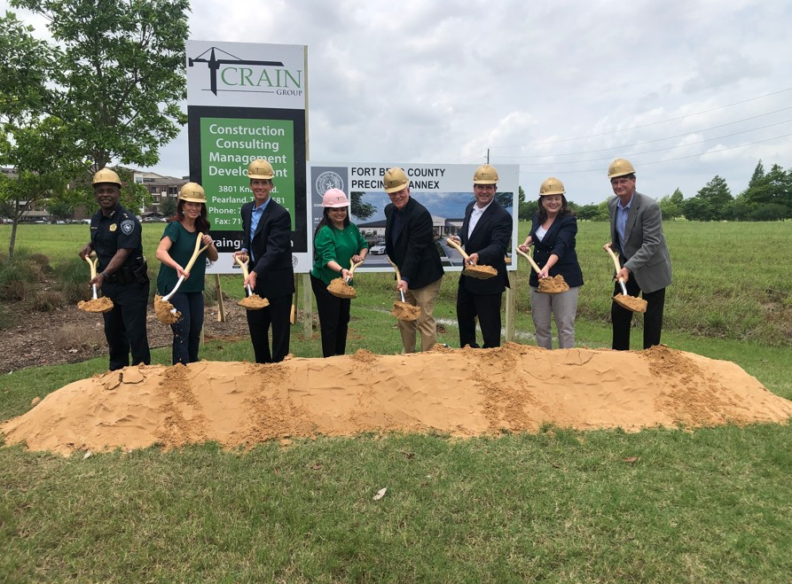
What’s Next for the County Clerk’s Office
More Than Words, Thank a Veteran program – an ID card issued at recording of veteran’s DD214 that entitles bearer to discounts from participating merchants.
Records Express, mobile satellite office – bringing County Clerk services to outlying areas of the county and saving residents from traveling long distances to county offices.
Launching Online Tutorials, providing step by step instructions on County Clerk services including online record search and online ordering of court, property, and personal records.
Broke ground on fourth annex office located in Sugar Land, beside Constellation Stadium with projected opening summer 2024.
Back to School Event for issuing birth certificates with new Saturday hours and multiple locations to be announced!

