Slide 1
Fort Bend County Lunch & Learn Series
Budget and Saving for Everyone
Presented by: Vikki McDonald
VP CRA Community Development Officer, Cadence Bank
Wednesday, September 14, 2022
12:15 – 12:45

Slide 2
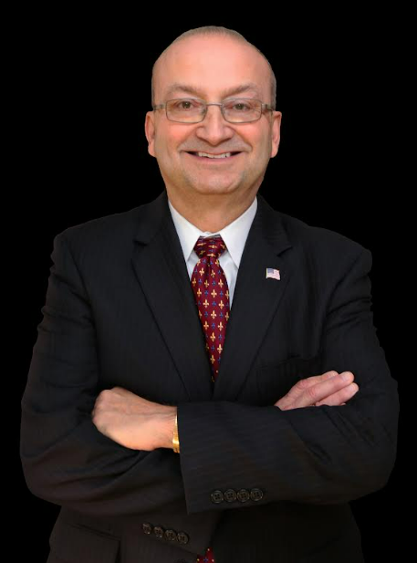
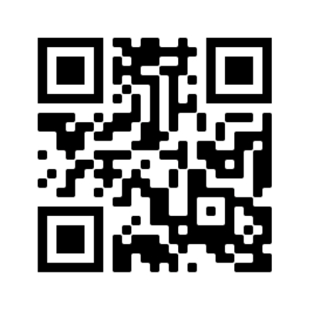
Hosted by: Bill Rickert, Fort Bend County Treasurer
Contact information:
Bill Rickert
Fort Bend County Treasurer
Email: treasurersoffice@fbctx.gov
Website: www.fbctx.gov/treasurer
Phone: 281-371-3750
QR Code:

Slide 3
Your Savings
Lunch & Learn Recorded Session
Link: https://cadencebank.zoom.us/rec/share/ifu5Sh3bctnBsUnozFZKpU7UfO7UW_Pif9VucPQRks5kCNJWDr8B0Hs4n-ryOcLR.8is2ikcF3tzt2LnT Passcode: 0^VK@V7v

Slide 4
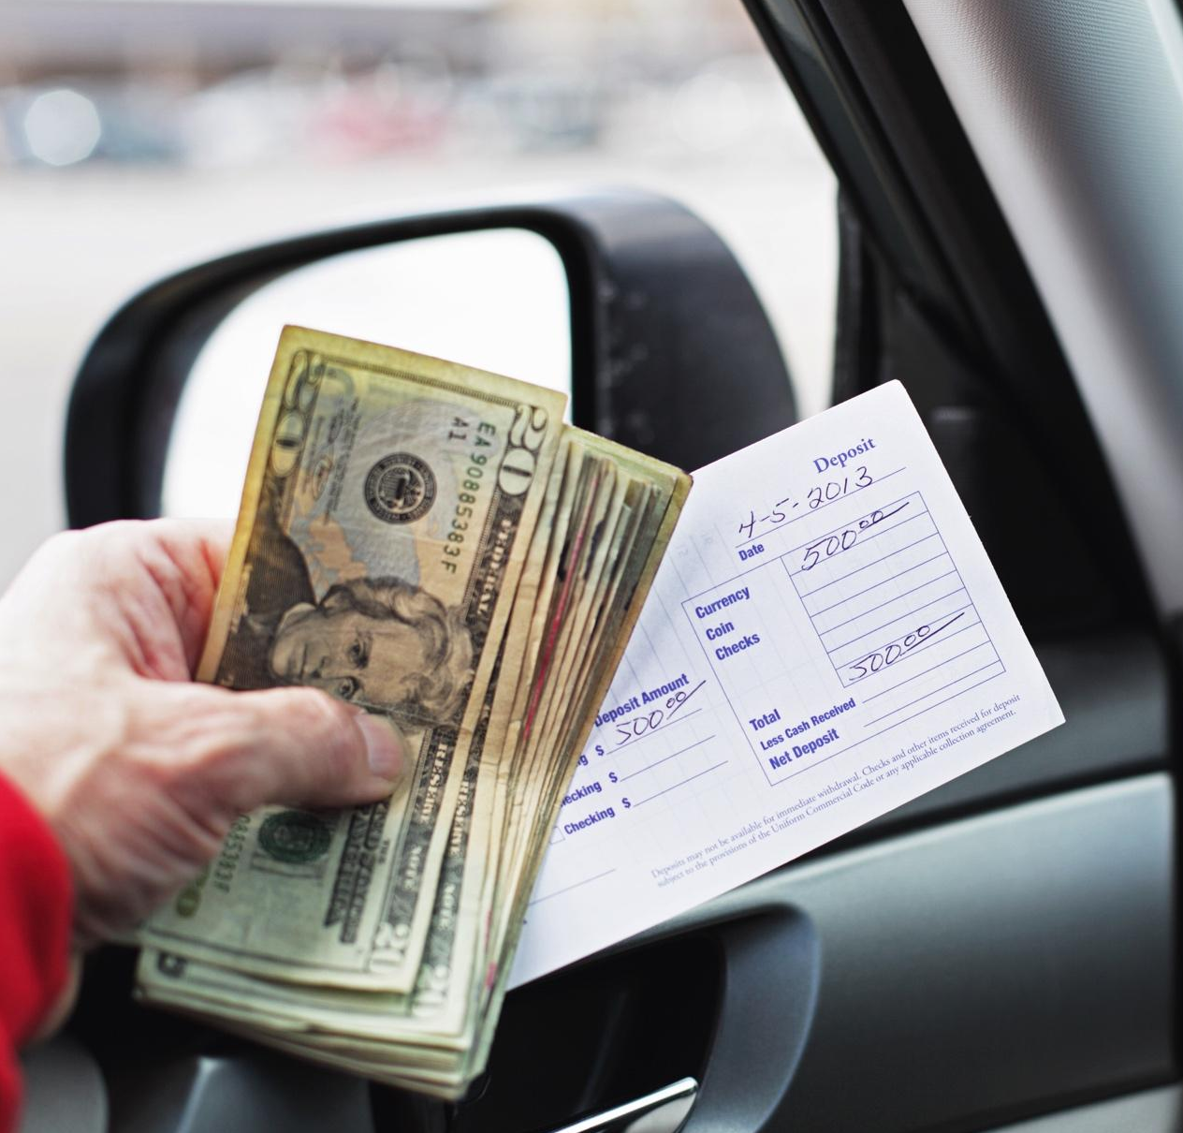
What is Savings?
Set aside some money every time you get income.
Regularly saving money, even if only a small amount, can make a big difference over time.

Slide 5
What does saving mean?
Is Spending Less Money the Same as Saving Money?
Only if you save what you didn’t spend
Saving is setting aside money today for the future
To build savings, Spend less money and put some or all of what you didn’t spend into savings

Slide 6
Why Save Money?
Goals
Build wealth
Emergencies
Times with less income or more expenses
Peace of mind
Get and keep a job
Buy a home
Plan for retirement
Other reasons

Slide 7
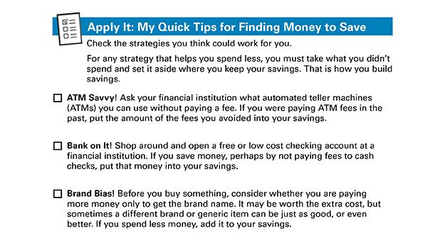
Quick Tips for finding money to save

Slide 8
Where to Build Your Savings
Consider the advantages and disadvantages of savings options before choosing where to build your savings:
Many options
Home
Friend or Family
Prepaid Cards
Rotating Savings or Credit Unions
Savings Account
Each one has advantages and disadvantages

Slide 9
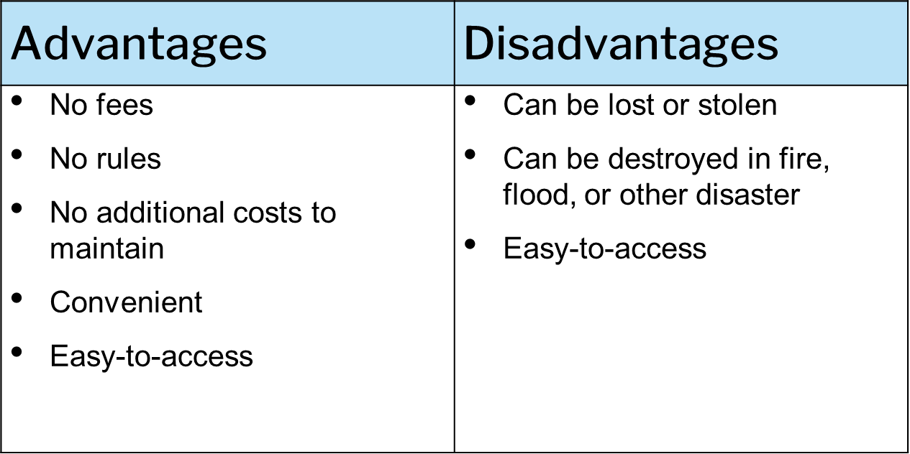
Home

Slide 10
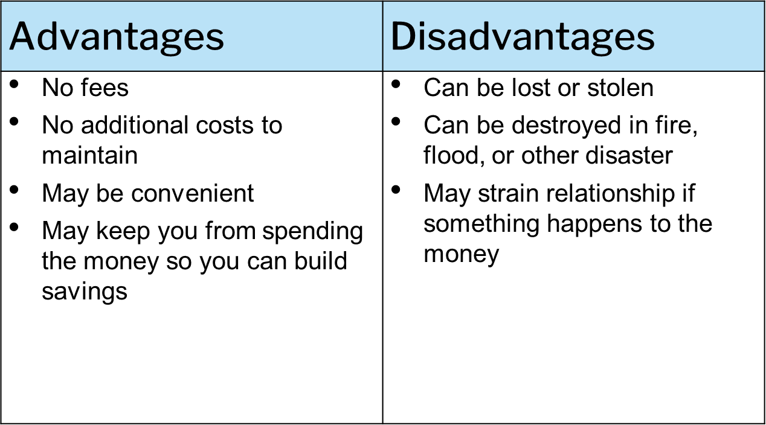
Friend or Family

Slide 11
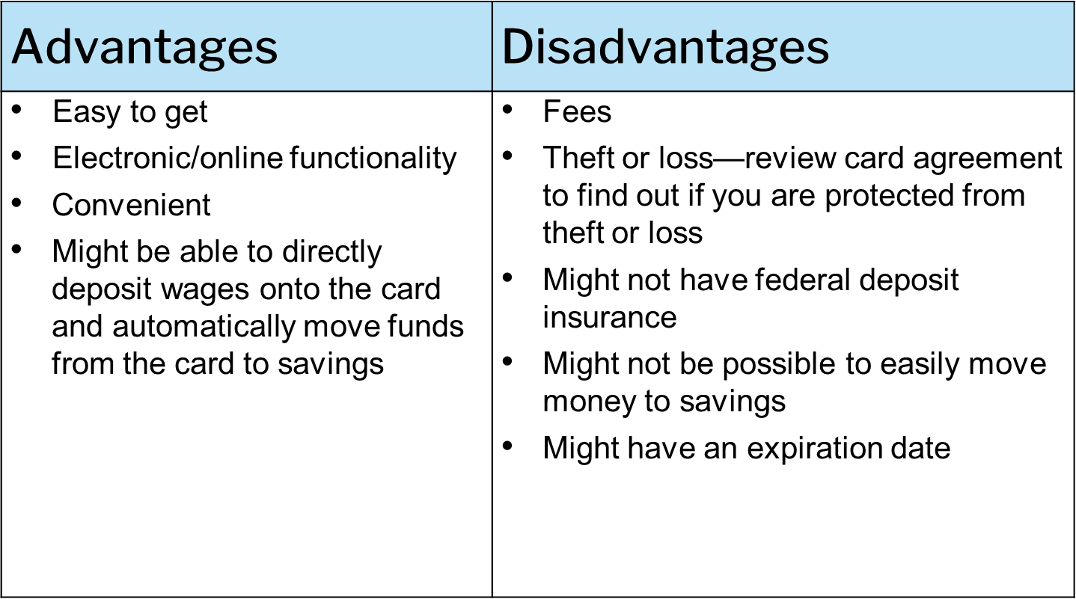
Prepaid Cards

Slide 12
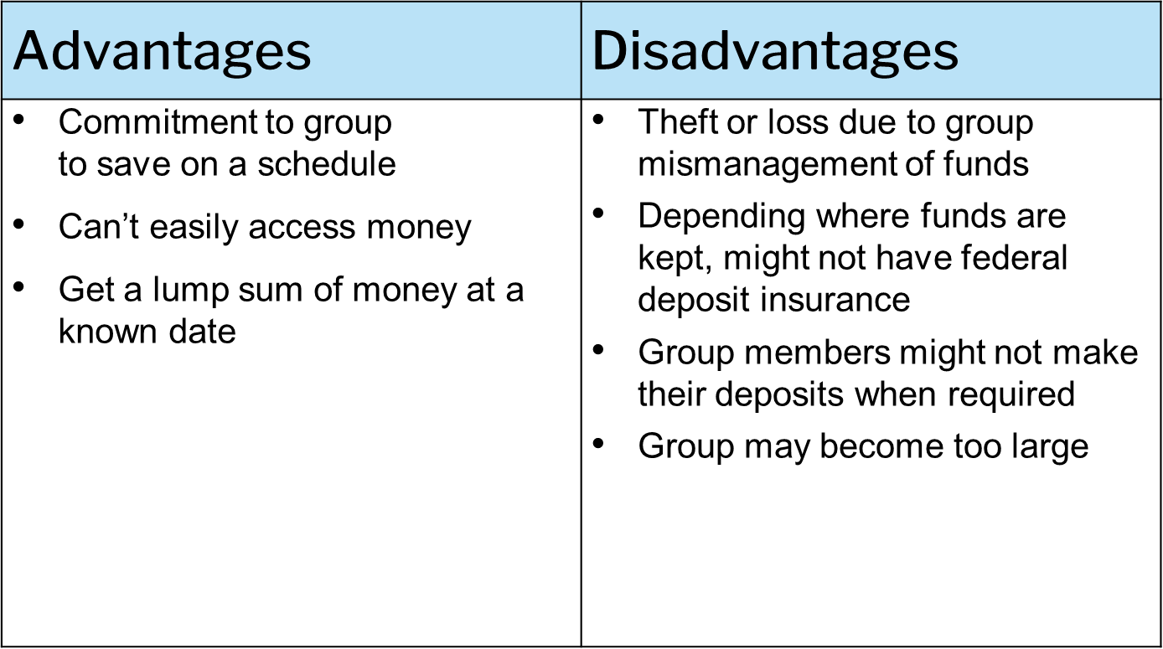
Rotating Savings & Credit Association

Slide 13
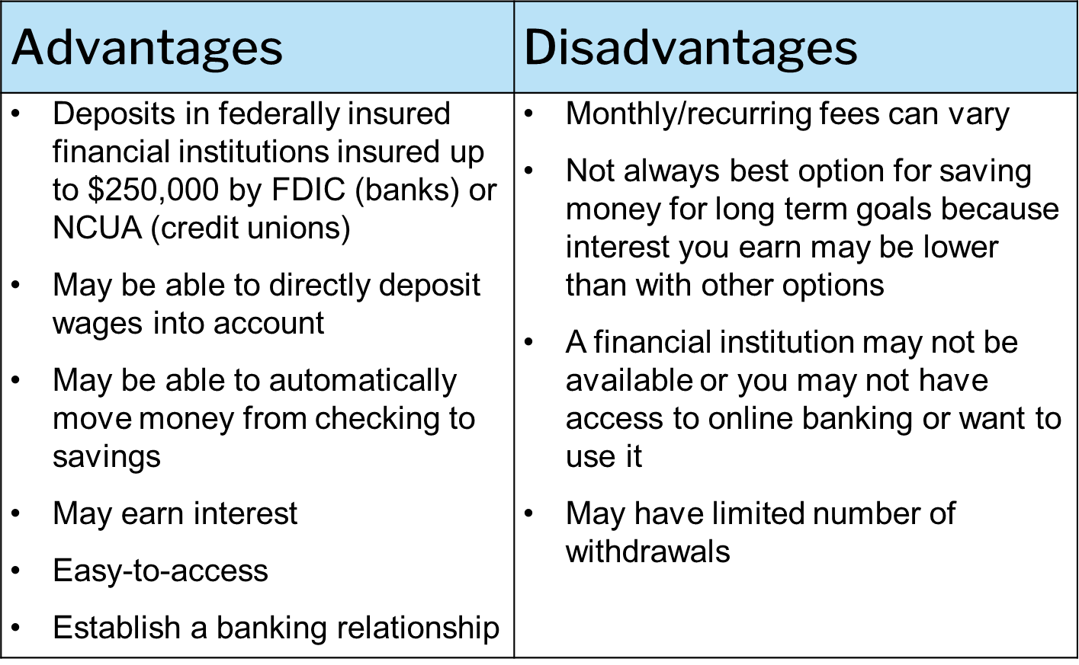
Savings Account

Slide 14
Other Places for Savings
Money market deposit accounts
Certificates of deposit (CDs)
U.S. savings bonds
Retirement accounts
From your employer
Individual Retirement Accounts (IRAs)
Investments, such as stocks, corporate bonds and mutual funds
Health Savings accounts

Slide 15
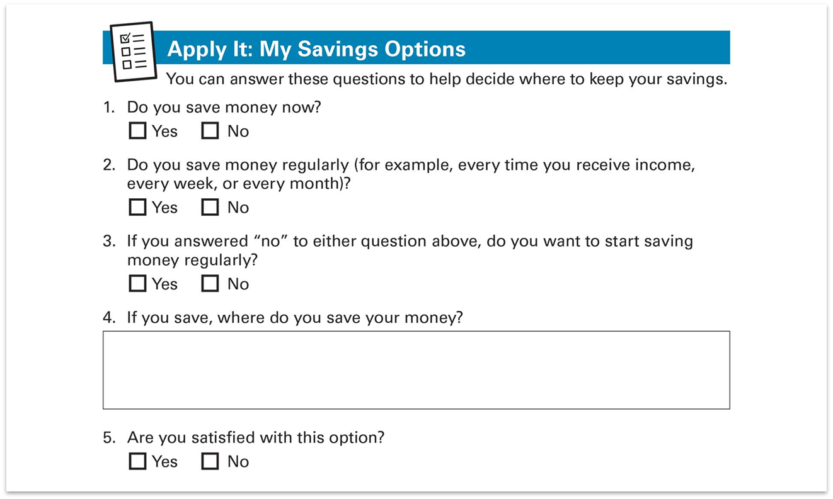
Apply It: My Savings Options

Slide 16
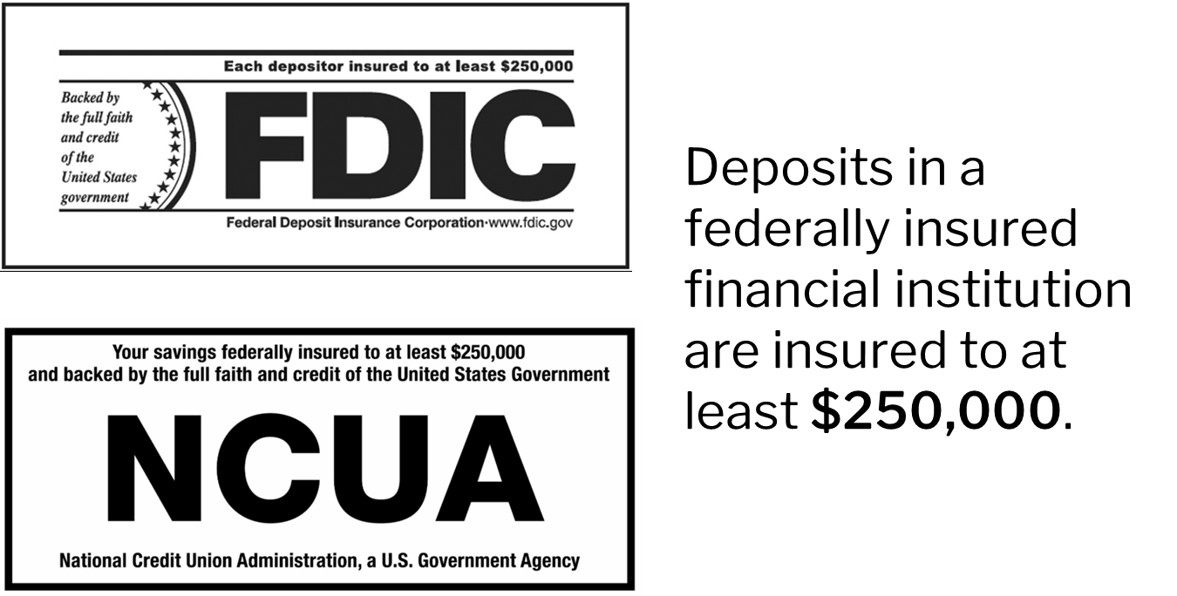
Understanding Deposit Insurance

Slide 17
Interest and Compounding
Interest: money financial institutions pay you for keeping money deposited with them and is expressed as a percentage
May need to pay income tax on interest
Compounding: earning interest on the interest

Slide 18
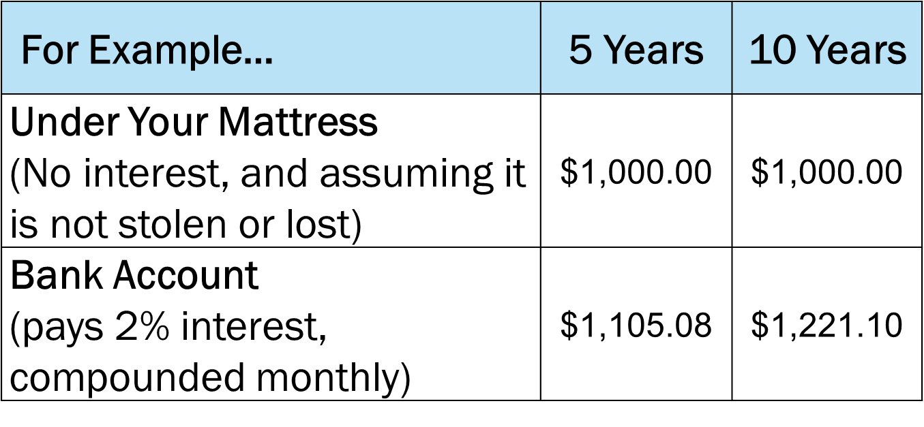
Mattress versus Bank Account

Slide 19
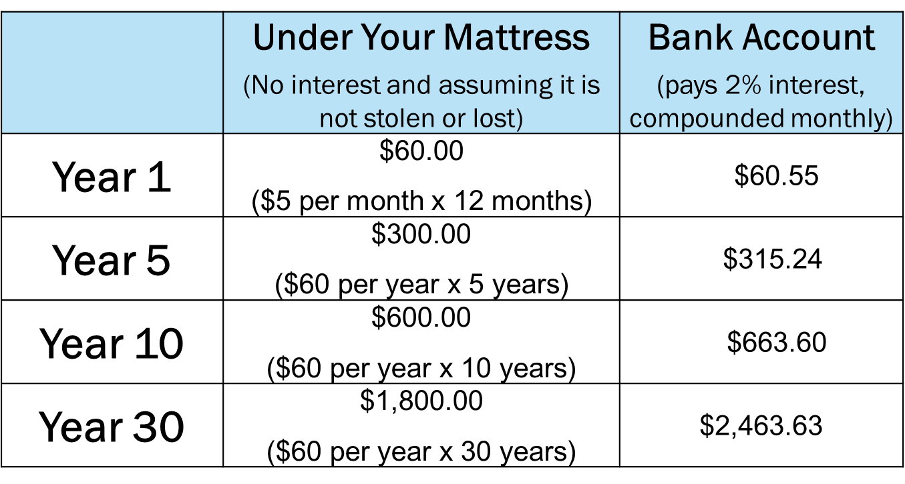
Interest combined with regular savings of $5.00 per month

Slide 20
Annual Percentage Yield (APY)
Reflects amount of interest on a yearly basis
Different from the interest rate
Includes the effects of compounding
The more often your money compounds:
The higher the APY
The more interest you earn
Compare APYs not interest rates

Slide 21
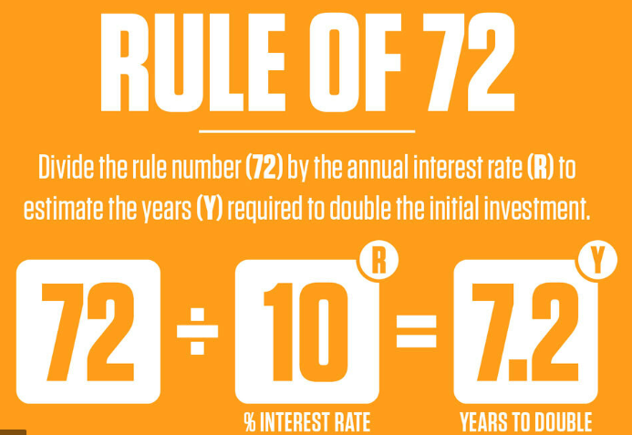
The Rule of 72
Formula that estimates how long it will take for money to double in value
Divide 72 by interest rate
Result is the estimated number of years to double the money, assuming:
No change in interest rate
No deposits or withdrawals

Slide 22
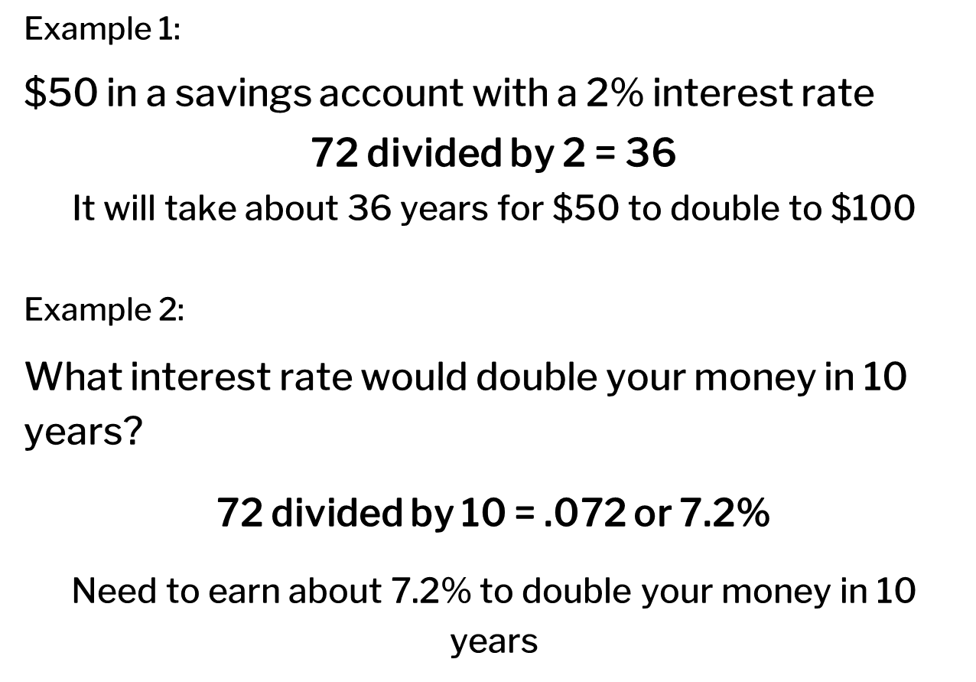
Rule of 72 Examples

Slide 23
Saving for the Unexpected Expenses
An emergency savings fund is part of the foundation of financial health. Setting aside $500 to $1,000 can cover many unexpected expenses.
Because life happens!
Because unexpected events occur!

Slide 24
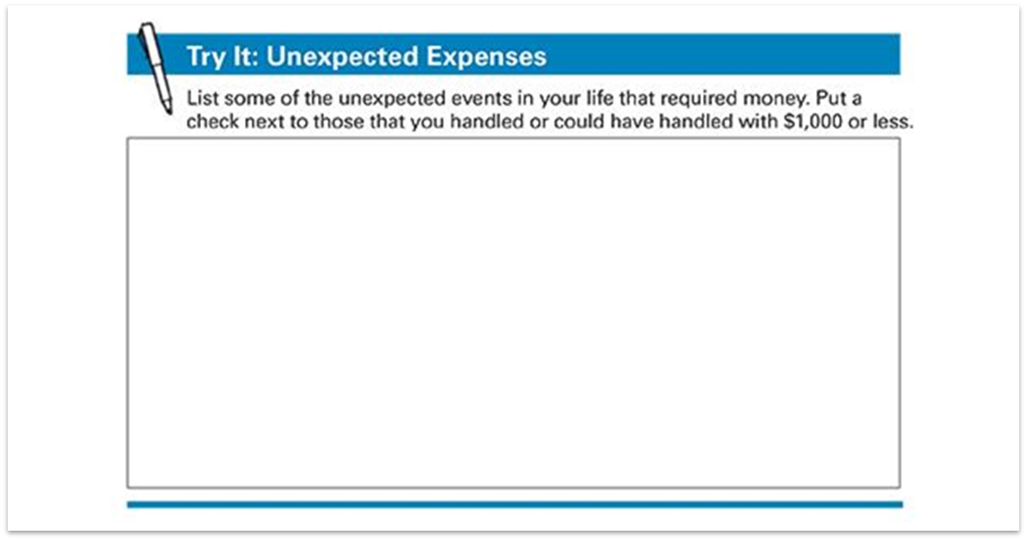
Try It: Unexpected Expenses

Slide 25
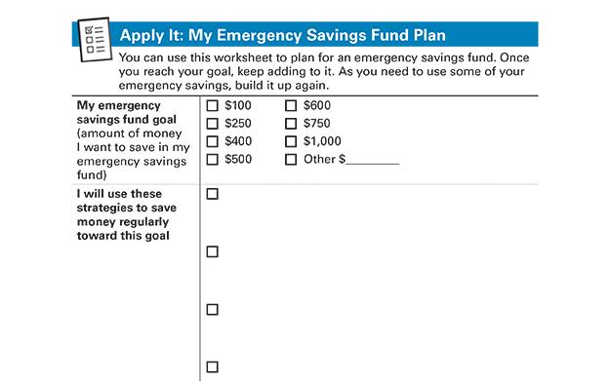
Emergency Savings Fund Goal
If you pay for unexpected expenses with money you have saved, you avoid creating debt. Takes time and commitment. It’s a cycle and still worth doing. Important step to improve financial health and stability

Slide 26
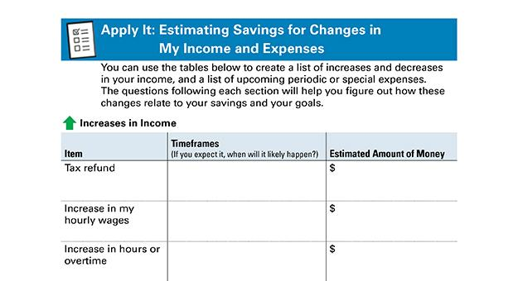
Anticipating Changes to Income & Expenses
Your income and expenses can change
You may have bills that arrive only once or a few times per year
Your spending can increase temporarily

Slide 27
Saving for Your Goals
Create a plan to save money for your goals.
What do you hope for or want in life for yourself?
What about for your family?
Smart Goals:
Specific
Measurable
Action-oriented
Reachable
Time-bound
"I will save $10 each month for six months, by getting cash at my bank's ATM rather than the ATM that charges fees, so that I have $60 for holiday gifts by November 1."

Slide 28
More Likely to Achieve Your Goals
Write them down
Post them
Share them
Focus
What are you saving for?
How much will it cost?
How much of that cost do you need to save?
What is your deadline?
Money Needed divided by Time to Save
For example: Emergency savings fund of $1,000 in 2 years
$1,000 ÷ 100 (50 weeks x 2 years) = Save $10/week
After 2 years you will have $1,040!

Slide 29
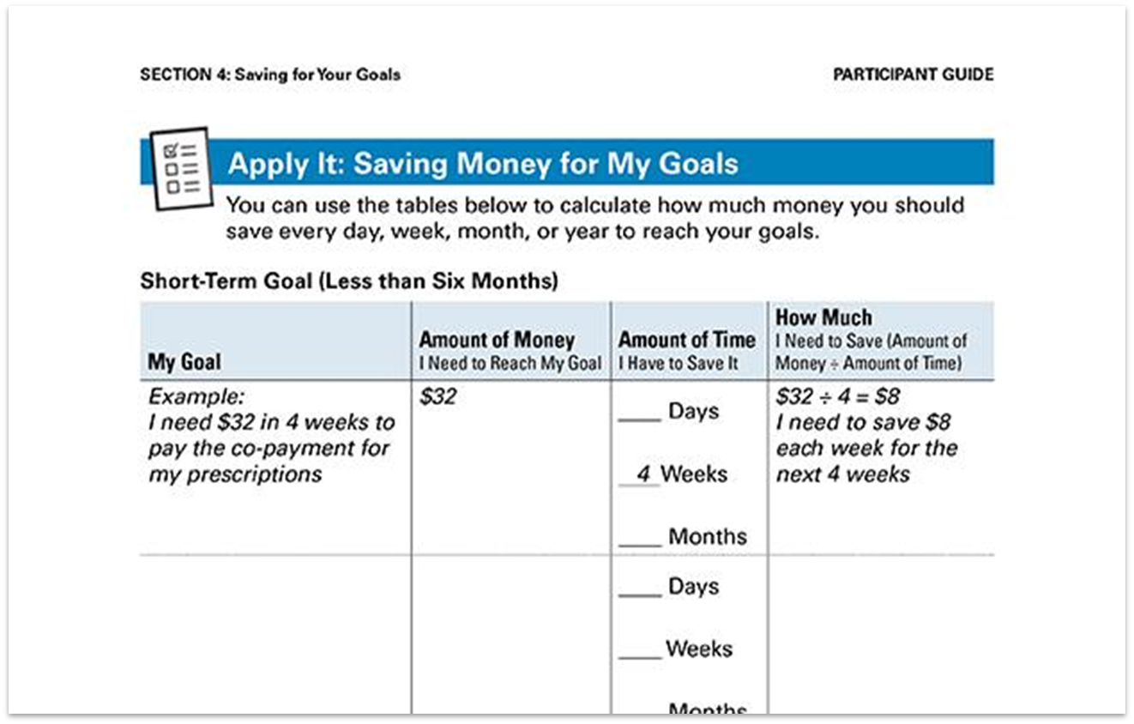
Apply It: Saving Money for My Goals

Slide 30
Large Expenses
Many goals are related to large expenses
Large expenses generally require more money than you have leftover after one or two paychecks

Slide 31
Savings & Public Benefits
Some public benefits may be reduced or removed when you exceed income or asset limits. However, some special accounts enable people to save more money without losing eligibility for their benefits.

Slide 32
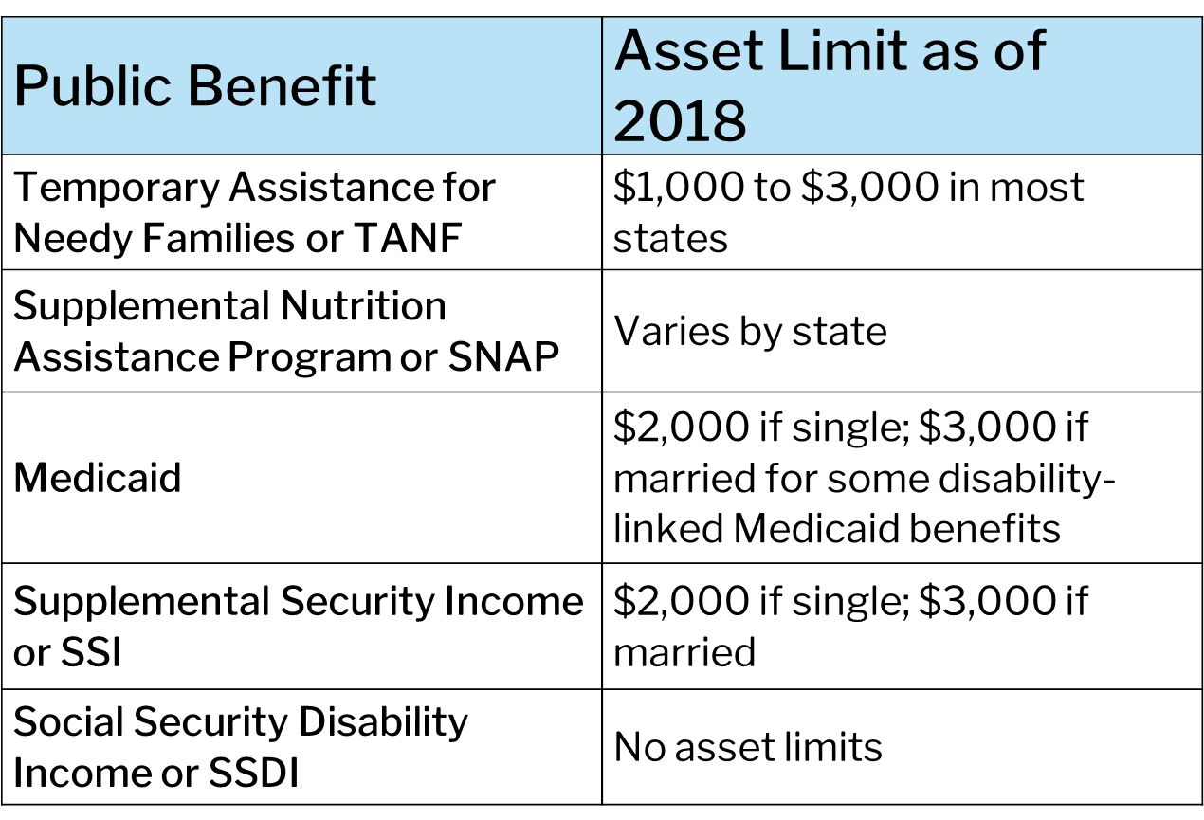
Assets and Income Limits

Slide 33
ABLE Accounts
Tax-advantaged savings accounts for individuals with disabilities
Blind or qualifying disability that began before 26th birthday; can be any age when account is opened
Save money without losing eligibility for Supplemental Security Income (SSI), Medicaid, or other federal means-tested public benefits
Anyone can contribute
Can only have one ABLE account
Total annual contributions limit set each year
Federal gift tax exclusion limit
Can be higher if account owner contributes earned income
Can include transfers from 529 accounts

Slide 34
ABLE Account Balance Limits
Up to $100,000: SSI cash benefit continues
Over $100,000: SSI eligibility retained but cash benefit suspended
Total account limit: set by sponsoring state
Shop around
Open ABLE account on state program website, not at a bank
Use money in ABLE account for “qualified disability expenses”
If used for anything else, withdrawal becomes taxable

Slide 35
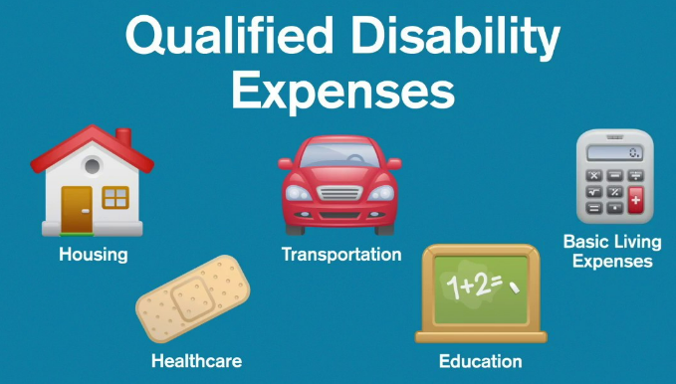
Qualified Disability Expenses
Education, Housing, Transportation
Employment training and support
Assistive technology, personal support services
Health care expenses
Financial management and administrative services
Other expenses which help improve health, independence, and/or quality of life

Slide 36
Special Needs Trusts
Special Needs Trust:
Designed to fund long-term expenses and needs of someone with a disability
Can be complicated; may need an attorney
Pooled Special Needs Trust:
Provides benefits of a special needs trust, but costs less
Single entity manages sub-accounts
Nonprofit corporation usually manages trust

Slide 37
Plan to Achieve Self Support
Set aside money for items or services needed to achieve a specific education or work goal
Objective: Employment (including self-employment) that reduces or eliminates the need for disability benefits
PASS Uses:
Supplies to start a business
School expenses
Equipment, tools, uniforms
Transportation
Other items or services needed to reach employment goals

Slide 38
Matched Savings Accounts
Encourage saving money for specific purpose
Usually run by local community-based organizations
Savings matched by organization running program
Individual Development Accounts (IDAs) and Children’s Savings Accounts (CSAs)
Allowable purposes may include:
Job training
College education
Small business start-up
Purchasing a home
May require financial education courses
May not count against benefits if federally funded or part of a PASS
Some public benefits may be reduced or removed when you exceed income or asset limits. However, some special accounts enable people to save more money without losing eligibility for their benefits.

Slide 39
Contact Information
Cadence Bank:
Sudha Menon, VP Retail Banking Fort Bend County
281-313-1783 sudha.menon@cadencebank.com
Kim Bonney, Branch Manager Sugar Land
DeJuan Edwards, Branch Manager Fulshear
Miranda Montoya, Branch Manager Cinco Ranch
Katrina King-Michalk, EVP Treasury Management
713-871-3916 katrina.Michalk@cadencebank.com
Melissa Silva, SVP Treasury Management
713-871-4129 melissa.silva@cadencebank.com
Vikki McDonald, VP Community Development
813-425-8215 vikki.mcdonald@cadencebank.com

Slide 40
Resources
FDIC Insurance Options:
https://www.fdic.gov/resources/deposit-insurance/brochures/documents/your-insured-deposits-english.pdf
Compounding Interest Calculator:
https://www.investor.gov/financial-tools-calculators/calculators/compound-interest-calculator

Slide 41
Who to Contact for help
Sandy Clark
America’s Financial Wellbeing Coach
Operation HOPE Inside Powered by Bancorp South
832-237-6747
Sandy.clark@operationhope.org
41

