Slide 1
Fort Bend County Lunch & Learn Series
Building Wealth
Presented by: Mary Katherine Franklin
Private Banking Executive
Cadence Bank
Wednesday, September 28, 2022
12:15 – 12:45

Slide 2
Hosted by: Bill Rickert, Fort Bend County Treasurer
Contact information:
Bill Rickert
Fort Bend County Treasurer
Email: treasurersoffice@fbctx.gov
Website: www.fbctx.gov/treasurer
Phone: 281-371-3750
QR Code:

Slide 3
Building Wealth
Lunch & Learn Recorded Session
Link: https://cadencebank.zoom.us/rec/share/lMpghFLvThobs8jPjYR-Gc-b0Ah_n8MeXcp7FjXWiJuLovNoFfl1cIBd6Vz7Uz9M.RhIaxdxdl9cx0BHr Passcode: aM2X=*eF

Slide 4
Defining Wealth
Some people consider themselves wealthy because they live in a very expensive house and travel around the world. Others believe they are wealthy simply because they’re able to pay their bills on time. What we are talking about here is financial wealth and what it means to you.
Building wealth requires having the right information, planning and making good choices. This workbook provides basic information and a systematic approach to building wealth. It is based on time-honored principles you probably have heard many times before—budget to save; save and invest; build credit and control debt; and protect the wealth you accumulate.

Slide 5
ASSETS – LIABILITIES = NET WORTH
A wealth-creating asset is a possession that generally increases in value or provides a return, such as:
• A savings account.
• A retirement plan.
• Stocks and bonds.
• A house.
Some possessions (like your car, household furnishings and clothes) are assets, but they aren’t wealth-creating assets because they don’t earn money or rise in value. A new car drops in value the second it’s driven off the lot. Your car is a tool that takes you to work, but it’s not a wealth-creating asset.
A liability, also called debt, is money you owe, such as:
• A home mortgage.
• Credit card balances.
• A car loan.
• Hospital and other medical bills.
• Student loans.

Slide 6
Home Equity
The market value of a home is an asset; the mortgage is a liability. Let’s say your house is worth $120,000, but your mortgage is $80,000. That means your equity in the home is $40,000. Equity contributes to your net worth.
Net worth is the difference between your assets (what you own) and your liabilities (what you owe). Your net worth is your wealth

Slide 7
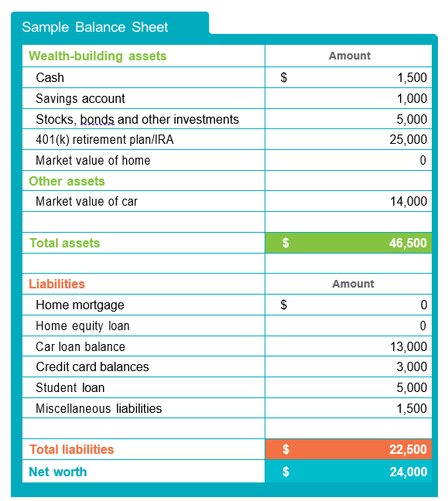
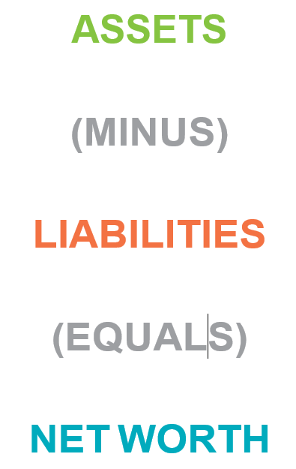
Balance Sheet

Slide 8
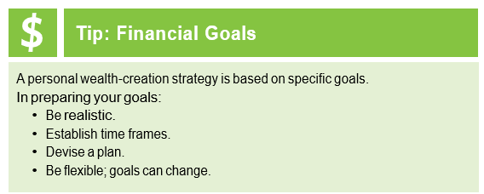
Set Financial Goals
Most people who have built wealth didn’t do so overnight. They got wealthy by setting goals and pushing themselves to reach them.
Set two short-term goals:
To save $3,000 a year for three years to have $9,000 for a down payment on a house
To add $500 to your emergency fund in one year
Also set two long- term goals:
To save and invest enough to have $25,000 in 15 years for your children’s college education
To have $5,000 a month to live on when he retires in 30 years

Slide 9
Develop a Budget
When it comes to reaching your financial goals, are you doing or wishing? The difference is doers put action to their goals. And doers are much more likely to reach their goals and achieve their dreams.
If you are a doer, you are more likely to:
• Track spending.
• Live within your means.
• Stick to a budget.
• Pay off credit cards in a timely way.
• Deposit money into savings each month.
• Make regular contributions to retirement savings.

Slide 10
Develop a Budget
A budget allows you to:
• Understand where your money goes.
• Avoid overspending.
• Find money for saving and investing to build your wealth.
To develop a budget, you need to:
• Calculate your monthly income.
• Track your daily expenses.
• Determine how much you spend on monthly bills.

Slide 11
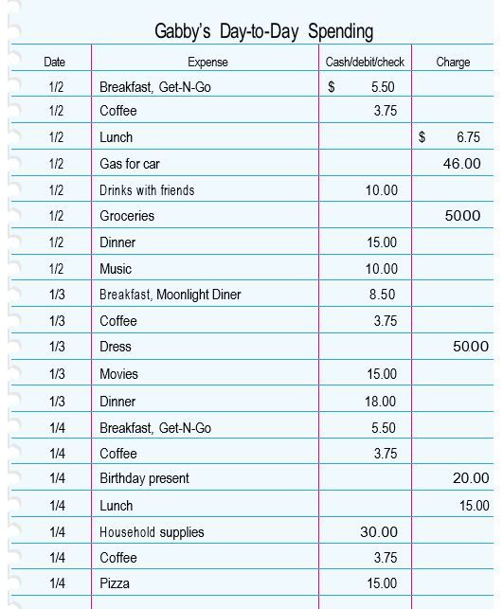
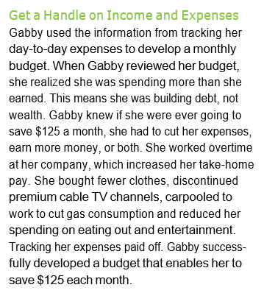
Track your daily spending

Slide 12
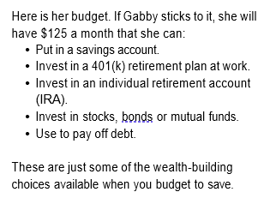
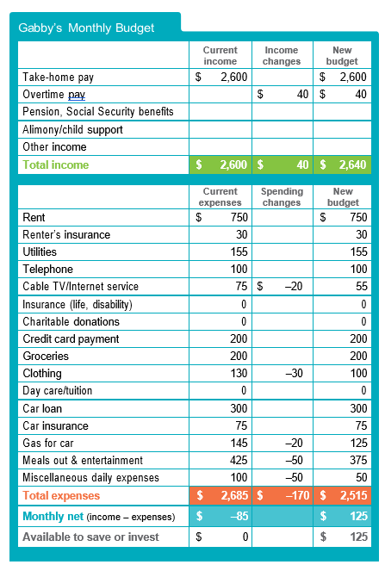
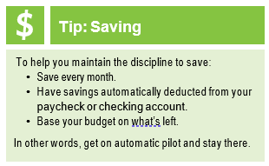
Gabby’s Budget

Slide 13
Save and Invest
You have budgeted and identified an amount to save monthly. Where are you going to put your savings?
By investing, you put the money you save to work making more money and increasing your wealth. An investment is anything you acquire for future income or benefit. Investments increase by generating income (interest or dividends) or by growing (appreciating) in value. Income earned from your investments and any appreciation in the value of your investments increase your wealth.
Get Guidance
There is an art to choosing ways to invest your savings. Good investments will make money; bad investments will cost money. Do your homework. Gather as much information as you can. Seek advice from licensed or registered advisers. States require licensing or registration for brokers, investment advisers and insurance salespeople, so check with your state securities regulator before trusting any investment adviser.

Slide 14
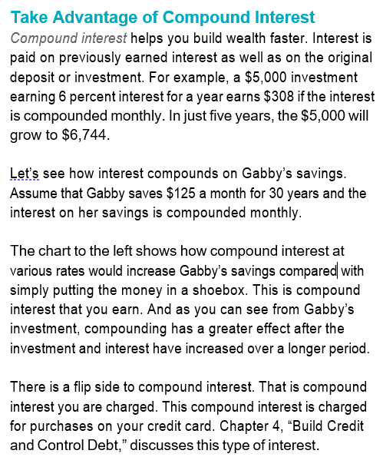
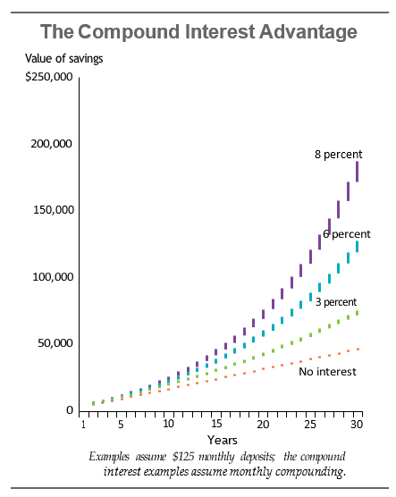
Compound Interest

Slide 15
Understand Risk & Return
When you are saving and investing, the amount of expected return is based on the amount of risk you take with your money. Generally, the higher the expected return, the higher the risk of losing money. For less risk, an investor will expect a smaller return.
For example, a savings account at a financial institution is fully insured by the Federal Deposit Insurance Corp. up to $250,000. The return—or interest paid on your savings—will generally be less than the expected return on other types of investments.
On the other hand, an investment in a stock is not insured. The money you invest may be lost or the value reduced if the investment doesn’t perform as expected.
After deciding how much risk you are able to take, you can use the investment pyramid to help balance your savings and investments. You should move up the pyramid only after you have built a strong foundation.

Slide 16
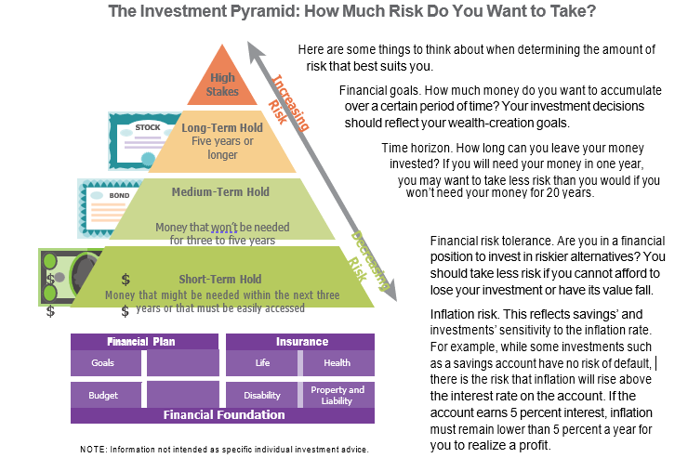
Financial Risk Tolerance

Slide 17
Tools for Saving
A good first step toward saving is to open a savings account at a bank or credit union. With a savings account, you can:
• Take advantage of compound interest, with no risk.
• Keep your money safer than in your pocket or at home.
• Take advantage of direct deposit of your paycheck.
• Monitor your balance online.
Financial institutions offer a variety of savings accounts, each of which pays a different interest rate. The box below describes the different accounts. Find the best one for your situation and compare interest rates and fees. You can choose to use these typical accounts to save for the near future or for years down the road.

Slide 18
Tools for Investing - Bonds
Once you have a good savings foundation, you may want to diversify your assets among different types of investments. Diversification can help smooth out potential ups and downs of your investment returns. Investing is not a get-rich-quick scheme. Smart investors take a long- term view, putting money into investments regularly and keeping it invested for five, 10, 15, 20 or more years.
Bonds—Lending Your Money
When you buy bonds, you are lending money to a federal or state agency, municipality or other issuer, such as a corporation. A bond is like an IOU. The issuer promises to pay a stated rate of interest during the life of the bond and repay the entire face value when the bond comes due or reaches maturity. The interest a bond pays is based primarily on the credit quality of the issuer and current interest rates. Firms like Moody’s Investor Service and Standard & Poor’s rate bonds.
With corporate bonds, the company’s bond rating is based on its financial picture. The rating for municipal bonds is based on the creditworthiness of the govern- mental or other public entity that issues it. Issuers with the greatest likelihood of paying back the money have the highest ratings, and their bonds will pay an investor a lower interest rate. Remember, the lower the risk, the lower the expected return.

Slide 19
Tools for Investing – Savings Bonds
A bond may be sold at face value (called par) or at a premium or discount. For example, when prevailing interest rates are lower than the bond’s stated rate, the selling price of the bond rises above its face value. It is sold at a premium. Conversely, when prevailing interest rates are higher than the bond’s stated rate, the selling price of the bond is discounted below face value. When bonds are purchased, they may be held to maturity or traded.
Savings bonds:
U.S. savings bonds are government- issued and government-backed. Unlike other investments, you can’t get back less than you put in. Savings bonds can be purchased in denominations ranging from $50 to $10,000.
There are different types of savings bonds, each with slightly different features and advantages. Series I bonds are indexed for inflation. The earnings rate on this type of bond combines a fixed rate of return with the annualized rate of inflation.
If you have paper U.S. savings bonds, you can register them online at TreasuryDirect, www.treasurydirect. gov. Then, you won’t have to worry about losing the paper copy.

Slide 20
Tools for Investing – Treasury notes
Treasury bills, bonds, notes and TIPS. The bonds the U.S. Treasury issues are sold to pay for an array of government activities and are backed by the full faith and credit of the federal government.
Treasury bills are short-term securities with maturities of three months, six months or one year. They are sold at a discount from their face value, and the difference between the cost and what you are paid at maturity is the interest you earn. Treasury bonds are securities with terms of more than 10 years. Interest is paid semiannually. Treasury notes are interest-bearing securities with maturities ranging from two to 10 years. Interest payments are made every six months. Treasury Inflation-Protected Securities (TIPS) offer investors a chance to buy a security that keeps pace with inflation. Interest is paid on the inflation-adjusted principal.
Bills, bonds and notes are sold in increments of $1,000.
These securities, along with U.S. savings bonds, can be purchased directly from the Treasury through Treasury- Direct at www.treasurydirect.gov.

Slide 21
Tools for Investing - Stocks
When you buy common stock, you become a part owner of the company and are known as a stockholder, or shareholder. Stockholders can make money in two ways—receiving dividend payments and selling stock that has appreciated. A dividend is an income distribution by a corporation to its shareholders, usually made quarterly. Stock appreciation is an increase in the value of stock in the company, generally based on its ability to make money and pay a dividend. However, if the company doesn’t perform as expected, the stock’s value may go down.
There is no guarantee you will make money as a stockholder. In purchasing shares of stock, you take a risk on the company making a profit and paying a dividend or seeing the value of its stock go up. Before investing in a company, learn about its past financial performance, management, products and how the stock has been valued in the past. Learn what the experts say about the company and the relationship of its financial performance and stock price.
Successful investors are well informed.

Slide 22
Tools for Investing – Mutual Funds
Mutual Funds—Investing in Many Companies Mutual funds are established to invest many people’s money in many firms. When you buy mutual fund shares, you become a shareholder of a fund that has invested in many other companies. By diversifying, a mutual fund spreads risk across numerous companies rather than relying on just one to perform well. Mutual funds have varying degrees of risk. They also have costs associated with owning them, such as management fees, that will vary depending on the type of investments the fund makes.
Before investing in a mutual fund, learn about its past performance, the companies it invests in, how it is managed, and the fees investors are charged. Learn what the experts say about the fund and its competitors.
Stocks, bonds and mutual funds can be purchased through a full-service broker if you need investment advice, from a discount broker or even directly from some companies and mutual funds.

Slide 23
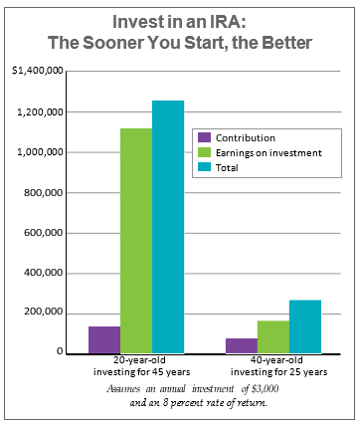
Invest for Retirement
Have you ever thought about how much money you will need when you retire? Will you save enough today to meet your future needs at prices higher than today’s due to inflation? Many people don’t save enough for retirement.
The chart on this page illustrates why it’s better to start saving and investing for retirement early in your career. A 20-year-old who begins investing $3,000 each year toward retirement will have a nest egg over $1.2 million at age 65 if that investment earns an average annual rate of return of 8 percent. If you wait until you are 40 to start investing, the results are much lower.

Slide 24
Invest for Retirement – IRA’s
An individual retirement account (IRA) lets you build wealth and retirement security. The money you invest in an IRA grows tax-free until you retire and are ready to withdraw it. You can open an IRA at a bank, brokerage firm, mutual fund or insurance company.
IRAs are subject to certain income limitations and other requirements you will need to learn more about, but here is an overview of what they offer, with the maximum tax-free annual contributions as of 2022.
You can contribute up to $6,000 a year to a traditional IRA, as long as you earn $6,000 a year or more. A married couple with only one person working outside the home may contribute a combined total of $12,000 to an IRA and a spousal IRA. Individuals 50 years of age or older may make an additional “catch-up” contribution of $1,000 a year, for a total annual contribution of $7,000. Money invested in an IRA is deductible from current-year taxes if you are not covered by a retirement plan where you work, and your income is below a certain limit.

Slide 25
Invest for Retirement – IRA’s
A traditional IRA is tax-deferred, meaning you don’t pay taxes on the money until it is withdrawn. All withdrawals are taxable, and there generally are penalties on money withdrawn before age 59½. However, you can make certain withdrawals without penalty, such as to pay for higher education, to purchase your first home, to cover certain unreimbursed medical expenses or to pay medical insurance premiums if you are out of work.
A Roth IRA is funded by after-tax earnings; you do not deduct the money you pay in from your current income. However, after age 59½ you can withdraw the principal and any interest or appreciated value tax-free.

Slide 26
Invest for Retirement – 401’s
Many companies offer a 401(k) plan for employees’ retirement. Participants authorize a certain percentage of their before-tax salary to be deducted from their paycheck and put into a 401(k). Many times, 401(k) funds are professionally managed, and employees have a choice of investments that vary in risk.
Employees are responsible for learning about the investment choices offered. By putting a percentage of your salary into a 401(k), you reduce the amount of pay subject to federal and state income tax. Tax-deferred contributions and earnings make up the best one-two punch in investing. In addition, your employer may match a portion of every dollar you invest in the 401(k), up to a certain percentage or dollar amount.
As long as the money remains in your 401(k), it’s tax- deferred. Withdrawals for any purpose are taxable, and withdrawals before age 59½ are subject to a penalty.
Take full advantage of the retirement savings programs your company offers—and understand thoroughly how they work. They are great ways to build wealth.

Slide 27
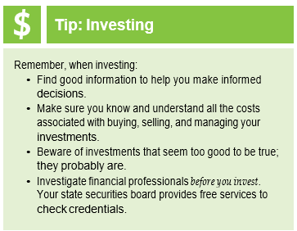
How Much Extra Savings is a Tax Deferred Investment Worth?
If you pay taxes, which most of us do, a tax-deferred investment will be worth the amount you invest multiplied by the tax rate you pay. For example, if your federal tax rate is 15 percent and you invest $3,000 in an IRA, you'll save $450 in taxes. So in effect, you will have spent only $2,550 for a $3,000 investment on which you will earn money. A good wealth-creation plan maximizes tax-deferred investments.
Check the IRS website—www.irs.gov—for current information on tax-deferred investments.

Slide 28
Build Credit & Control Debt
It’s difficult to pay cash for your car, home and college education, so these are typically bought using credit. That is why it’s important to have a plan to build and maintain a good credit history. Good credit saves money; bad credit costs money. Think of credit as a tool to be used wisely. Employers, landlords and insurance companies will use credit history to determine whether you are a good risk. A good credit history will result in getting the lowest interest rates for loans and other services, which will put you in a better position to increase your savings and increase your wealth.
Remember the definition of net worth (wealth)?
ASSETS – LIABILITIES = NET WORTH
Liabilities are debts. Debt reduces net worth. Plus, the interest you pay on debt, including credit card debt, is money that cannot be saved or invested—it’s just gone.
If credit is not used wisely, debt can easily get out of hand and may result in late payments. The most important part of your credit history is your track record of paying your bills on time.

Slide 29
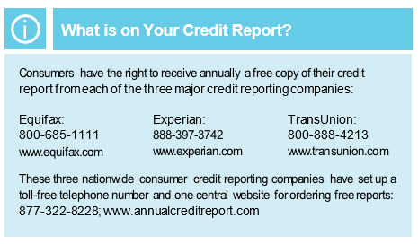
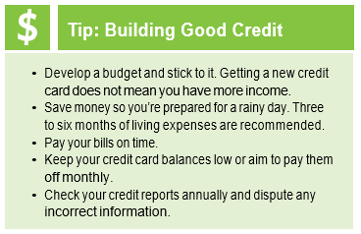
Know What Creditors Say About You
If you have used credit, you will have a credit report that shows everything about your payment history, such as any late payments. When making the decision whether to extend credit, lenders use credit reports, credit scores and other information, such as employment and income history.
Are You Ready to Take On a Credit Obligation?
If you don’t have a budget, or spending plan, you’re not ready to take on debt. Before you take on credit obligations, it’s very important to have a good foundation, including your emergency savings, a budget, your financial records and goals, and insurance to protect your assets. Do you have a strong financial foundation?

Slide 30
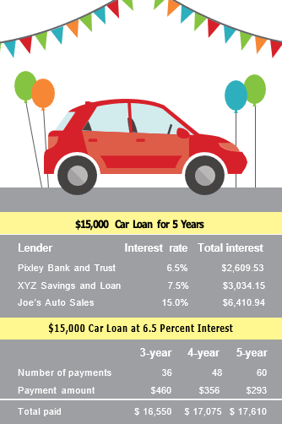
Save Money by Choosing the Right Loan
If you have good credit, you may want to take out a loan to purchase a car or a house or to cover educational expenses—all are investments in the future. But regardless of how the money is spent, a loan is a liability, or debt, and decreases your wealth. So choose loans carefully.
Shop and negotiate for the lowest interest rate. The interest you save can be invested to build wealth. Take a look at the table below. It may be obvious which lender will charge the lowest interest. What’s not obvious is that your credit score may determine which interest rate you are offered. Obtain your credit score well before you plan to apply for a loan. Use an online auto loan calculator to compare rates. You can save interest expense by increasing your monthly payments or choosing a shorter payment term on your loans. The table also shows how shorter terms with higher payments would affect the total amount and interest on a $15,000 car loan.

Slide 31
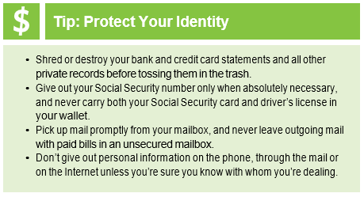
Keep Your Good Name
Every month, go back to your budget and plan carefully to ensure your bills are paid before their due dates. Setting up direct deposit and putting bills on auto debit can help you keep your good name.
Guard Your Identity
Just as you protect the security of your home with locks for your windows and doors, you should take steps to protect your identity. Secure your financial records, Social Security number and card, account numbers, and all passwords and PINs (personal identification numbers). A periodic check of your credit report can alert you if someone is illegally using credit products in your name. If you suspect unauthorized access, contact the three major credit reporting companies and place a fraud alert on your name and Social Security number

Slide 32
Protect Your Wealth with Insurance
After working hard to create personal wealth, you need to protect it. People acquire insurance to protect themselves from major financial loss. Insurance is simply a promise of reimbursement for a loss in return for a premium paid. When shopping for insurance products, consumers should match their needs with what the product offers and seek out the best deal. A solid credit history is also important because insurers use credit information to price some types of insurance policies. You can buy insurance to cover all kinds of risks, but basic needs can be met with property, health and life insurance.
Auto Insurance
State laws require that all motor vehicles have liability insurance to cover injury to other people or damage to their property. If you have a loan on your vehicle, your lender will also require physical damage coverage on it.
Home Insurance
If you are renting your home or apartment, you should purchase renters or contents insurance to cover your possessions against loss from fire or theft. Your landlord’s insurance will only cover damage to the building, not its contents. Also, if someone is hurt in your rented home, that liability is yours, not the landlord’s.

Slide 33
Protect Your Wealth with Insurance
Homeowners insurance covers your home and possessions. The personal liability coverage in a homeowners policy protects you from loss resulting from any injuries that may occur on your property.
Your mortgage lender will require you to carry a certain amount of insurance coverage as long as the mortgage is in place. You may also consider a higher-deductible insurance plan to save money on your homeowners coverage.
Standard homeowners coverage insures your home and its contents against loss from such risks as fire and theft. You may require special insurance for flood, earthquake or other risks specific to your area. Contact your state department of insurance for more information on insurance in high-risk areas.

Slide 34
Protect Your Wealth with Insurance
Medical Insurance
No one wants to worry about a trip to the emergency room wiping out everything they’ve saved toward their financial goals. Studies show unexpected medical expenses are the leading cause of bankruptcy in America.
Research also tells us that many people cut back on their medications trying to keep medical costs low—a practice that will likely lead to worsening health and higher costs. Many households have significant levels of debt because they didn’t have medical insurance or because they didn’t have savings to pay the expenses that weren’t covered by their health plan.
Late payments and defaults on medical debt may be reported on credit reports and affect a person’s credit score.

Slide 35
Protect Your Wealth with Insurance
Disability Insurance
Statistics show that you have a higher risk of becoming disabled than of dying before age 65. Disability insurance helps you pay living expenses if you are sick or injured and unable to work for a long time. Your employer may offer this insurance in its benefits plan. Consider buying this protection even if you have to pay for part of the premium.
Life Insurance
The need for life insurance depends on a person’s circumstances. In the event of your death, life insurance pays money to the person you choose (your beneficiary). Life insurance helps give financial protection to your children, spouse, parents or even your business.
Long-Term Care Insurance
If you or a family member became very ill and needed a nursing home, who would pay for it? You would, until all your assets and those of your spouse are exhausted. Only then would government assistance help cover these needs. Long-term care insurance is not medical insurance, but it pays for such health-related items as nursing home, assisted living or in-home care.

Slide 36
Contact Information
Cadence Bank:
Mary Katherine Franklin, EVP Wealth Management
713-871-3968 marykatherine.franklin@cadencebank.com
Sudha Menon, VP Retail Banking Fort Bend County
281-313-1783 sudha.menon@cadencebank.com
Kim Bonney, Branch Manager Sugar Land
DeJuan Edwards, Branch Manager Fulshear
Miranda Montoya, Branch Manager Cinco Ranch
Katrina King-Michalk, EVP Treasury Management
713-871-3916 katrina.Michalk@cadencebank.com
Melissa Silva, SVP Treasury Management
713-871-4129 melissa.silva@cadencebank.com

Slide 37
Who to Contact for help
Sandy Clark
America’s Financial Wellbeing Coach
Operation HOPE Inside Powered by Bancorp South
832-237-6747
Sandy.clark@operationhope.org
37

Slide 38
Glossary
1. Accrued interest - Interest that has been earned but not received or recorded.
2. Amortization Liquidation of a debt by making periodic payments over a set period, at the end of which the balance is zero.
3. Annual percentage rate (APR) - The annual rate that is charged for borrowing (or made by investing), expressed
as a single percentage number that represents the actual yearly cost of funds over the term of a loan. The APR includes any fees or additional costs associated with the transaction.
4. Appreciation - An increase in the value or price.
5. Asset - Anything an individual or business owns that has commercial or exchange value.
6. Auto debit - The deduction from a checking or savings account of funds that are automatically transferred to a creditor each month. Some lenders offer interest rate discounts if loan payments are set up on auto debit at the beginning of the loan.
7. Balance - The amount owed on a loan or credit card or the amount in a savings or investment account.
8. Balance sheet - A financial statement showing a “snapshot” of the assets, liabilities and net worth of an individual or organization on a given date.
9. Bankruptcy - A legal proceeding declaring that an individual is unable to pay
debts. Chapters 7 and 13 of the federal bankruptcy code govern personal bankruptcy.
10. Beneficiary - The person designated to receive the proceeds of a life insurance policy.
11. Budget - An itemized summary of probable income and expenses for a given period.
12. Capital - Cash or other resources accumulated and available for use in producing wealth.

Slide 39
Glossary
13. Cash flow - Money coming to an individual or business minus money being paid out during a given period.
14. Certificate of deposit (CD) - A type of savings account that earns a fixed
interest rate over a specified period of time.
15. Collateral - Assets pledged to secure a loan.
16. Common stock - A kind of ownership in a corporation that entitles the investor to share any profits remaining after all other obligations have been met.
17. Compound interest - Interest computed on the sum of the original principal and accrued interest.
18. Credit - The granting of money or something else of value in exchange for a promise of future repayment.
19. Credit card - A plastic card from a financial services company that allows cardholders to buy goods and services on credit.
20. Credit report - A loan and bill payment history, kept by a credit reporting company and used by financial institutions and other potential creditors to determine the likelihood a future debt will be repaid.
21. Credit reporting company - An organization that compiles credit information on individuals and businesses and makes it available for a fee.
22. Credit score - A number generated by a statistical model that objectively predicts the likelihood that a debt will be repaid on time.
23. Credit union - A cooperative organization that provides financial services to its members.
24. Creditor - A person, financial institution or other business that lends money.
25. Debit - Charges to an account.

Slide 40
Glossary
26. Debit card - A plastic card similar to a credit card that allows money to be withdrawn or the cost of purchases paid directly from the holder’s bank account.
27. Debt - Money owed; also known as a liability.
28. Debt service - Periodic payment of the principal and interest on a loan.
29. Deductible - The amount of loss paid by an insurance policyholder. The deductible may be expressed as a specified dollar amount or a percent of the claim amount.
30. Delinquency - The failure to make timely payments under a loan or other credit agreement.
31. Direct deposit - The electronic transfer of a payment from a company to an individual’s checking or savings account. Many employers offer direct deposit of paychecks.
32. Diversification - The distribution of investments among several companies to lessen the risk of loss.
33. Dividend - A share of profits paid to a stockholder.
34. Equity - Ownership interest in an asset after liabilities are deducted.
35. Face value - The principal amount of a bond, which will be paid off at maturity.
36. Fair market value - The price a willing buyer will pay and a willing seller will accept for real or personal property.
37. Federal Deposit Insurance Corp. (FDIC) - A federally chartered corporation that insures bank deposits up to $250,000.
38. Finance charge - A fee charged for the use of credit or the extension of existing credit. It may be a flat fee or a percentage of borrowings. The finance charge may include the cost of carrying the debt itself along with any related transaction fees, account maintenance fees or late fees charged by the lender.

Slide 41
Glossary
39. Finance company - A company that makes loans to individuals.
40. Financing fee - The fee a lender charges to originate a loan. The fee is based on a percentage of the loan amount; one point is equivalent to 1 percent.
41. Flexible spending account – An employer-sponsored account that allows employees to save pretax dollars to cover qualified medical or dependent care expenses.
42. Foreclosure - The legal process used to force the payment of debt secured by collateral whereby the property is sold to satisfy the debt.
43. 401(k) plan - A tax-deferred investment and savings plan that serves as a personal retirement fund for employees.
44. Health savings account - A tax- advantaged personal savings account, set up to be used exclusively for medical expenses; must be paired with a high- deductible health insurance policy.
45. High-deductible health plan - A health insurance policy that requires the policyholder to pay more out-of-pocket medical expenses but usually has
lower premiums than traditional health insurance plans.
46. Home warranty - A service contract that protects a homeowner from unexpected costs for repair or replacement of major systems.
47. Individual development account (IDA) - A type of savings account, offered in some communities, for people whose income is below a certain level.
48. Individual retirement account (IRA) - A retirement plan, offered by banks, brokerage firms, mutual funds and insurance companies, to which
individuals can contribute each year on a tax-deferred basis.
49. Inflation - A sustained increase in the prices of goods and services.
50. Installment plan - A plan requiring a borrower to make payments at specified intervals over the life of a loan.

Slide 42
Glossary
51. Insurance premium - The amount of money required for coverage under a specific insurance policy for a given period of time. Depending on the policy agreement, the premium may be paid monthly, quarterly, semiannually or annually.
52. Interest - A fee for the use of money over time. It is an expense to the borrower and revenue to the lender. Also, money earned on a savings account.
53. Interest rate - The percentage charged for a loan, usually a percentage of the amount lent. Also, the percentage paid on a savings account.
54. Investment - Anything one acquires for future income or benefit.
55. Investor - An organization, corporation, individual or other entity that acquires an ownership position in an investment, assuming risk of loss in exchange for anticipated returns.
56. Leverage - The ability to use a small amount of money to attract other funds, including loans, grants and equity investments.
57. Liability (1) - Money an individual or organization owes; same as debt.
58. Liability (2) - A kind of insurance for the policyholder’s legal obligation to pay for either bodily injury or property damage caused to another party.
59. Lien - A creditor’s claim against a property, which may entitle the creditor to seize the property if a debt is not repaid.
60. Liquidity - The ease with which an investment can be converted into cash.
61. Load - The fee a brokerage firm charges an investor for handling transactions.
62. Loan - A sum of money lent at interest.
63. Management fee - The fee paid to a company for managing an investment portfolio.
64. Market value - The amount a seller can expect to receive on the open market for merchandise, services or securities.

Slide 43
Glossary
65. Maturity - The time when a note, bond or other investment option comes due for payment to investors.
66. Money market account - A type of savings account offered by a financial institution.
67. Mortgage - A temporary and conditional pledge of property to a creditor as security for the repayment of a debt.
68. Municipal bond - A bond issued by cities, counties, states and local governmental agencies to finance public projects, such as construction of bridges, schools
and highways.
69. Mutual fund - A pool of money managed by an investment company.
70. Net worth - The difference between the total assets and total liabilities of an individual.
71. Par value - The nominal, or face, value of a stock or bond, expressed as a specific amount on the security.
72. Payday loan - A loan taken out against the borrower’s paycheck. In exchange for money, the borrower writes a postdated check. This type of loan generally comes with a very high interest rate.
73. Predatory lending - Targeting loans to seniors, low-income and other people to take advantage of their financial status or lack of financial knowledge.
74. Prepaid debit card - An alternative to traditional debit cards that are tied to a checking account, prepaid debit cards are typically tied to a direct deposit or a savings account. These cards charge monthly fees and/or usage fees and
do not report payments to the credit reporting companies.
75. Pretax - A person’s salary before state and federal income taxes are calculated.
76. Prime rate - The lowest interest rate on bank loans, offered to preferred borrowers.
77. Principal - The unpaid balance on a loan, not including interest; the amount of money invested.

Slide 44
Glossary
78. Promissory note - A written promise on a financial instrument to repay the money plus interest.
79. Qualified plan - A tax-deferred retirement plan for the self-employed.
80. Return - The profit made on an investment.
81. Revenue bond - A type of municipal bond backed by revenue from the project the bond finances.
82. Risk - The possibility of loss on an investment.
83. Roth IRA - A retirement plan funded by after-tax earnings, so no taxes are due when the money is withdrawn at retirement.
84. Savings account - A service depository institutions offer whereby people can deposit their money for future use and earn interest.
85. Secured credit card - Requires a cash deposit that becomes the credit line. Secured credit cards are offered by many banks and credit unions and usually report payments to the credit reporting companies. Charges typically include an annual fee and higher interest rates than unsecured credit cards.
86. Stock option - The right to buy or sell a corporation’s stock at a predetermined price or calculable formula; sometimes used as part of employee compensation.
87. Stockholder or shareholder - A person who owns stock in a company and is eligible to share in profits and losses.
88. Tax-deferred - Phrase referring to money that is not subject to income tax until it is withdrawn from an account, such as an individual retirement account or a
401(k) account.
89. Term - The period from when a loan is made until it is fully repaid.
90. Terms - Provisions specified in a loan agreement.

Slide 45
Glossary
91. Treasury bill - A short-term investment issued by the U.S. government for a year or less.
92. Treasury bond - A government security with a term of more than 10 years; interest is paid semiannually.
93. Treasury Inflation Protected Security (TIPS) - A Treasury bond or note that
is tied to inflation so that the principal amount of the investment increases or decreases according to the annual inflation rate.
94. Treasury note - A government security with a maturity that can range from two to 10 years; interest is paid every six months.
95. U.S. savings bond - A nontransferable, registered bond issued by the U.S. government in denominations of $50 to $10,000.
96. Utilization rate - For credit cards, the percentage of an available credit line that is being used. Current account balance ÷ available credit = utilization rate.

