Slide 1


Fort Bend County
Lunch & Learn Series
Building a Better Credit Report, a Beginner’s Guide
Presented by: Operation Hope & Cadence Bank
Wednesday, August 17, 2022
12:15 – 12:45

Slide 2


Hosted by: Bill Rickert,
Fort Bend County Treasurer
Contact information:
Bill Rickert
Fort Bend County Treasurer
Email: treasurersoffice@fbctx.gov
Website: www.fbctx.gov/treasurer
Phone: 281-371-3750
QR Code:

Slide 3


Lunch & Learn Recorded Session
Link: https://cadencebank.zoom.us/rec/share/G_HaiUX0oCtMYgrzxXud8751rzqHId10m0l_YlSssRZxU40v-NpWrD6_QQPNlJP4.yrYOLa2V5oWn8Ltb
Passcode: k=h=R24X

Slide 4
How can you improve your score?

Slide 5

What is a credit report?
A credit report includes information on where you live, how you pay your bills, and whether you’ve been sued or have filed for bankruptcy.
Nationwide credit reporting companies sell the information in your report to creditors, insurers, employers, and other businesses that, in turn, use it to evaluate your applications for credit, insurance, employment, or renting a place to live.

Slide 6
Why should I check my credit report?
Some financial advisors and consumer advocates suggest that you review your credit report several times a year. Why?
● The information in it affects whether you can get a loan — and how much you will have to pay to borrow money.
● To make sure the information is accurate, complete, and up-to- date before you apply for a loan for a major purchase like a house or car, buy insurance, or apply for a job.
● To help repair possible identity theft. Identity thieves may use your information to open new credit accounts in your name. Then, when they don’t pay the bills, the delinquent account is reported on your credit report. Inaccurate information like that could affect your ability to get credit, insurance, or even a job.

Slide 7
How do I get my credit report?
By law, you’re entitled to a free copy of your credit report from each of the nationwide credit reporting companies — equifax, experian, and transUnion — once every 12 months. to order, visit annualcreditreport.com or call 1-877-322-8228.
You may order reports from one, two, or all three of the companies at the same time, or you may stagger your requests. Some financial advisors say staggering your requests during a 12-month period may be a good way to keep an eye on the accuracy and completeness of the information in your reports. If you’re getting ready to apply for a loan or job, you might want to check all three reports at the same time.
To learn more, read Free Credit Reports at consumer.ftc.gov.

Slide 8
How do I correct errors?
Both the credit reporting company and the information provider (that is, the person, company, or organization that provides information about you to a credit reporting company) are responsible for correcting inaccurate or incomplete information in your report once you bring it to their attention. Letting them know involves two steps:
Step 1:
Tell the credit reporting company, in writing, what information you think is inaccurate. A sample dispute letter is at consumer.ftc.gov. Your letter should identify each item in your report you dispute, explain why you dispute the information, and ask that it be removed or corrected. Include copies (Not originals) of documents that support your position. You may want to enclose a copy of your report with the items in question circled. Send your letter by certified mail, “return receipt requested,” so you can document what the credit reporting company received. Keep copies of your dispute letter and enclosures.

Slide 9
How do I correct errors?
Credit reporting companies must investigate the items in question usually within 30 days, unless they consider your dispute frivolous.
They also must forward all the relevant data you provide about the inaccuracy to the information provider, which reviews the relevant information, investigates, and reports the results back to the credit reporting company.
If the information provider finds the disputed information is inaccurate, it must notify all three nationwide credit reporting companies so they can correct the information in your file.

Slide 10
How do I correct errors?
When the investigation is complete, the credit reporting company must give you the results in writing and a free copy of your report if the dispute results in a change. if an item is changed or deleted, the credit reporting company cannot put the disputed information back in your file unless the information provider verifies that it is accurate and complete.
The credit reporting company also must send you written notice that includes the name, address, and phone number of the information provider.
If you ask, the credit reporting company must send notices of any corrections to anyone who received your report in the past six months. You can have a corrected copy of your report sent to anyone who received a copy during the past two years for employment purposes.

Slide 11

How do I correct errors?
What if the investigation doesn’t resolve my dispute?
Ask that a statement of the dispute be included in your file and in future reports. You also can ask the credit reporting company to provide your statement to anyone who received a copy of your report in the recent past.
Expect to pay a fee for this service.

Slide 12
How do I correct errors?
Step 2:
Tell the information provider, in writing, that you dispute an item in your credit report.
A sample dispute letter is at consumer.ftc.gov. include copies (Not originals) of documents that support your position. If the provider listed an address on your credit report, send your letter to that address. If no address is listed, contact the provider and ask for the correct address to send your letter. If the information provider does not give you an address, you can send your letter to any business address for that provider.

Slide 13
How do I correct errors?
What if the provider continues to report the disputed item to a credit reporting company?
The provider must let the credit reporting company know about your dispute. And if you are correct — that is, if the information you dispute is found to be inaccurate or incomplete — the information provider must tell the credit reporting company to update or delete the item.
To learn more, read Disputing Errors on Credit Reports at
consumer.ftc.gov.

Slide 14
How long is it on my credit report?
A credit reporting company can report most accurate negative information for seven years and bankruptcy information for 10 years.
There is no time limit on reporting information about criminal convictions; information reported in response to your application for a job that pays more than $75,000 a year; and information reported because you’ve applied for more than $150,000 worth of credit or life insurance.
Information about a lawsuit or an unpaid judgment against you can be reported for seven years or until the statute of limitations runs out, whichever is longer. the standard method for calculating the seven-year reporting period starts with the date that the event took place.

Slide 15
How can my credit report affect my job application?
When you apply for a job, employers look at the application you complete and the resume you prepare. Some employers also check into your background before they hire you. Depending on the employer and the job, that background information might include your employment history, your driving record, criminal records, and your credit report.
An employer must get your permission before asking for a report about you from a credit reporting company or any other company that provides background information.
If you don’t give your okay, your application for employment may not get a second look. That’s up to you.

Slide 16
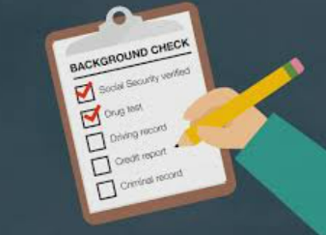
How can my credit report affect my job application?
But if you don’t get the job because of information in your report, the employer has some legal obligations:
First, the employer must show you the report; second, the employer must tell you how to get your own copy. The report is free if you ask for it within 60 days of learning the bad news.
To learn more about your rights, read Employment Background Checks at consumer.ftc.gov.

Slide 17
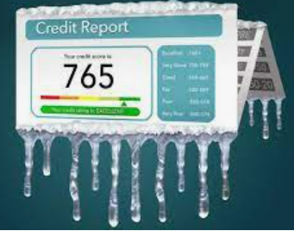
What is a credit freeze?
A credit freeze, also known as a security freeze, lets you restrict access to your credit report, which in turn makes it more difficult for identity thieves to open new accounts in your name. that’s because most creditors need to look at your credit report before approving a new account. if they can’t see your file, they may not extend the credit.
You may want to place a credit freeze on your credit reports if you’re concerned about the potential consequences of data breaches.

Slide 18
Placing a credit freeze
To place a freeze on your credit reports, contact each of the nationwide credit reporting companies:
Equifax — 1‑800‑525‑6285; equifax.com
Experian —1‑888‑397‑3742; experian.com
TransUnion — 1‑800‑680‑7289; transunion.com
You’ll need to supply your name, address, date of birth, Social Security number and other personal information.
Fees vary based on where you live; they commonly range from $5 to $10.

Slide 19
Credit Freeze
A credit freeze does not:
● Affect your credit score
● Prevent you from getting your free annual credit report
● Keep you from opening a new account, applying for a job, renting an apartment, or buying insurance.
● Prevent a thief from incurring charges on your existing accounts.
If you’re doing any of these, you’ll need to lift the freeze temporarily, either for a specific time, or for a specific party, like a potential landlord or employer.
The cost and lead times to lift a freeze vary, so it’s best to check with the credit reporting company in advance. You still need to monitor all bank, credit card and insurance statements for fraudulent transactions.

Slide 20
What is a fraud alert?
Unlike a credit freeze that locks down your credit, a fraud alert allows creditors to get a copy of your credit report as long as they take steps to verify your identity.
For example, if you provide a telephone number, the business must call you to verify whether you are the person making the credit request.
Fraud alerts may be effective at stopping someone from opening new credit accounts in your name, but they may not prevent the misuse of your existing accounts.

Slide 21
Improving your credit score
There are three types of fraud alerts:
1. Initial Fraud Alert
if you’re concerned about identity theft, but haven’t yet become a victim, this fraud alert protects your credit from unverified access for at least 90 days. You may want to place a fraud alert on your file if your wallet, Social Security card, or other personal, financial or account information are ever lost or stolen.
2. Extended Fraud Alert
For victims of identity theft, an extended fraud alert protects your credit for seven years.
3. Active-Duty Military Alert
For those in the military who want to protect their credit while deployed, this type of fraud alert lasts for one year.

Slide 22

Fraud Alerts
To place a fraud alert on your credit reports:
Contact one of the nationwide credit reporting companies.
A fraud alert is free.
You must provide proof of your identity. the company you call must tell the other companies; they, in turn, will place an alert on their versions of your report.
To learn more, visit ftc.gov/idtheft.

Slide 23
What are my options for dealing with debt?
Many people face a financial crisis at some point in their lives. Whether the crisis is caused by illness, the loss of a job, or overspending, it can seem overwhelming.
If you get into financial hot water, there are options:
Credit counseling from a reputable organization
Debt consolidation
Bankruptcy
Which path works best for you depends on your level of debt, your level of discipline, and your prospects for the future. Contact your creditors immediately if you ever have trouble making ends meet. tell them why it’s difficult for you to pay your bills and try to work out a modified payment plan that reduces your payments to a manageable level.
To learn more, read Coping with Debt at consumer.ftc.gov.

Slide 24
For more information
The FTC works to prevent fraudulent, deceptive and unfair business practices in the marketplace and to provide information to help consumers spot, stop and avoid them.
To file a complaint or get free information on consumer issues, visit ftc.gov or call toll- free, 1-877-Ftc-HeLP (1-877-382-4357); TTY: 1-866-653-4261.
Watch a video, How to File a Complaint, at consumer.ftc.gov/media to learn more.
The FTC enters consumer complaints into the consumer Sentinel Network, a secure online database and investigative tool used by hundreds of civil and criminal law enforcement agencies in the U.S. and abroad.

Slide 25
Contact Information
Cadence Bank:
Sudha Menon, VP Retail Banking Fort Bend County
281-313-1783 sudha.menon@cadencebank.com
Kim Bonney, Branch Manager Sugar Land
DeJuan Edwards, Branch Manager Fulshear
Miranda Montoya, Branch Manager Cinco Ranch
Katrina King-Michalk, EVP Treasury Management
713-871-3916 katrina.Michalk@cadencebank.com
Melissa Silva, SVP Treasury Management
713-871-4129 melissa.silva@cadencebank.com
David Vasquez, VP Community Development
832.275.0746 david.Vasquez@cadencebank.com

Slide 26

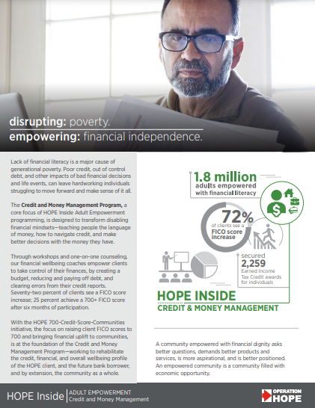


Who to Contact for help
Sandy Clark
America’s Financial Wellbeing Coach
Operation HOPE Inside Powered by Bancorp South
832-237-6747
Sandy.clark@operationhope.org
26

