Slide 1


Fort Bend County
Lunch & Learn Series
Everything You Need to Know About Credit Scores
Presented by: Operation Hope & Cadence Bank
Wednesday, August 3, 2022
12:15 – 12:45

Slide 2


Hosted by: Bill Rickert,
Fort Bend County Treasurer
Contact information:
Bill Rickert
Fort Bend County Treasurer
Email: treasurersoffice@fbctx.gov
Website: www.fbctx.gov/treasurer
Phone: 281-371-3750
QR Code:

Slide 3

Credit Scores
Lunch & Learn Recorded Session
Link: https://cadencebank.zoom.us/rec/share/SzVrL5HQLqD7Qn2XsZHC1KWnLP53kCO-X_ULcDQAEmGUimUreeXRCIaDwBu8LtSu.IDCRoAktcQVnuTsq
Password: H*?1&ZA0

Slide 4
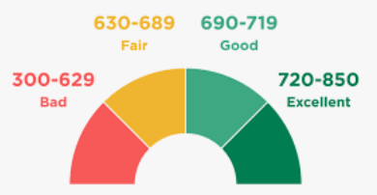
Credit Scores
Ever wonder how a lender decides whether to grant you credit? For years, creditors have been using credit scoring systems to determine if you’d be a good risk for credit cards, auto loans, and mortgages. These days, other types of businesses — including auto and homeowners insurance companies and phone companies — are using credit scores to decide whether to issue you a policy or provide you with a service and on what terms. A higher credit score is taken to mean you are less of a risk, which, in turn, means you are more likely to get credit or insurance
— or pay less for it.
The Federal Trade Commission (FTC), the nation’s consumer protection agency, wants you to know how credit scoring works.

Slide 5
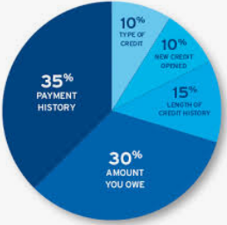
What is credit scoring
Credit scoring is a system creditors use to help determine whether to give you credit. It also may be used to help decide the terms you are offered or the rate you will pay for the loan.
Information about you and your credit experiences, like your bill-paying history, the number and type of accounts you have, whether you pay your bills by the date they’re due, collection actions, outstanding debt, and the age of your accounts, is collected from your credit report. Using a statistical program, creditors compare this information to the loan repayment history of consumers with similar profiles. For example, a credit scoring system awards points for each factor that helps predict who is most likely to
repay a debt. A total number of points — a credit score — helps predict how creditworthy you are: how likely it is that you will repay a loan and make the payments when they’re due.

Slide 6
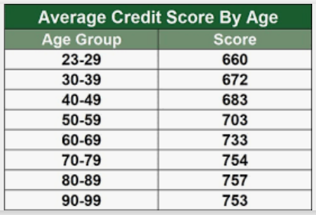
Other credit score uses
Some insurance companies also use credit report information, along with other factors, to help predict your likelihood of filing an insurance claim and the amount of the claim. They may consider this information when they decide whether to grant you insurance and the amount of the premium they charge. The credit scores insurance companies use sometimes are called “insurance scores” or “credit- based insurance scores.”

Slide 7

Credit Scores and credit reports
Your credit report is a key part of many credit scoring systems.
That’s why it is critical to make sure your credit report is accurate. Federal law gives you the right to get a free copy of your credit reports from each of the three national credit reporting companies once every 12 months.
The Fair Credit Reporting Act (FCRA) also gives you the right to get your credit score from the national credit reporting companies. They are allowed to charge a reasonable fee for the score. When you buy your score, you often get information on how you can improve it.

Slide 8

How to get your credit report
To order your free annual credit report from one or all of the national credit reporting companies, and to purchase your credit score, visit www.annualcreditreport.com, call toll-free 877- 322-8228, or complete the Annual Credit Report Request Form and mail it to:
Annual Credit Report Request Service P. O. Box 105281
Atlanta, GA 30348-5281
For more information,
see Free Credit Reports at
consumer.ftc.gov.

Slide 9


How is a credit scoring system developed
To develop a credit scoring system or model, a creditor or insurance company selects a random sample of customers and analyzes it statistically to identify characteristics that relate to risk. Each of the characteristics then is assigned a weight based on how strong a predictor it is of who would be a good risk. Each company may use its own scoring model, different scoring models for different types of credit or insurance, or a generic model developed by a scoring company.
Under the Equal Credit Opportunity Act (ECOA), a creditor’s scoring system may not use certain characteristics — for example, race, sex, marital status, national origin, or religion — as factors. The law allows creditors to use age, but any credit scoring system that includes age must give equal treatment to applicants who are elderly.

Slide 10

How can you improve your score?
Credit scoring systems are complex and vary among creditors or insurance companies and for different types of credit or insurance. If one factor
changes, your score may change — but improvement generally depends on how that factor relates to others the system considers. Only the business using the system knows what might improve your score under the particular model they use to evaluate your application.
Nevertheless, scoring models usually consider the following types of information in your credit report to help compute your credit score:

Slide 11
Improving your credit score
Have you paid your bills on time? You can count on payment history to be a significant factor. If your credit report indicates that you have paid bills late, had an account referred to collections, or declared bankruptcy, it is likely to affect your score negatively.
Are you maxed out? Many scoring systems evaluate the amount of debt you have compared to your credit limits. If the amount you owe is close to your credit limit, it’s likely to have a negative effect on your score.
How long have you had credit? Generally, scoring systems consider your credit track record. An insufficient credit history may affect your score negatively, but factors like timely payments and low balances can offset that.

Slide 12
Improving your credit score
Have you applied for new credit lately? Many scoring systems consider whether you have applied for credit recently by looking at “inquiries” on your credit report. If you have applied for too many new accounts recently, it could have a negative effect on your score. Every inquiry isn’t counted: for example, inquiries by creditors who are monitoring your account or looking at credit reports to make “prescreened” credit offers are not considered liabilities.
How many credit accounts do you have and what kinds of accounts are they? Although it is generally considered a plus to have established credit accounts, too many credit card accounts may have a negative effect on your score. In addition, many scoring systems consider the type of credit accounts you have. For example, under some scoring models, loans from finance companies may have a negative effect on your credit score.

Slide 13
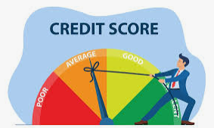
Improving your credit score
Scoring models may be based on more than the information in your credit report. When you are applying for a mortgage loan, for example, the system may consider the amount of your down payment, your total debt, and your income, among other things.
Improving your score significantly is likely to take some time, but it can be done. To improve your credit score under most systems, focus on paying your bills in a timely way, paying down any outstanding balances, and staying away from new debt.

Slide 14
Are credit scoring systems reliable?
Credit scoring systems enable creditors or insurance companies to evaluate millions of applicants consistently on many different characteristics. To be statistically valid, these systems must be based on a big enough sample. They generally vary among businesses that use them.
Properly designed, credit scoring systems generally enable faster, more accurate, and more impartial decisions than individual people can make. And some creditors design their systems so that some applicants — those with scores not high enough to pass easily or low enough to fail absolutely — are referred to a credit manager who decides whether the company or lender will extend credit.
Referrals can result in discussion and negotiation between the credit manager and the would-be borrower.

Slide 15
Denied credit or insurance
What if I am denied credit or insurance, or don’t get the terms I want?
If you are denied credit, the ECOA requires that the creditor give you a notice with the specific reasons your application was rejected or the news that you have the right to learn the reasons if you ask within 60 days.
Ask the creditor to be specific: Indefinite and vague reasons for denial are illegal. Acceptable reasons might be “your income was low” or “you haven’t been employed long enough.” Unacceptable reasons include “you didn’t meet our minimum standards” or “you didn’t receive enough points on our credit scoring system.”

Slide 16


Denied credit or insurance
Sometimes you can be denied credit or insurance — or offered less favorable terms — because of information in your credit report. In that case, the FCRA requires the creditor or insurance company to give you a notice that includes, among other things, the name, address, and phone number of the credit reporting company that supplied the information.
If a credit score was a factor in the decision to deny you credit or to offer you terms less favorable than most other customers receive, the notice also will include that credit score. If you receive one of these notices, you are entitled to a free copy of your credit report.
Contact the company to find out what your report said. The credit reporting company can tell you what’s in your report, but only the creditor or insurance company can tell you why your application was denied.

Slide 17
What can you do if denied credit?
If a creditor or insurance company says you were denied credit or insurance because you are too near your credit limits on your credit cards, you may want to reapply after paying down your balances. Because credit scores are based on credit report information, a score often changes when the information in the credit report changes.
If you’ve been denied credit or insurance or didn’t get the rate or terms you want, ask questions:
● Ask the creditor or insurance company if a credit scoring system was used. If it was, ask what characteristics or factors were used in the system, and how you can improve your application.

Slide 18

What can you do if denied credit?
● If you receive a notice explaining that you are being offered less favorable credit terms than those offered to most other consumers, ask the creditor or insurance company why you aren’t getting its best offer.
● If you are denied credit or not offered the best rate available because of inaccuracies in your credit report, be sure to dispute the inaccurate information with the credit reporting company.
To learn more about this right, see Disputing Errors on Credit Reports at consumer.ftc.gov.

Slide 19

For More Information
The FTC works to prevent fraudulent, deceptive and unfair business practices in the marketplace and to provide information to help consumers spot, stop and avoid them. To file a complaint or get free information on consumer issues, visit ftc.gov or call toll-free, 1-877-FTC-HELP (1-877-382-4357); TTY: 1-866-653-4261.
Watch a video, How to File a Complaint, at consumer.ftc.gov/media to learn more. The FTC enters consumer complaints into the Consumer Sentinel Network, a secure online database and investigative tool used by hundreds of civil and criminal law enforcement agencies in the U.S. and abroad.

Slide 20
Contact Information
Cadence Bank:
Sudha Menon, VP Retail Banking Fort Bend County
281-313-1783 sudha.menon@cadencebank.com
Kim Bonney, Branch Manager Sugar Land
DeJuan Edwards, Branch Manager Fulshear
Miranda Montoya, Branch Manager Cinco Ranch
Katrina King-Michalk, EVP Treasury Management
713-871-3916 katrina.Michalk@cadencebank.com
Melissa Silva, SVP Treasury Management
713-871-4129 melissa.silva@cadencebank.com
David Vasquez, VP Community Development
832.275.0746 david.Vasquez@cadencebank.com

Slide 21
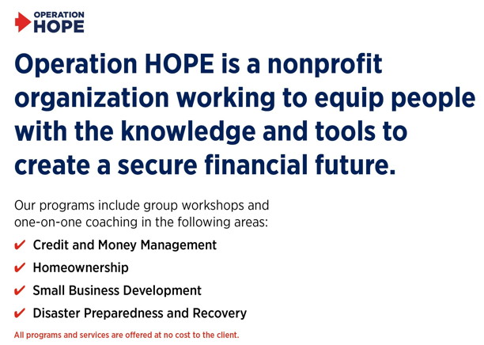
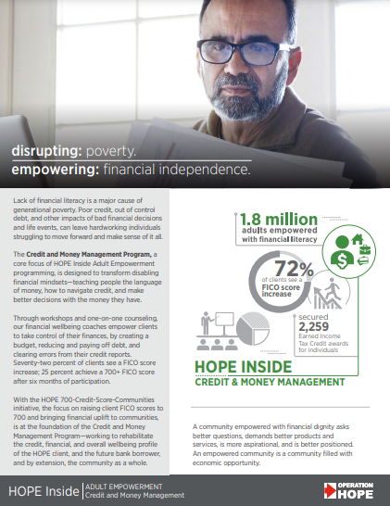


Who to Contact for help
Sandy Clark
America’s Financial Wellbeing Coach
Operation HOPE Inside Powered by Bancorp South
832-237-6747
Sandy.clark@operationhope.org
21

Slide 22
Q&A from the online Chat
Q | Should the payments be made at the beginning of the cycle or just within that timeframe | A | The Goal is to keep the payment within the timeframe and not beyond the due date
Q | Should we make payments before or on the due date to increase our credit score? | A | Payments made after the due date will lower your score. Setting up autopayment on the due date is also an easy way to manage your payments.
Q | How to determine if you have too many credit cards? | A | As long as you keep your credit card balances low and always pay the bills on time will keep your credit score strong regardless if you have 2 credit cards or 10. Sometimes too much open credit lines can hurt your credit if your outstanding debit is more than 30% of your total available credit; additionally, your income should be enough to service your current debt.
Q | Does making sure the basic information is correct affect my credit score. For example, if there are several different address listed that I may not have ever lived at. if I get this info removed will my credit score improve | A | Personal identifying information such as your name, aliases, addresses match you to your credit history. Cleaning up your personal information with avoid having someone elses credit history mixed in with yours impacting your score.
Q | How long does it take for my credit score to be impacted if I continue to keep my credit cards usage under the 30% | A | It takes 30-60 days for a credit score to update after paying off debt or updating based on usage.
Q | The difference between hard inquiries vs soft inquiries and the effect on credit rating? | A | Soft Pull occurs when you check your own credit or lenders pull to prequalify. A hard Pull is when the consumer applies for credit. A soft credit inquiry does not adversely affect your credit score and a hard inquiry will.
Q | Is it possible to get all 3 credit bureaus to report all the same information | A | The 3 credit bureaus may report different detail based on which bureau is used by the lender or creditor so they may not all reflect the same information.
Q | Do we get the recording or at least the slides from this? | A | yes, we are recording and the FBC Human Resources dept will post the recording on the County's intranet.

