Slide 1
Brazos River Recreation Master Plan Community Survey Results

Slide 2
Survey Overview
Survey open from October 26 – January 11
Total Respondents: 742
49% asked to be notified of opportunities
to participate in planning

Slide 3
Vision Comments
43% of respondents commented
34% of commenters agreed with Vision
45% of commenters agreed but with modifications
14% wanted more emphasis on protection of
natural ecosystem
18% suggested specific activities to include
Only 4% disliked the river planning effort

Slide 4
Importance of Actions on the Brazos

Slide 5
Importance of Facilities & Services

Slide 6
Desired Trail Activities

Slide 7
Significance of Issues

Slide 8
Survey Respondents by Zip Code

Slide 9
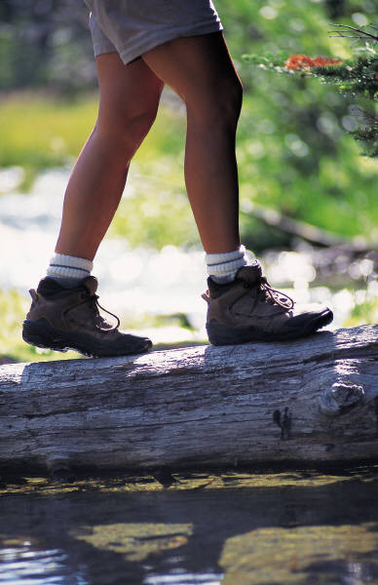
“Having this for use as a trail & natural area will greatly increase the value of my home and the quality of my life. If done properly this is a Win Win… Sooner the better as far as I am concerned.”
Survey respondent:

